Slide 1


Preparing for a workplace survey
Occupational Health Clinics for Ontario Workers Inc.
John Oudyk & Tracey Feener-Snow
May 27, 2017

Slide 2
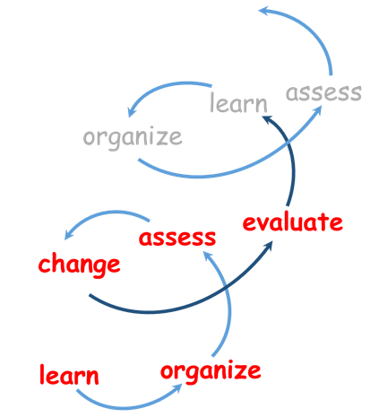
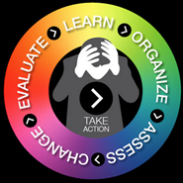
Overview:
Notes:
.

Slide 3
Mayo Clinic: “Chronic stress puts your health at risk”
“The long-term activation of the stress-response system — and the subsequent overexposure to cortisol and other stress hormones — can disrupt almost all your body's processes. This puts you at increased risk of numerous health problems, including:
anxiety
depression
digestive problems
heart disease
sleep problems
weight gain
memory and concentration impairment”
http://www.mayoclinic.org/healthy-lifestyle/stress-management/in-depth/stress/art-20046037?pg=1

Slide 4
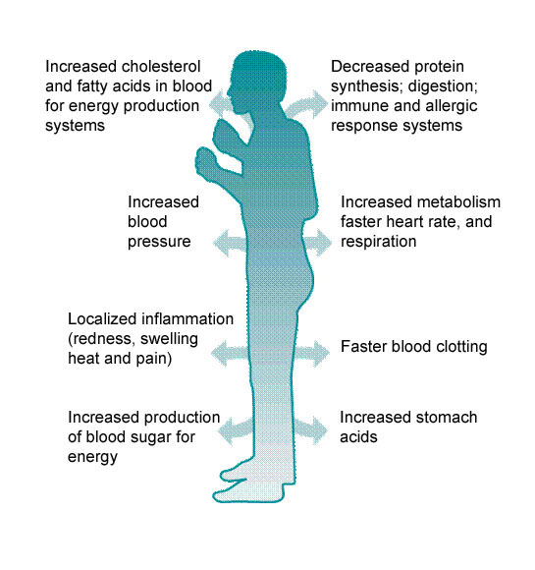
the “Fight or Flight” stress reaction
WHSC, Occupational Health & Safety: A Training Manual 1982

Slide 5


The big picture:
with $51 billion lost due to workplace stress, isn’t the business case obvious? (Great West Life, federal & provincial governments, Bell Canada, all think so)
the CSA std Z1003-13 Psychological health and safety in the workplace
  30,000 downloads, but
  “download doesn’t mean uptake”
[Weathering the …]
Perfect Legal Storm
(Shain, 2010, [2014])

Slide 6

Tracking the Perfect Legal Storm (Shain, 2010, [Weathering the …, 2014] )
Labour relations law
Employment standards
Human rights legislation
Law of torts (negligence)
OH&S law (violence & harassment)
Workers’ compensation changes (BC & Ont WSIAT)
Awards up 700% over that last 5 years
… legal opinion (22/10/2013) that CSA standard sets the legal criteria for a psychologically safe system of work
… no specific legislation …
http://www.mentalhealthcommission.ca/English/node/506?terminitial=30

Slide 7
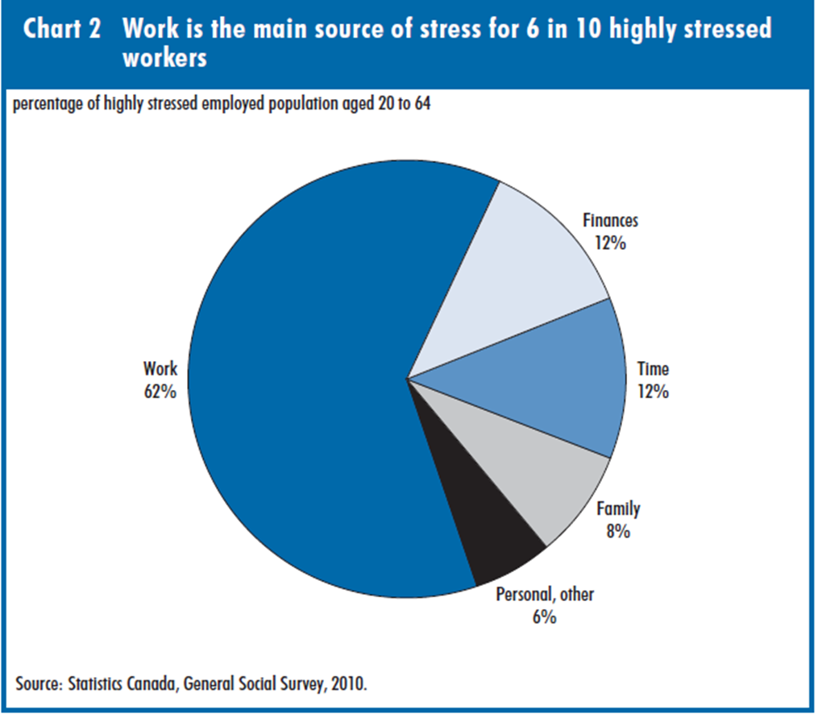
“What’s stressing the stressed?
Main sources of stress among
workers”
by Susan Crompton (Stats Can) 2011
“In Canada, in 2010, 27% of working adults reported that, on most days, their lives were ‘quite’ or ‘extremely stressful.”
http://www.statcan.gc.ca/pub/11-008-x/2011002/article/11562-eng.pdf

Slide 8

the new CSA Standard Z1003-13
http://shop.csa.ca/en/canada/occupational-health-and-safety-management/cancsa-z1003-13bnq-9700-8032013/invt/z10032013/?utm_source=redirect&utm_medium=vanity&utm_content=folder&utm_campaign=z1003

Slide 9




Differing Perspectives:
Psychology
focus on what’s going on between the ears
Psychosocial
focus on the interaction between the social environment and the person
Notes:
There are two main approaches to stress and these approaches dictate the strategies to deal with it.
The biomedical model focuses on what goes on in a person’s head and leads to “individual approaches” where we try to fix or improve the individual. Unfortunately this type of approach also can BLAME an individual.
In this model—the assumption is that a person impacts their environment.
In workplace stress we see this when some people assume that stress in the workplace is all about how a person copes or all the personal problems they bring into the workplace.
Interventions are aimed at the individual.
For a worker returning to work this kind of approach can isolate the worker as the focus is on the person and not their environment.

Slide 10
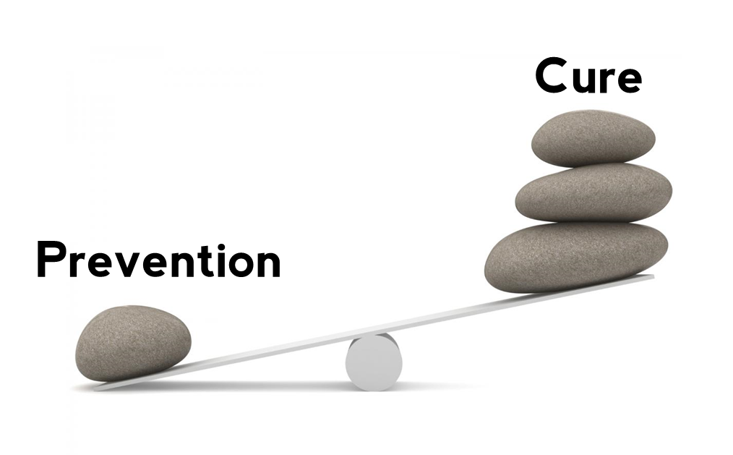
Prevention levels:
http://www.pvisoftware.com/blog/prevention-is-better-than-cure/
Primary prevention (at the source)
  job design, organizational adaptations, flexibility – collective agreement, H&S Committee, management policy/program
Secondary prevention (early detection)
  educate people about symptoms and on coping skills – wellness programs, screening
Tertiary prevention (help those with problems)
  get good treatment, compensation recognition, return to work support – EAP, therapy

Slide 11
Prevention
 | individual | organization
prevention level | primary - coping and appraisal skills | primary – changing the workplace
 | secondary - wellness, relaxation techniques (mindfulness) | secondary - awareness, screening (MH 1st aid)
 | tertiary - therapy, counselling, medication, support | tertiary - Employee Assistance Programs (EAP), Return to Work

Slide 12

Wellness programs, awareness training
Primary Prevention
Employee Assistance Program
Accommodate the worker (RTW)
Notes:
A strategy to move forward:
Take a step back to see what the real problem is:
For example, in a harassment and bulling rife workplace the issues may be all about work.
Negativity toward accommodations may be actually due to the way work is organized and how demands are laid out and not to do with any accommodated person at all. We all may need accommodation at some point. Our job is to change the focus away from the individual and onto the organizational aspects
Ensure your workplace interventions span all the areas---Primary, secondary and tertiary prevention.
The employer should take a balanced approach that recognizes that the organization has impacts and that organizational aspects can be changed as well.

Slide 13
Overview:
Notes:
.

Slide 14
Organize the workplace
Set up a steering committee with good representation (JHSC?)
Get commitment to respect and respond to process
Get endorsements (JHSC, wellness committee?, union, management, other respected leaders/committees)
Prepare for receiving the results – what will be the game plan and the time frame?

Slide 15
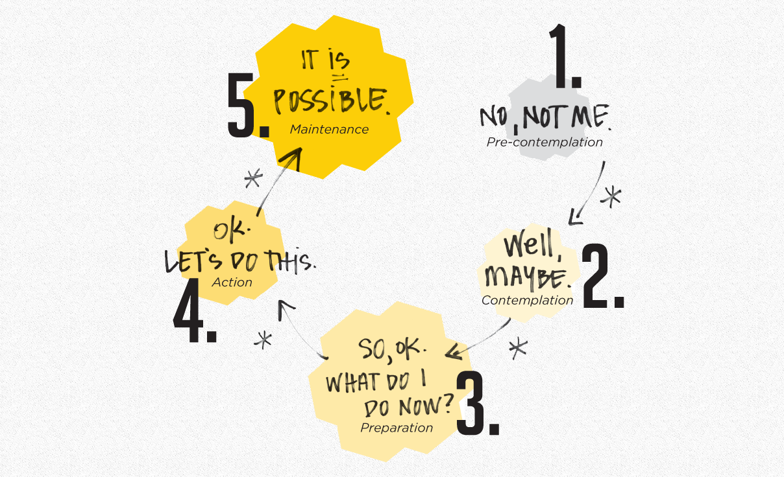
Are you ready?
https://www.its-possible.ca/awareness/

Slide 16

Motivation
(sticks and carrots):
Costs ($51 billion)
Risk (do you want to read about your workplace in the newspaper?)
Legal liability (Kathrine Lippel & Martin Shain’s work)
Worker retention and recruitment (good place to work)
Excellence and sustainability
The right thing to do – “law is the conscience of those who have none” (James Ham, 1983 IAPA Conference)

Slide 17
Overview:
Notes:
.

Slide 18
Mental Injuries Tool (MIT) Group:
The Mental Injuries Tool group was established in 2009 out of a stakeholder sub-committee of worker representatives and the Occupational Health Clinics for Ontario Workers who were charged with “supporting worker representatives in taking action on prevention and workers’ compensation”.
This sub-committee held a workshop in 2010 to select projects which could be developed jointly to address common concerns. The topic which received the most interest was mental injuries (workplace psychosocial risk factors; recognition & compensation for mental injuries).

Slide 19
MIT Group Reviewed Available Tools
Looked at theories of jobs stress:
  Job Demand – Control model (Karasek)
  Effort – Reward Imbalance model (Siegrist)
  Transaction Process model (Lazarus & Folkman)
  Organisational Justice (Kivimäki et al)
Looked at survey instruments and tried them out – compared experiences
  UK-HSE, JCQ, GM@W, SOBANE and others …

Slide 20
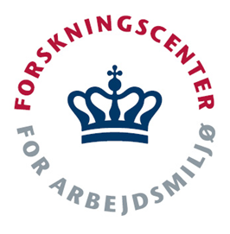
COPSOQ
Copenhagen Psychosocial Questionnaire
(COPSOQ II – short version)
http://www.arbejdsmiljoforskning.dk/Sp%C3%B8rgeskemaer/Psykisk%20arbejdsmilj%C3%B8.aspx?lang=en
Notes:
The Copenhagen Psychosocial Questionnaire (COPSOQ) relates sources of workplace stress to self-reported health symptoms and to general health experienced by participants. Because the survey has been validated and extensively used in Denmark, it contains a data-bank of data that allows results to be compared to a representative sample of the Danish population. As such, it provides a comparison to our data and information. The questionnaire contains questions on work environment, personal health and well-being, how work affects personal and family life, and conflicts and offensive behaviours.
The purpose of using the survey is to see which stress factors are most contributing to health symptoms which will provide a focus for our efforts to prevent the stress. It is important to take a dual approach to workplace stress—support and assistance for the individual affected is important, and action to minimize or eliminate the causes of workplace stress is also essential. Too often efforts are focused on “taking care of the individual, or teaching them to cope,” rather than addressing the workplace factors that contribute to the stress in the first place.

Slide 21
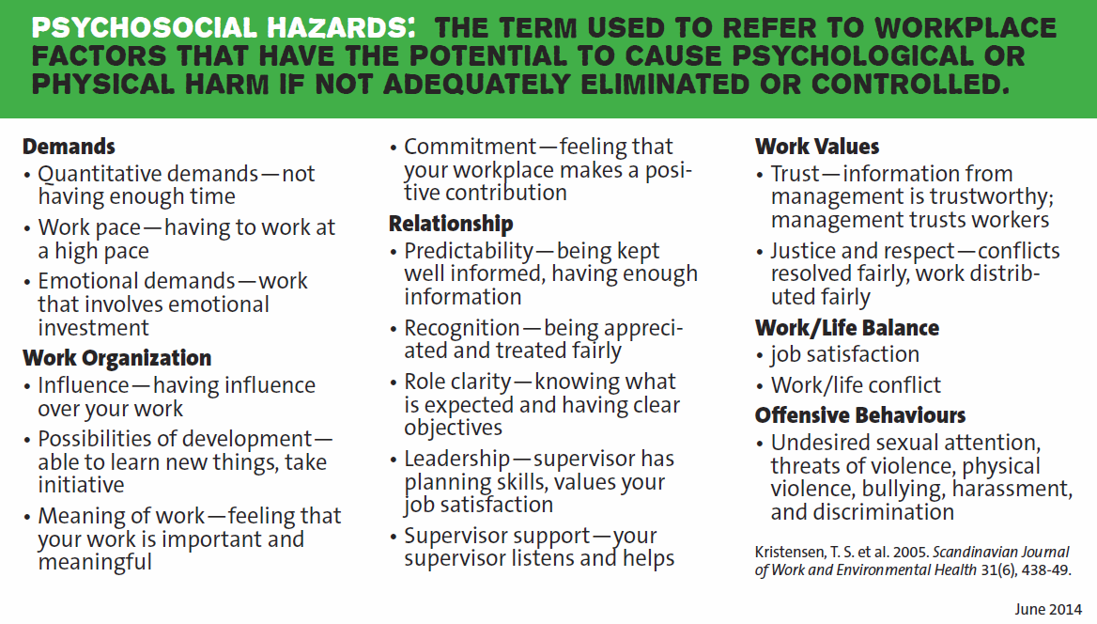
COPSOQ Psychosocial Hazards:

Slide 22
COPSOQ health measures:
Self-rated overall health status
Burnout
Stress
Sleeping troubles
Somatic stress symptoms
Cognitive stress symptoms
Notes:
These are the self-reported symptoms used in the COPSOQ that may affected by the factors in the previous slide.

Slide 23
Physical safety factors:
safety hazards
workstation ergonomics
physical factors (noise, lighting)
thermal comfort
air quality
dangerous chemicals
biological hazards
radiation (ionizing and non-ionizing)
driving hazards
working alone

Slide 24
Other additions:
two more offensive behaviours:
  “discrimination” (undefined – ask respondent for definition)
  “vicarious offensive behaviours” (ask respondent to identify all)
a global question rating the psychological health & safety climate
questions about behaviour based safety attitudes

Slide 25
COPSOQ III content changes
New items moved/added to CORE (formerly SHORT) version:
role conflict (“illegitimate task”)
  Do you sometimes have to do things which ought to have been done in a different way?
  Do you sometimes have to do things which seem to be unnecessary? – actually from MIDDLE version
social support from colleagues
sense of community at work
insecurity over employment
insecurity over working conditions
“double presence”
  Are there times when you need to be at work and at home at the same time?

Slide 26
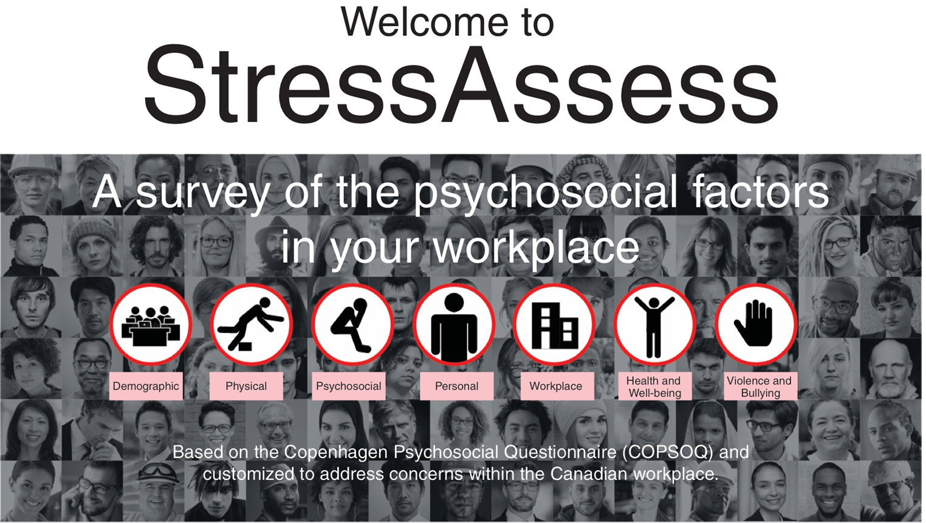
MIT Tools:
Website http://www.ohcow.on.ca/mental-injury-toolkit.html
Guide
Survey (often use Survey Monkey)
You-Tube videos
Posters, cards
[training materials]*
[mini-MIT: shortened guide for workplaces]*
App http://www.ohcow.on.ca/measure-workplace-stress.html
Webinar http://www.ccohs.ca/products/webinars/workplace_stress/
[Online survey administration]*

Slide 27
Try it out …
Self-scoring paper version
… or…

Slide 28

… try it on our app …
In partnership with the CCOHS, we’ve created an app that allows you to do the survey and have your own personal score
http://www.ohcow.on.ca/measure-workplace-stress.html

Slide 29
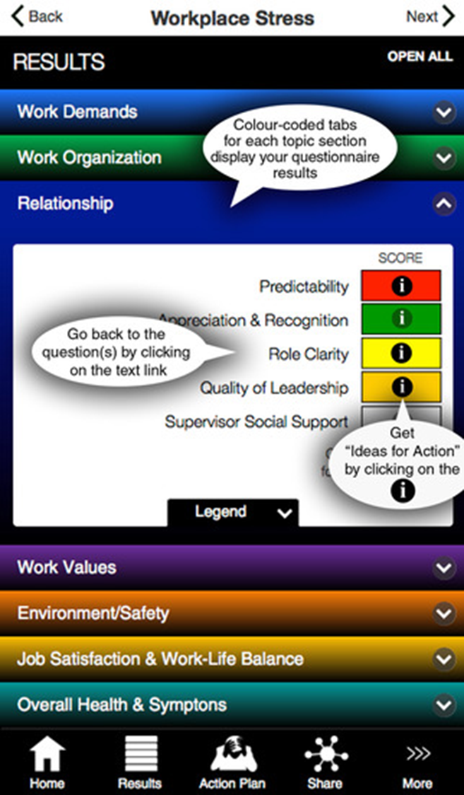
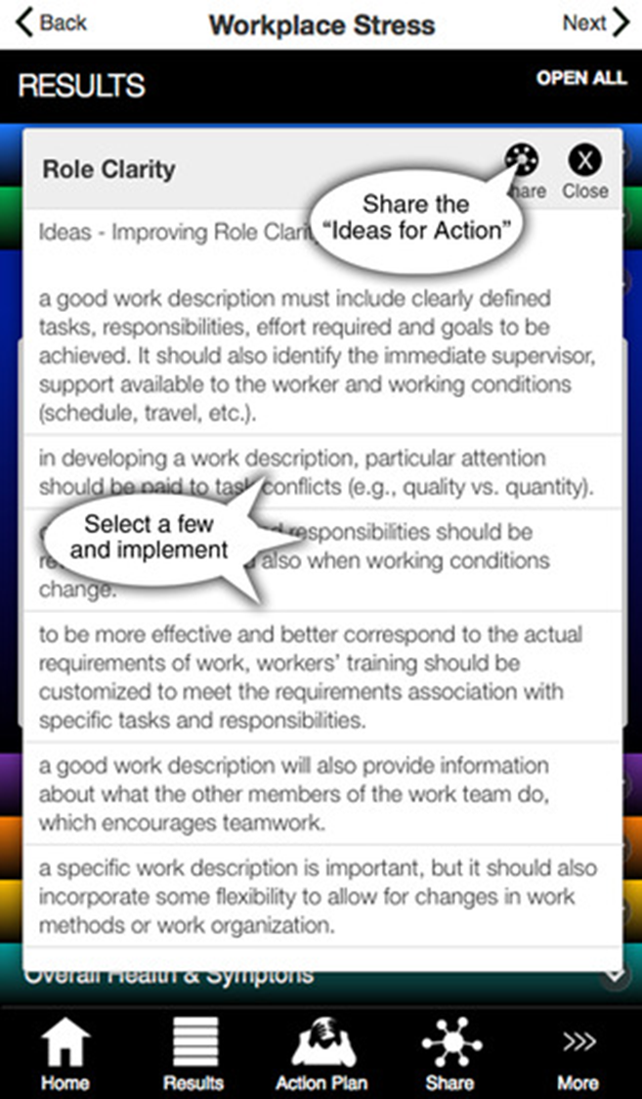

Slide 30
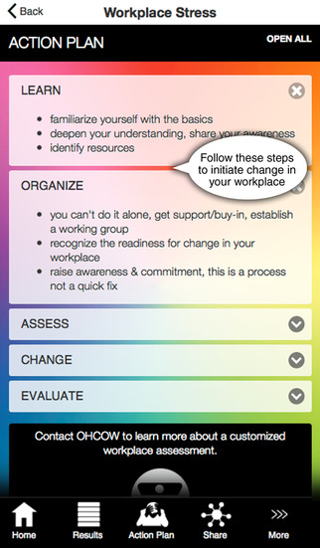

Slide 31
How do we do it?
Get buy-in (union, employer, establish steering committee)
Recruit a coordinator/champion in each unit (knowledgeable in workplace stress)
Administer survey (define units, collect e-mail lists, Dilman’s 5 contact survey administration, spreadsheet report production, identify issues)
Begin dialogue to improve issues

Slide 32
Survey administration:
Usually you only have one chance to do it right
Get endorsements
Prepare people
Provide time and space
Aim for 80% response rate (get at least 60%)
Have a timeline on what you’re going to do after the survey (so people know what to expect and when)

Slide 33

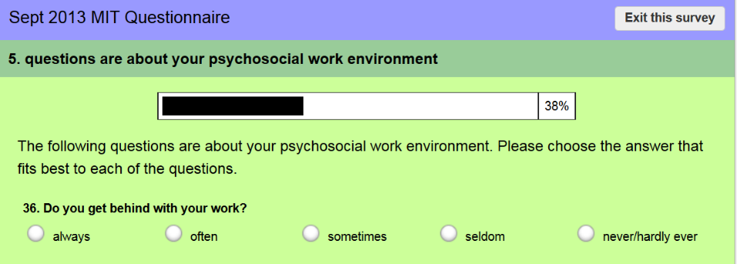
Collecting responses
Send URL link to participants who fill out survey online (7-20 minutes)
Response confidential; downloaded only by Clinic – raw data not shared

Slide 34

Don Dilman’s approach to maximizing survey response:
Lay the groundwork – get endorsements/buy-in; set up steering committee; define relationships to JH&SC, union, employer involvement; sort out logistics (who’s in charge of what, confidentiality, when do we report results, what do we do next – long term objectives)
Pre-survey announcement (1-2 weeks prior) with endorsements
Distribute survey – fanfare?; provide time, space, incentives?
1-2 weeks later send out reminder
After another 1-2 weeks send a 2nd reminder.
  if response rate is poor (<66%) you may have to consider a stronger intervention (i.e. start “nagging” people directly)
After a reasonable period of time (and depending on response rate) set a closing date and send out a final notice with an urgent message.

Slide 35
Response interpretation:
  >80% If the response rate is 80% or more, then you can be confident that the results in this report are representative of the whole group
  67-80% A response rate between 67-80% is reasonable but not as strong as over 80%; there is a bit of uncertainty about representativeness.
  50-66% A response rate between from 50-66% suggests there may be issues among those who did not respond or else the survey was not administered well. At this level of response, we cannot rule out the possibility that, if those who did not participate had been included, the results would be different.
  <50% A response rate of less than 50% means that either the administration of the survey was not done properly or that a large proportion of the group being surveyed did not have confidence in the process. Any results of the survey can only be considered as reflecting those who participated not the group as a whole. However, if you identify issues and resolve them for <50% of your people the others will probably also benefit!

Slide 36
Sample size:
For less than 15 responses the results are very uncertain – this number of responses is really too small to analyze for correlations
Between 16-30 responses we can calculate correlations but a fair number of these correlations may be the result of random effects, thus we need to observe the overall patterns rather than focus on individual associations
Between 31-50 responses, we still have some random “statistical noise” but the individual associations are approaching a significant degree of confidence
With more than 50 responses we can be confident that each association is statistically significant, although even in these circumstances one in 20 associations could be due to chance.

Slide 37
Overview:
Notes:
.

Slide 38
Finding solutions to your problems …
List the top risk factors associated with symptoms (or pick the “low hanging fruit”)
Refer to resources (plenty online) and don’t be afraid to ask for help
Best not to work alone but with a representative steering committee
“let the conversation begin …”
Notes:
38

Slide 39
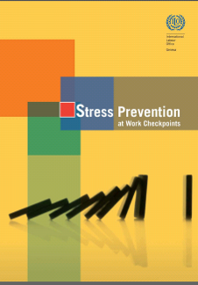
International Labour Organization (ILO) Stress Prevention Guidebook:
checkpoint format
lists specific hazards
identifies prevention strategies
http://www.ilo.org/global/publications/books/forthcoming-publications/WCMS_168053/lang--en/index.htm

Slide 40
ILO Checkpoint example
CHECKPOINT 6
Adjust the total workload (quantitative demands) taking into account the number and capacity of workers.
HOW
Assess individual and team workloads through observation and discussion with workers to determine whether change is necessary and feasible.
Reduce unnecessary tasks such as control operations, writing reports, filling in forms or registration work.
…

Slide 41
e.g. Hospital Guidance tool
High emotional demands prevention activities:
  Feedback, coaching and acknowledgement from colleagues and managers
  Specific objectives for work (when is the work result good enough/success criteria?)
  Consensus and practice with regard to care and treatment
  Overlap/transfer for shift changes
  Possibility of withdrawing (a place for privacy)
extracted from: http://www.ohcow.on.ca/edit/files/events/mayday__mayday_may_3rd_2017/eu_2012_-_guidance_tool_for_hospitals2.pdf

Slide 42
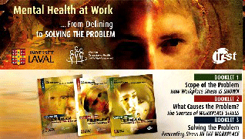
Laval Business group
(business case)
http://www.irsst.qc.ca/media/documents/pubirsst/R-427-1.pdf
http://www.irsst.qc.ca/media/documents/pubirsst/R-427-2.pdf
http://www.irsst.qc.ca/media/documents/pubirsst/R-427-3.pdf

Slide 43

Taking Action on
Workplace Stress
Occupational Health Clinics for Ontario Workers Inc.
John Oudyk, Occupational Hygienist
Occupational Health Clinics for Ontario Workers (OHCOW)

Slide 44

http://www.ohcow.on.ca/mental-injury-toolkit.html

Slide 45
Overview:
Notes:
.

Slide 46

Evaluation:
Wait for changes to stabilize (6 months to 1 year) and repeat survey to find out whether things have really changed.

Slide 47
Thank you!
… any questions/comments? …

