Slide 1

Online Ergonomic Tools
Presented by Chelsie Baizana, B.Sc, M.Sc

Slide 2
MSD’s in Ontario
$1.2 Billion
44%
Cost Ontario workplaces $1.2 Billion per year
MSDs account for 44% of injuries where a worker missed work
Preventing MSDs means more employees go home healthy and safe at the end of the day

Slide 3

Defining Ergonomics
“The Science of studying people at work, and then designing the working environment to ensure that they can be safe, healthy, effective and comfortable”.
GOAL IS TO fit the job to the worker NOT TO fit the worker to the job

Slide 4
MSD Hazards
Duration
Awkward/Fixed
Posture
Repetition
Force
Temperature
(hot or cold)
Organization
Contact Stress
Vibration
Notes:
Time Required: 5 minutes
Gather workplace specific examples of force, repetition and posture to share with participants as needed:
Force :
Repetition:
Posture :
Secondary Hazards:

Slide 5

OHCOW - ErgoTools

Slide 6
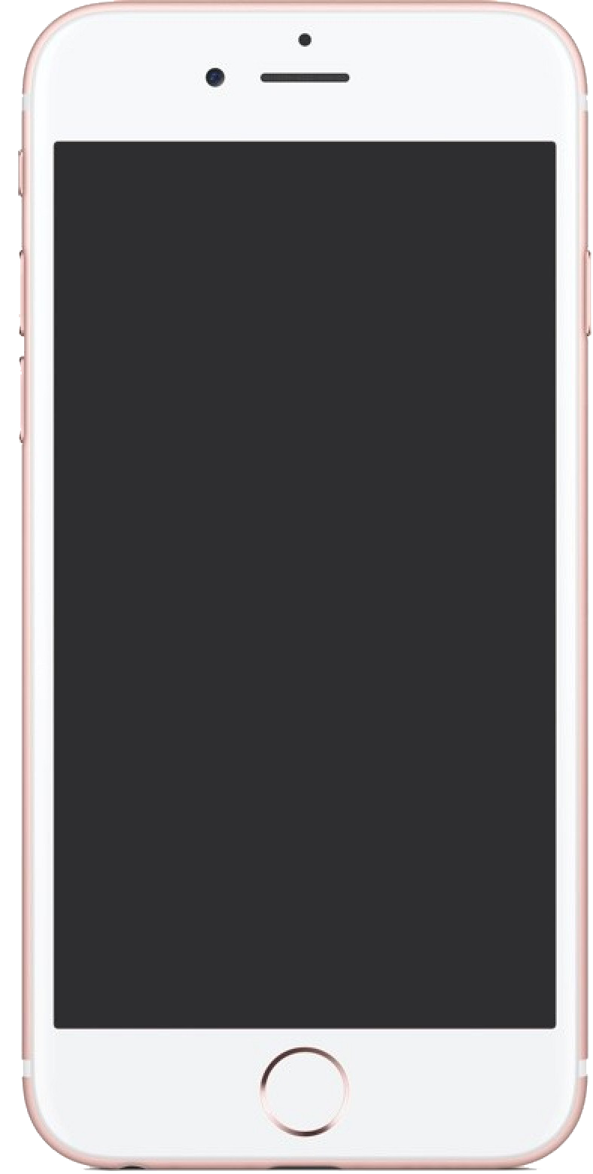
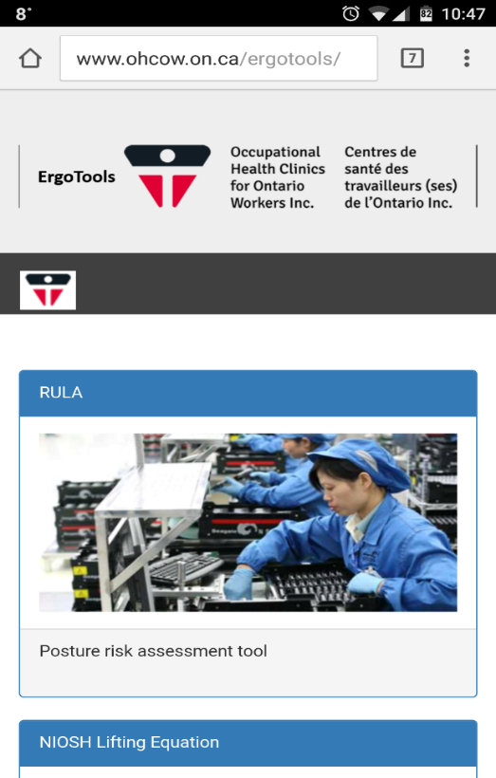
Presenting: ErgoTools!
www.ohcow.on.ca/ergotools
Works well on desktops, as well as cell phones and tablet
Give a preliminary idea into if jobs are acceptable for known MSD prevention standards

Slide 7
ErgoTools - Use
screening assessments
build a database in your workplace
Self-help tools

Slide 8
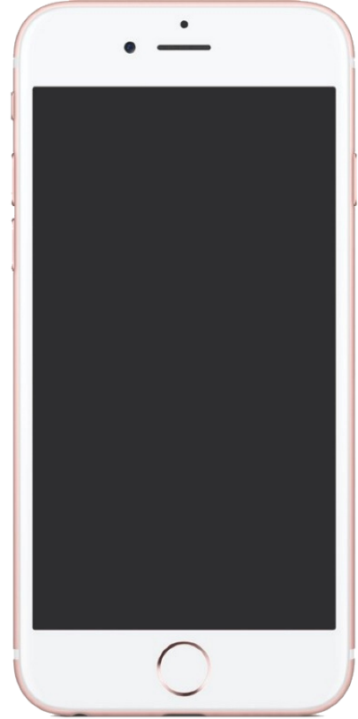
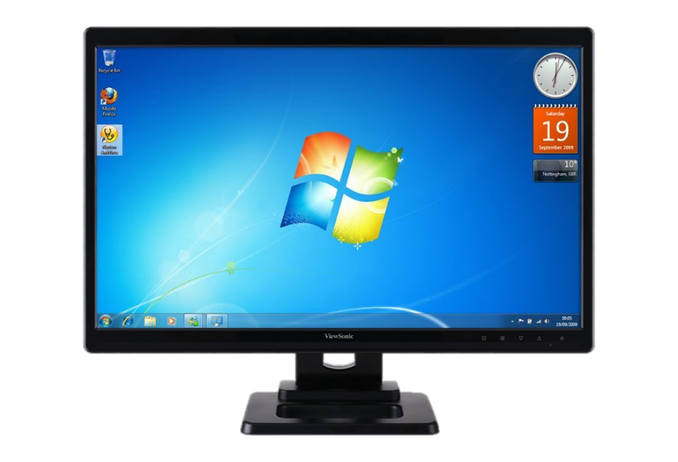

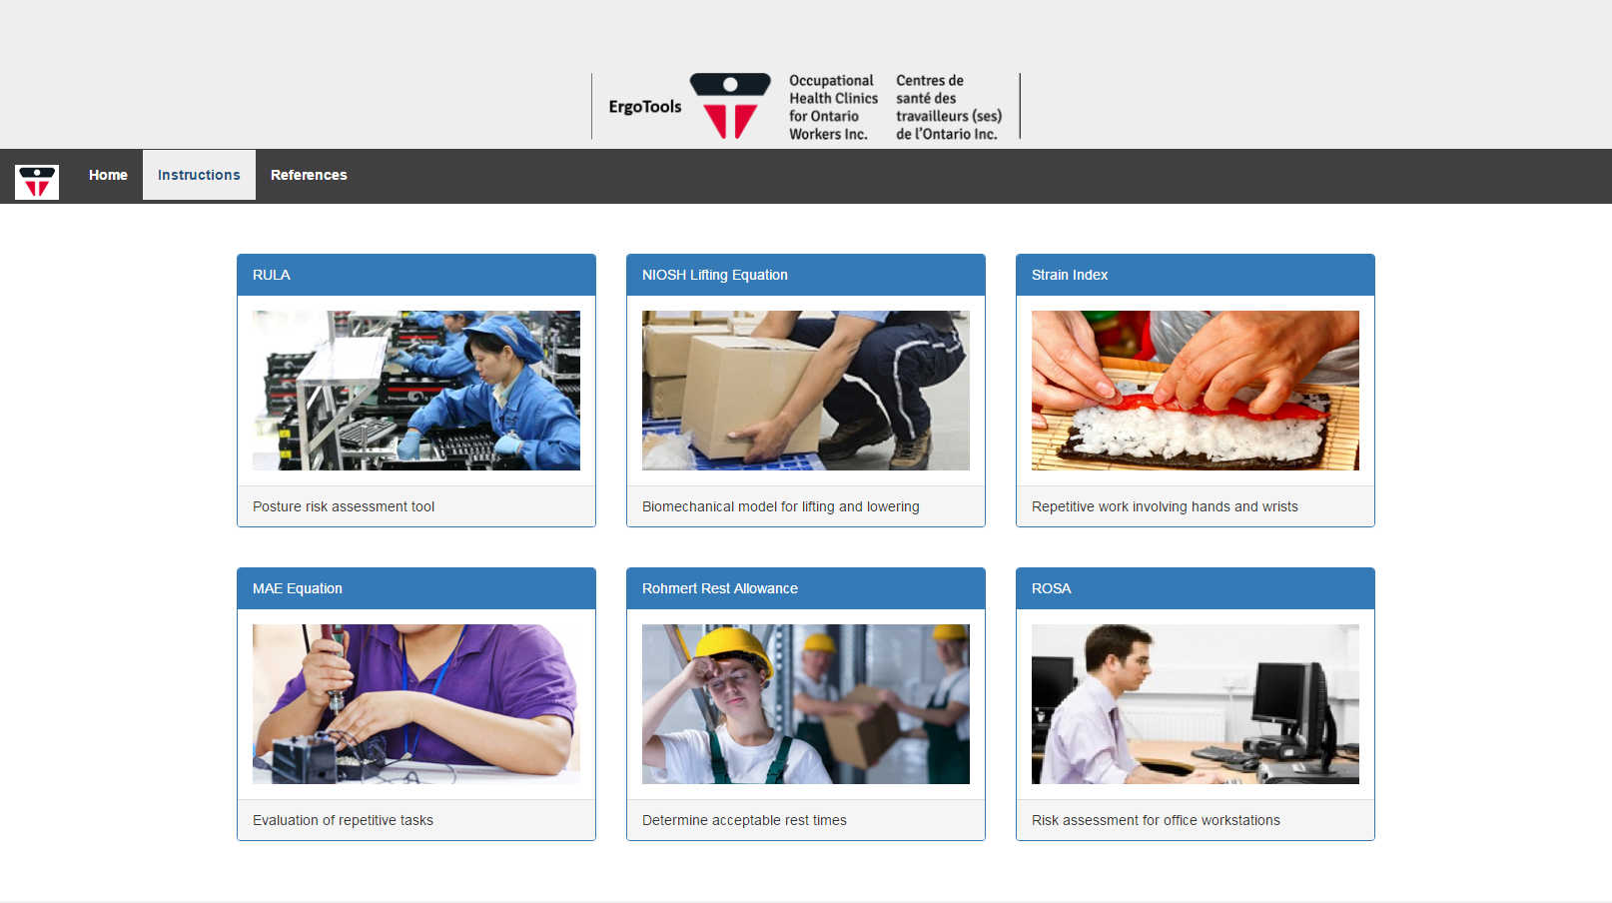
There’s an app for that!
ROSA
OfficeErgo Calculator

Slide 9
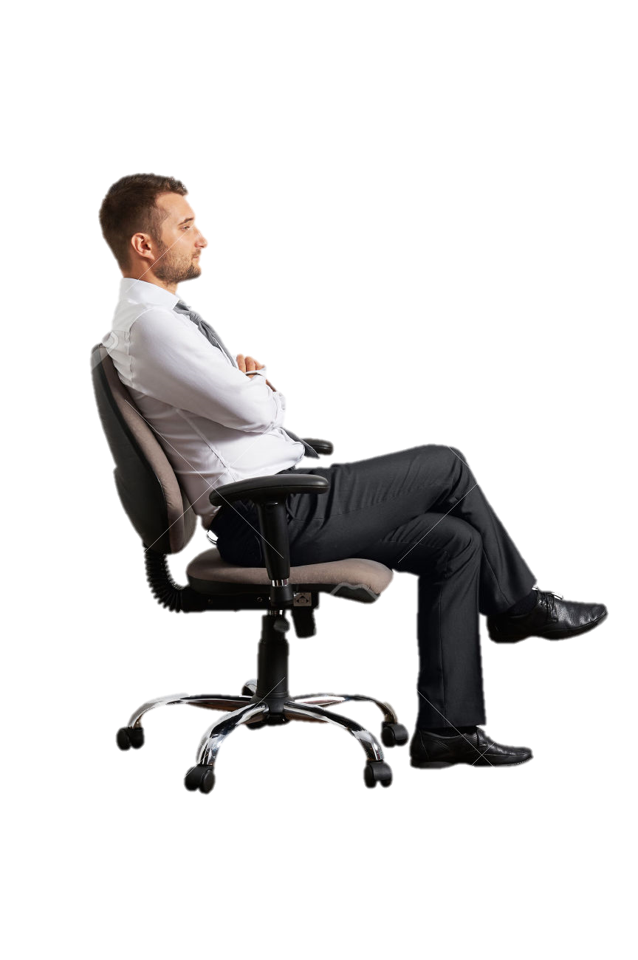
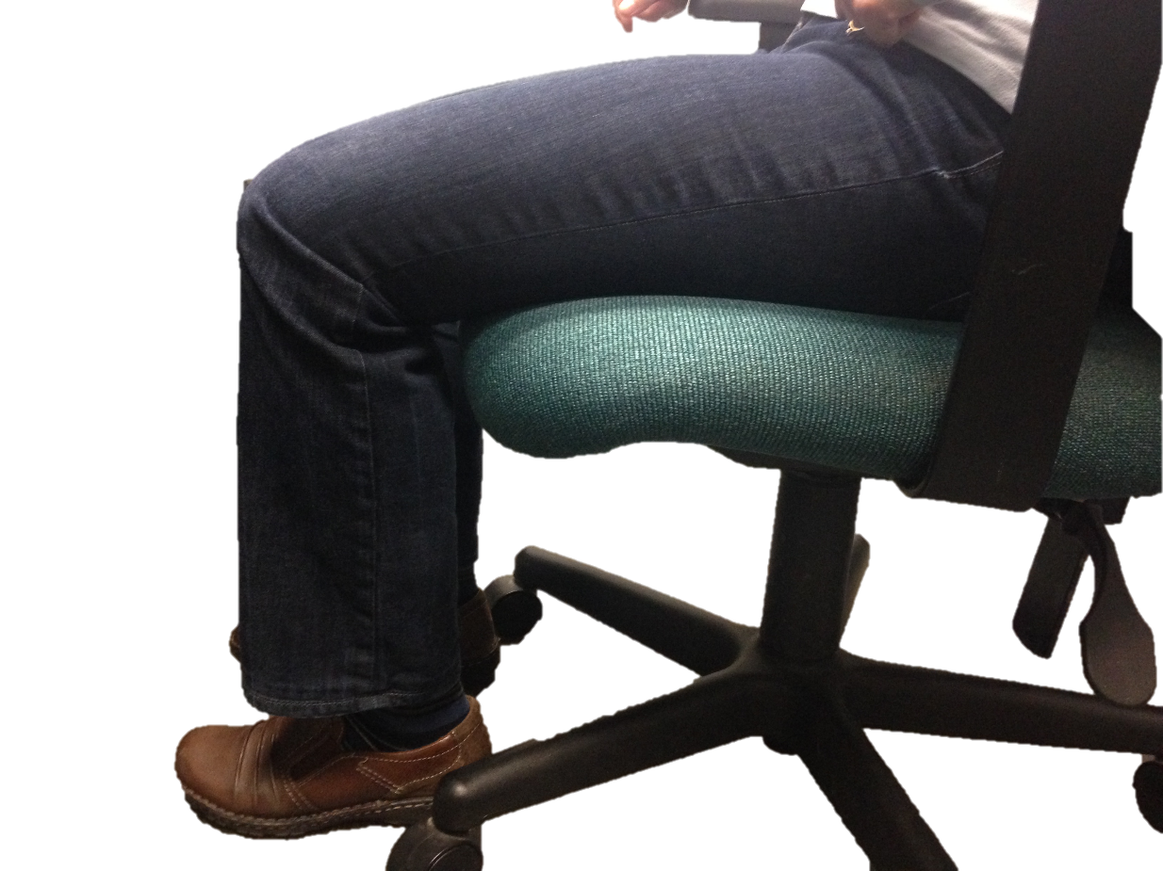
Your Chair – The Fist Test

Slide 10
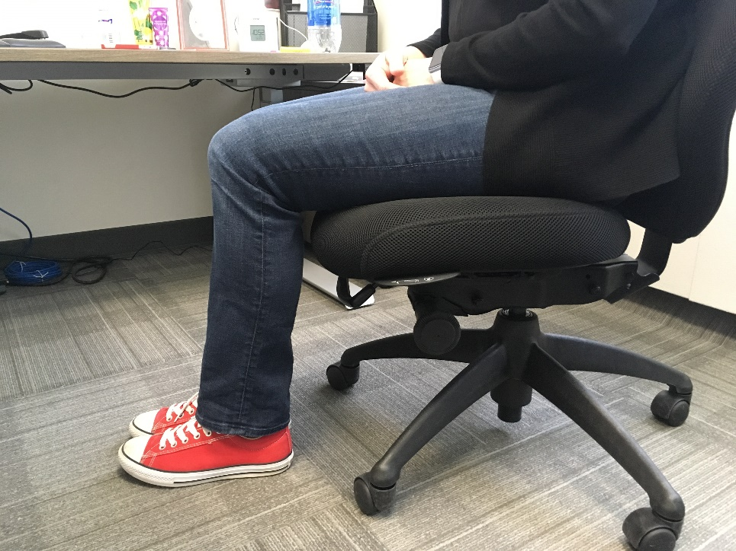
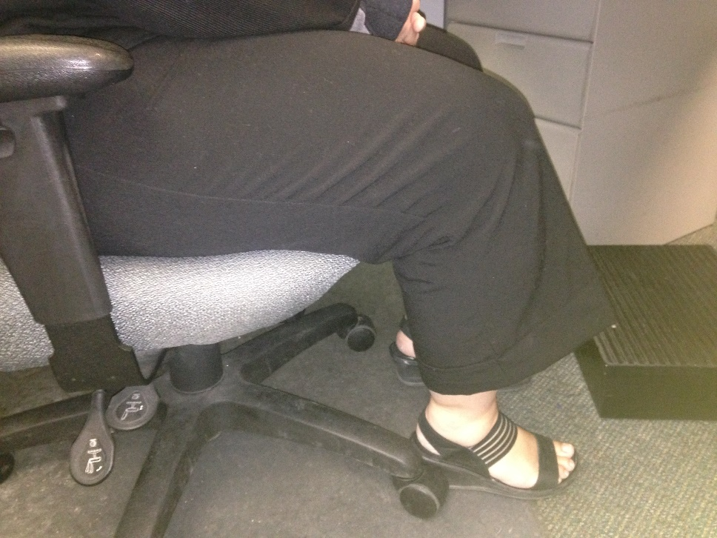
Your Chair – Seat Height

Slide 11
Your Chair – Armrests
Allows shoulders to relax
Supports arm weight
Relieves neck tension
Adjustable
Width adjustability option
Height
Slide forward and backward
Can be changed/removed

Slide 12
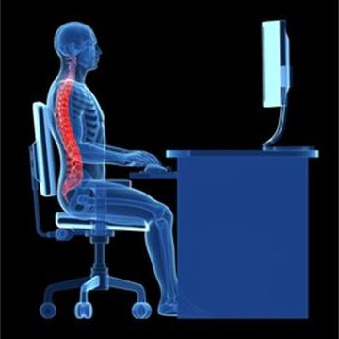
Keyboard Trays
Want elbow joint at 90° with shoulders relaxed
Elbow Height
Keep arms close to body

Slide 13
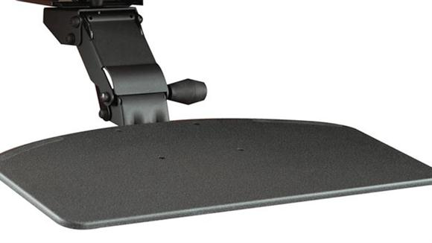
Ideal Keyboard Trays
Sturdy surface
Angle and height
adjustability
65 cm wide

Slide 14
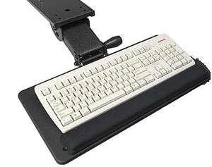
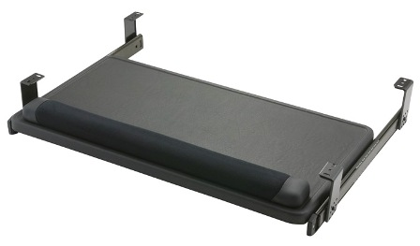
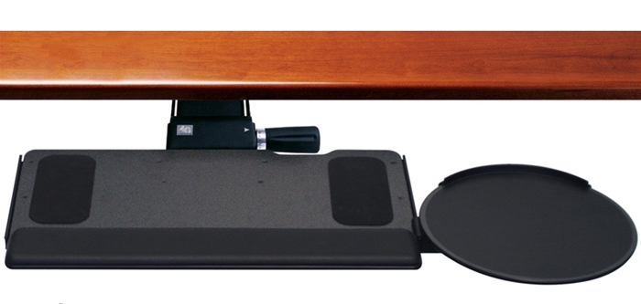
Keyboard Trays to Avoid
Tray with slide-out platform for the mouse: tray is unsteady, and causes user to lean on the right hip
Rail keyboard trays: are not adjustable in height or angle
Small keyboard trays: no space for the mouse, which causes user to place the mouse on the desk

Slide 15
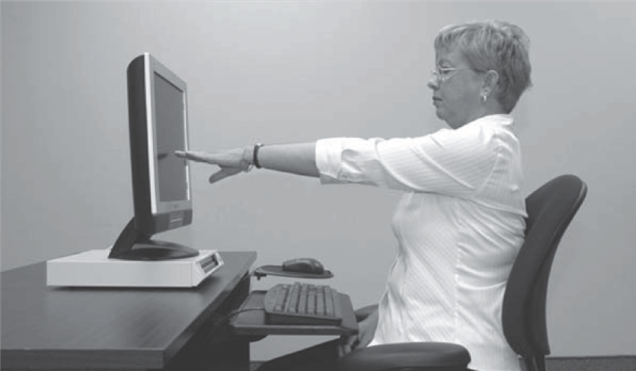
Screen Height - Ideal
The monitor should be:
Directly in front of user
Situated at seated eye height
Arm’s length away from user

Slide 16
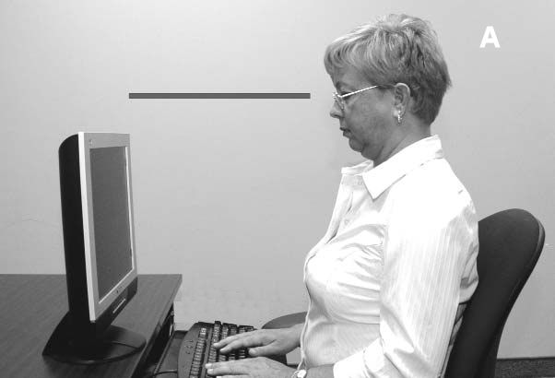
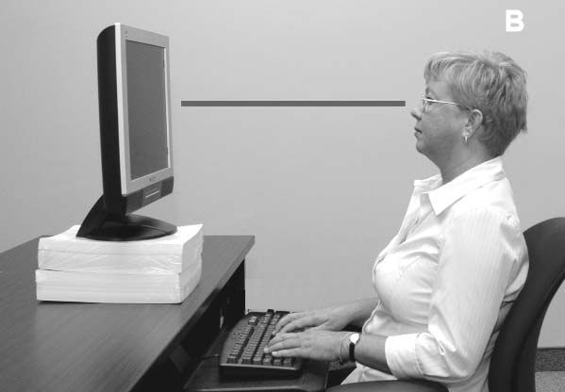
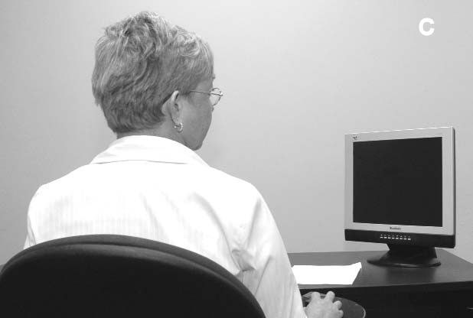
Screen Height - AVOID
When the monitor is too low, the neck is flexed
When the monitor to too high, the neck is extended
When the monitor is not directly in front of the user, the neck is twisted

Slide 17
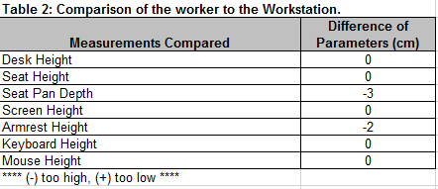
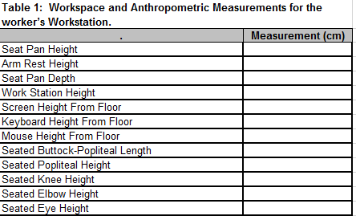
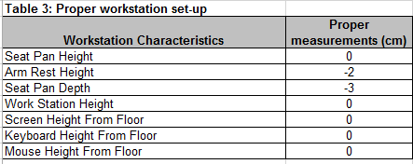
Office Ergonomics Calculator
Office Ergo Calculator

Slide 18
ROSA
The Rapid Office Strain Assessment – Allows a quick evaluation of the office workstation, provides a 1-10 scale representing risk level (10 is higher)
Risk Factors and ideal postures identified using the CSA Standards on Office Ergonomics (CSA Z412)
ROSA looks at chair, monitor, telephone, keyboard and mouse
Notes:
The rapid office strain assessment was developed based on the ideal postures listed in the CSA standards for office ergonomics – CSA Standard Z412. Each ideal posture was coded as a score of 1, and postures that deviated from ideal were assigned increasing values up to 3.
Postures and equipment configurations were sorted into 5 categories – the chair (with sub categories of chair pan height, chair pan depth, arm rests and back support), monitor, telephone, mouse and keyboard. Each posture and equipment configuration was diagrammed using Poser Figure Artist.

Slide 19
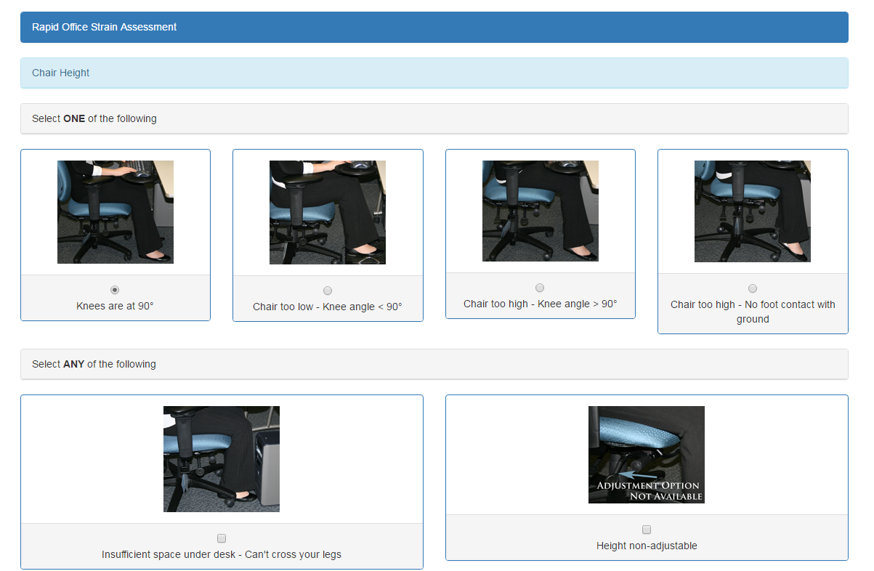
ROSA Example
Select one of these options
Select any of these options

Slide 20
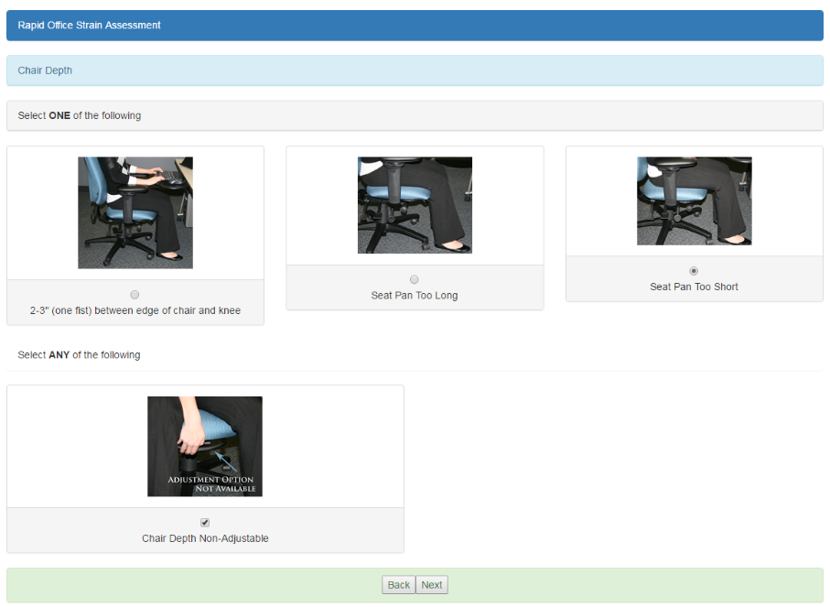
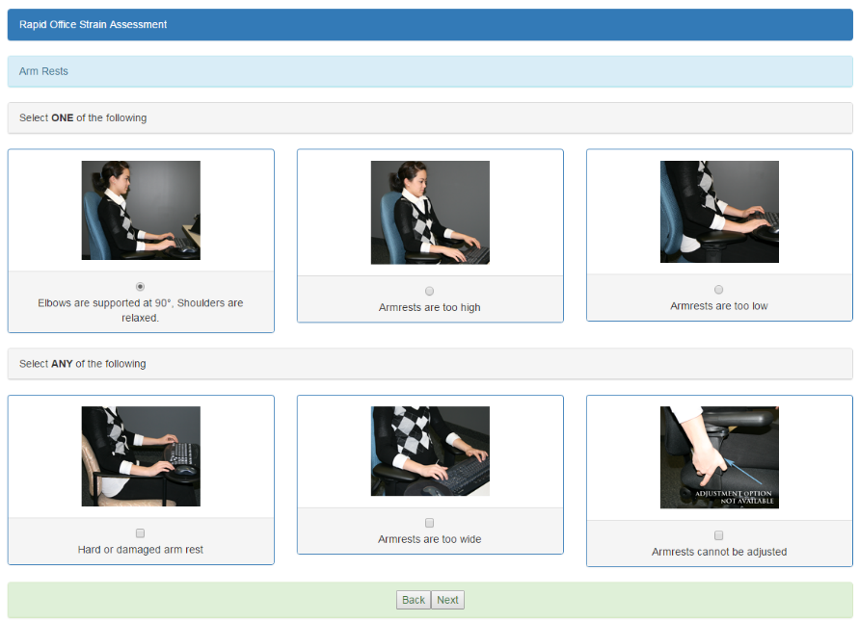
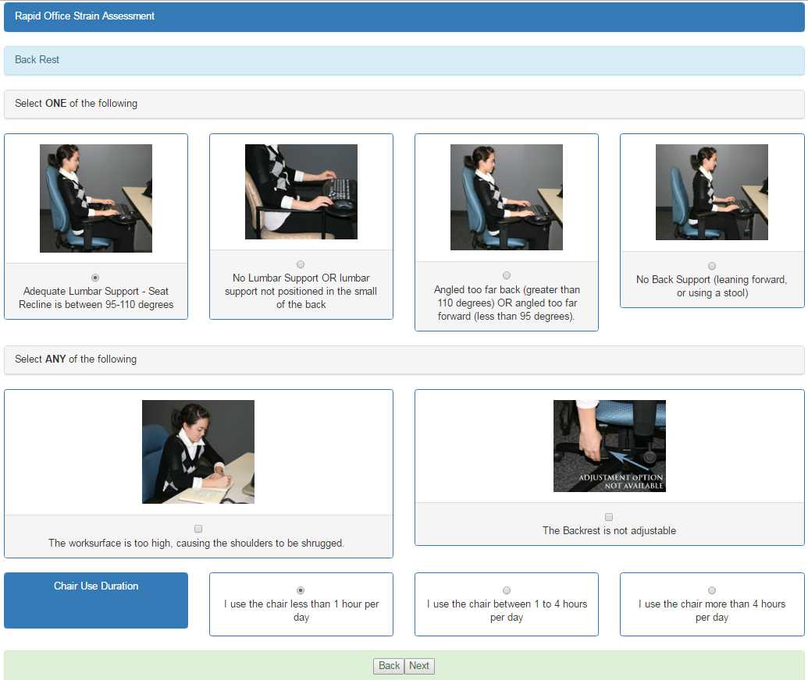
ROSA - Chair Depth

Slide 21
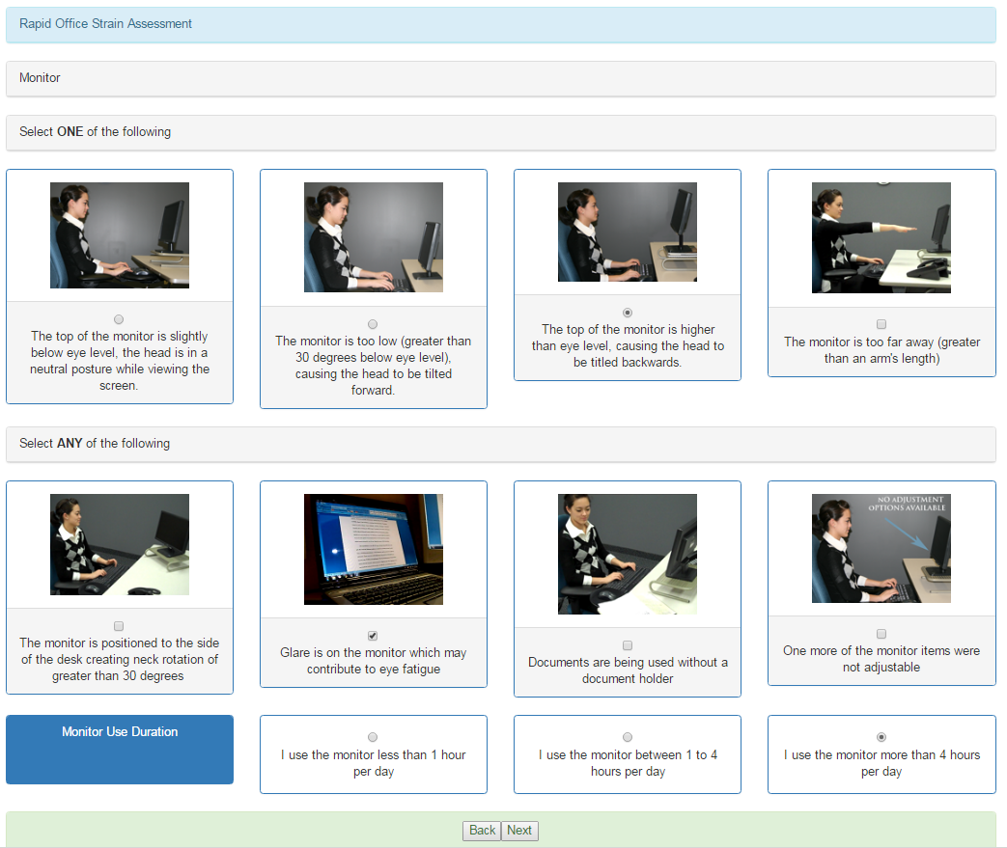
ROSA - Monitor

Slide 22
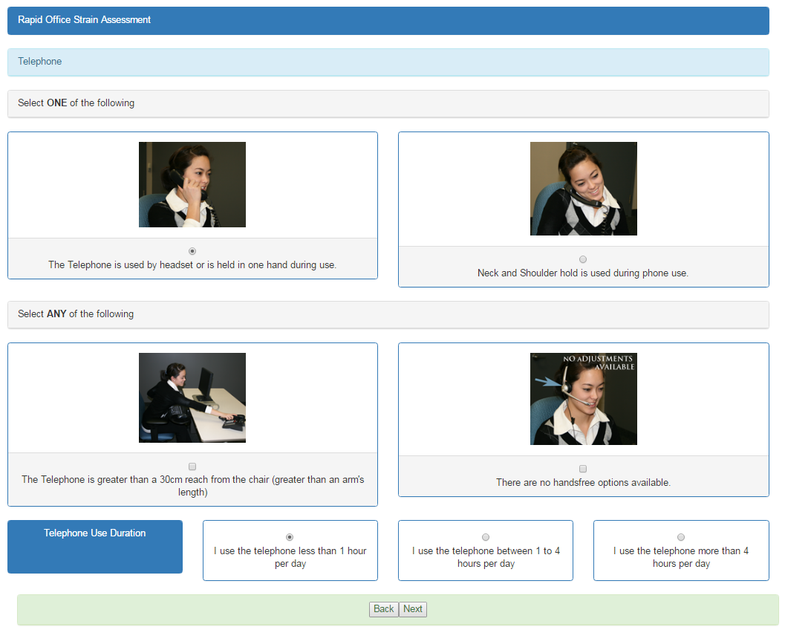
ROSA - Telephone

Slide 23
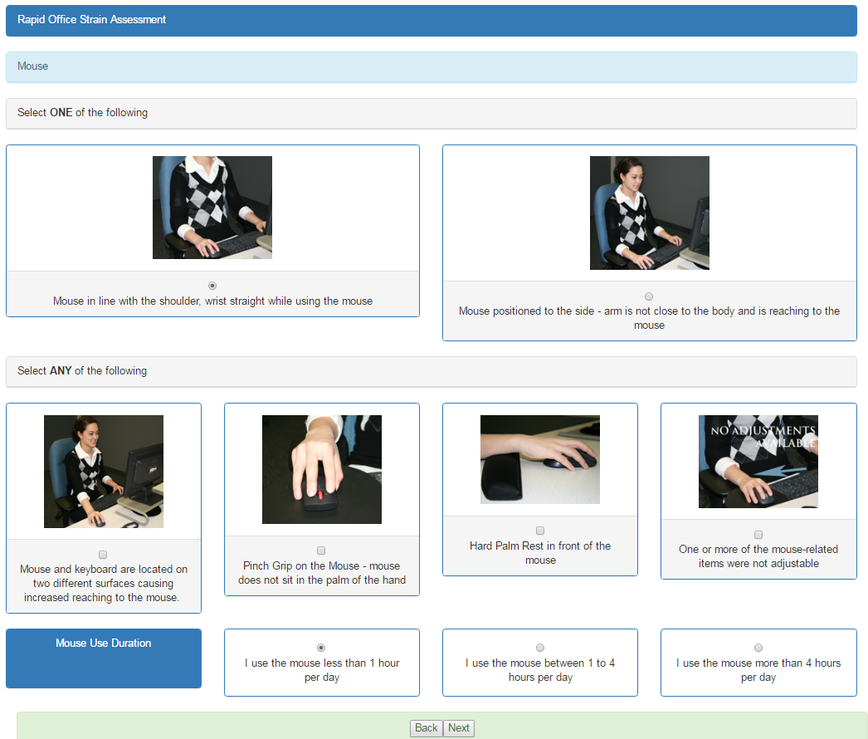
ROSA - Mouse

Slide 24
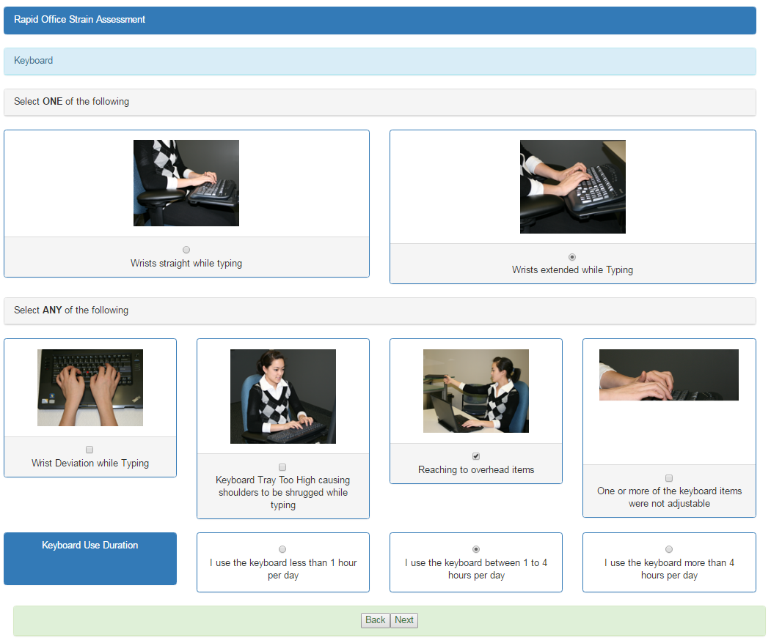
ROSA - Keyboard

Slide 25
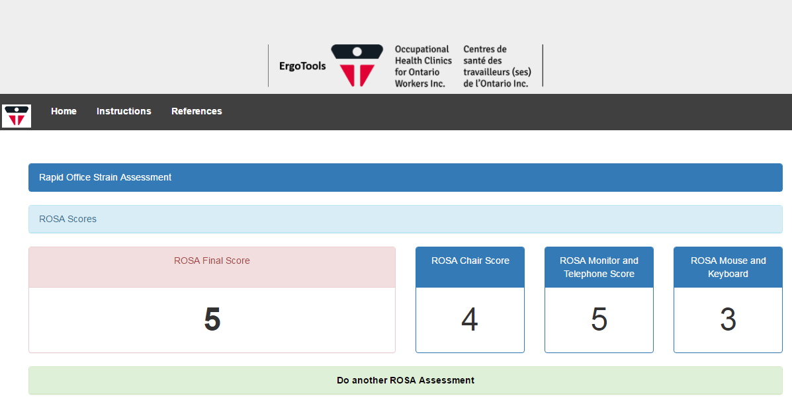
ROSA - Scores
Scores of 5 or greater – ↑ Discomfort
Have an Ergonomics Assessment completed

Slide 26
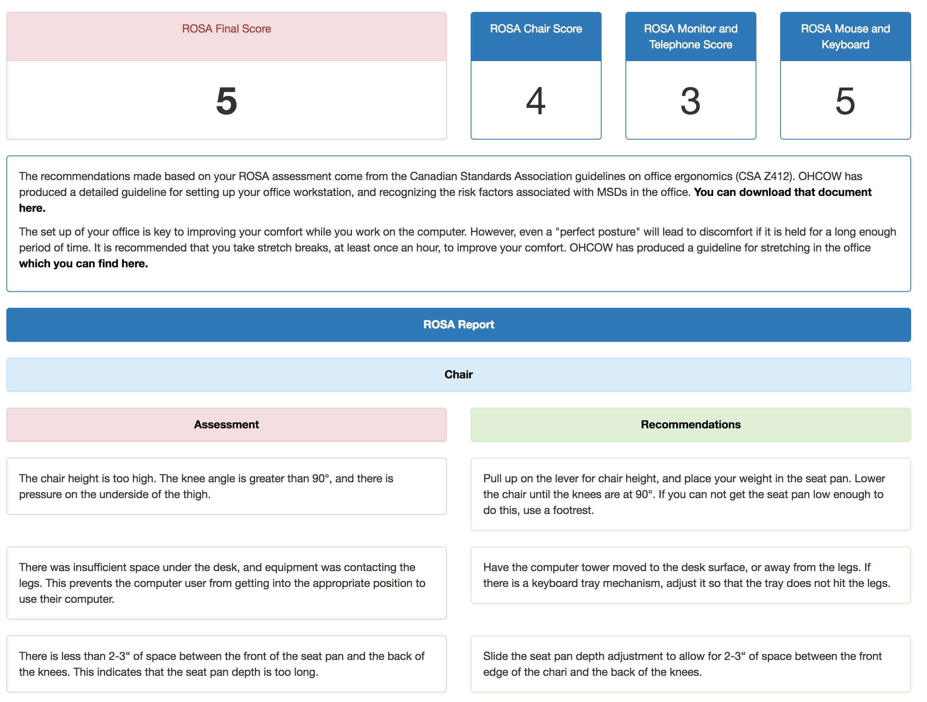
ROSA - Reporting

Slide 27
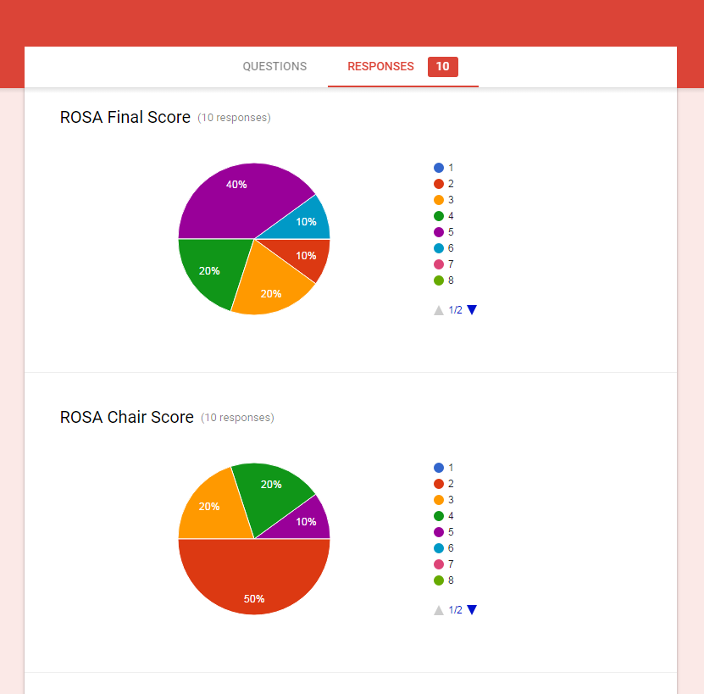
ROSA - Results

Slide 28
ROSA - Example
http://www.ohcow.on.ca/ergotools/rosa/index.php

Slide 29
ROSA - Subjects & Procedure
72 Office Workers were recruited from a local hospital’s administrative staff.
Each workstation was assessed using ROSA.
Each worker completed a discomfort questionnaire (Hedge et al., 1999).
Notes:
Subjects were recruited from a local hospital’s administrative support staff. The inclusion criteria for this study required subjects to spend at least 50% of their day in their office.
Assessments of 72 offices were conducted. Workers were given a copy of the Cornell University Discomfort Questionnaire to report the frequency, intensity and degree of work interference they experienced at the time of assessment.

Slide 30
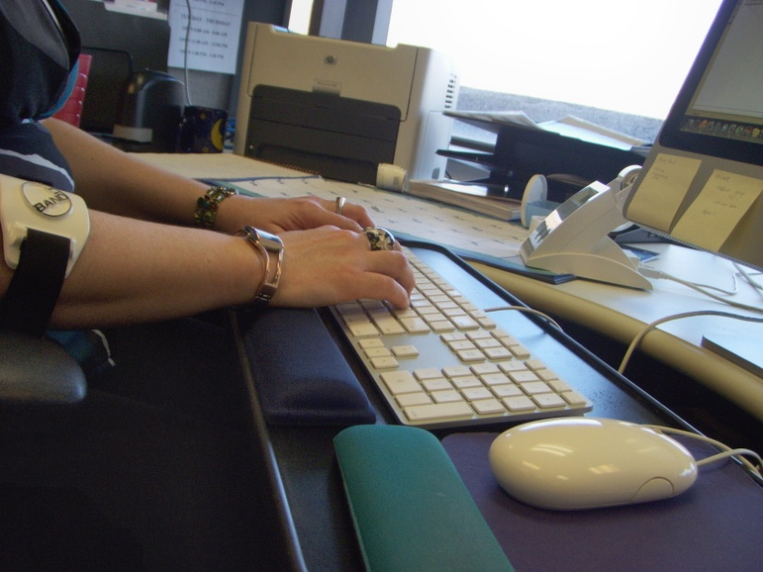
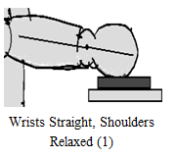
ROSA - Procedure
Inter-rater reliability:
  3 Trained observers assessed 14 workstations from the same population of 72 workers
Intra-rater reliability:
  3 trained observers assessed workstations once a week for 4 weeks.
Notes:
To assess Interrater reliability – three trained observers conducted simultaneous assessments of 14 workstations from the same population as the 72 other office assessments.
To assess Intrarater reliability – 3 mock workstations were configured at the university of windsor. Three trained observers assessed the workstations once a week for 4 weeks.

Slide 31
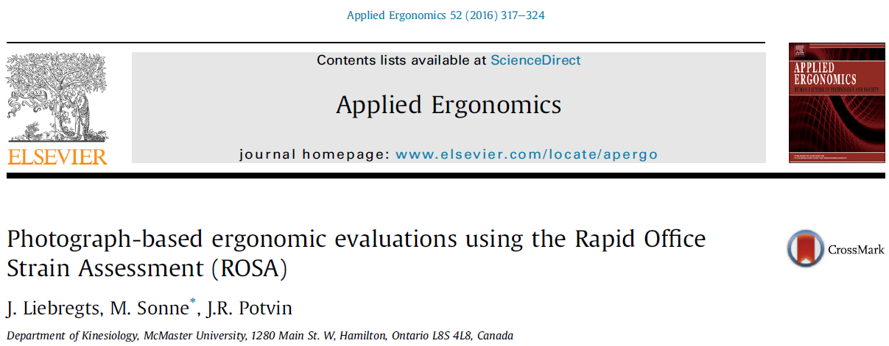
ROSA - Photographs
Research Question: Is photo-analysis a valid method of office workstation risk factor assessments using ROSA?
Notes:
3 ergos
Did assessments of 20 workstations and while he was there took 5 photos
compared on-site score to photos

Slide 32
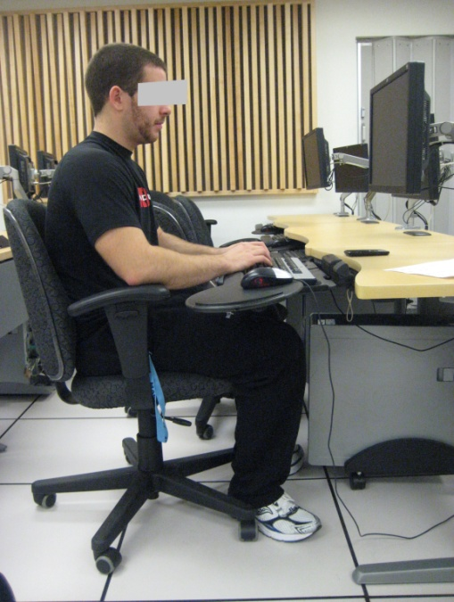
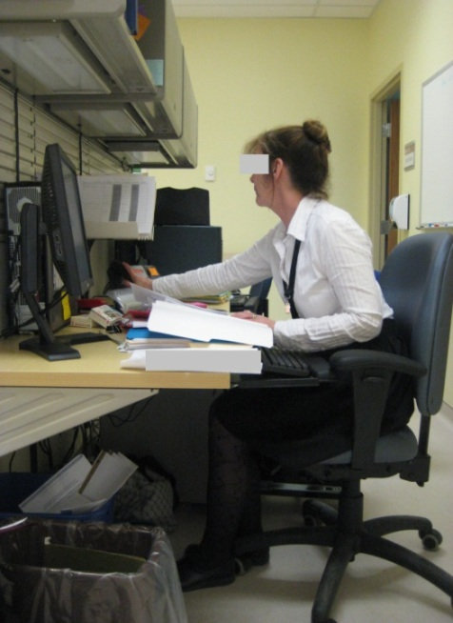
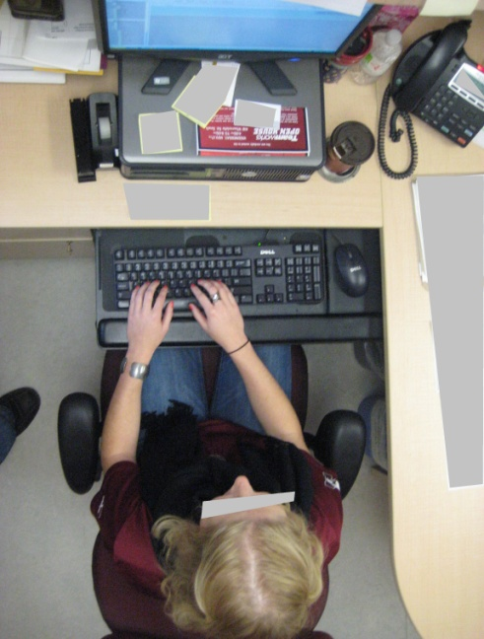


Methods
Photographs:
Fig. 2. Fully inclusive sagittal photo – trunk, seat properties, upper limb, neck, equipment orientation
Fig. 3. Sagittal photo capturing reach for telephone
Fig. 4. Coronal photo showing upper limb postures while typing, neck rotation
Notes:
5/26/2017 9:47 AM
© 2007 Microsoft Corporation. All rights reserved. Microsoft, Windows, Windows Vista and other product names are or may be registered trademarks and/or trademarks in the U.S. and/or other countries.
The information herein is for informational purposes only and represents the current view of Microsoft Corporation as of the date of this presentation. Because Microsoft must respond to changing market conditions, it should not be interpreted to be a commitment on the part of Microsoft, and Microsoft cannot guarantee the accuracy of any information provided after the date of this presentation.
MICROSOFT MAKES NO WARRANTIES, EXPRESS, IMPLIED OR STATUTORY, AS TO THE INFORMATION IN THIS PRESENTATION.
32

Slide 33
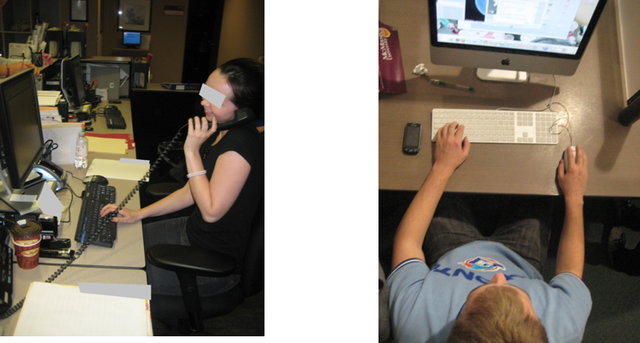
Methods
Photographs:
Fig. 5. Photo capturing the workstation operator’s phone usage
Fig. 6. Coronal photo depicting upper limb postures while mousing

Slide 34

MSD Tools
Pen and Paper
Desktop Only
RULA
ROHMERT
ROSA
STRAIN INDEX
MAE
NIOSH

Slide 35
ErgoTools! - MSD
Combination of 5 commonly used Ergonomics tools
  RULA
  MAE Equation
  Rohmert Rest Allowance
  Strain Index
  NIOSH Lifting Equation

Slide 36
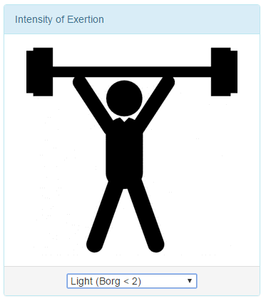
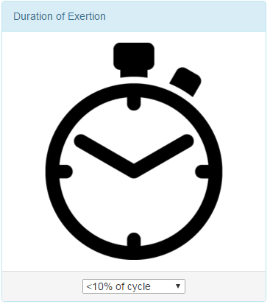
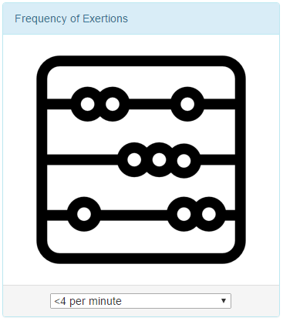
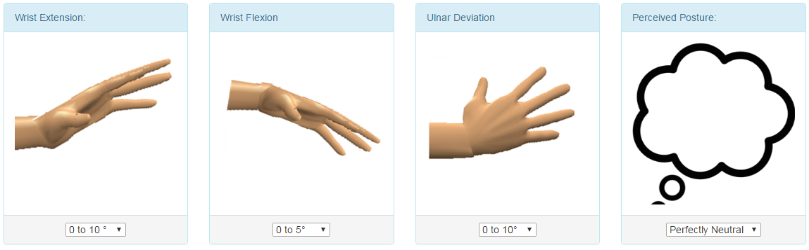
Strain Index
Notes:
The Strain Index is a tool used to evaluate a job’s level of risk for developing a disorder of the hand, wrist, forearm, or elbow. You use this when you need to evaluate the risk of developing a musculoskeletal disorder (MSD) in a hand intensive task. Many small assembly tasks will qualify for this.

Slide 37
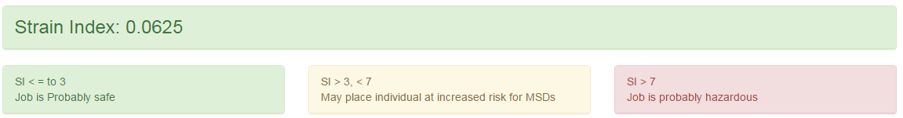
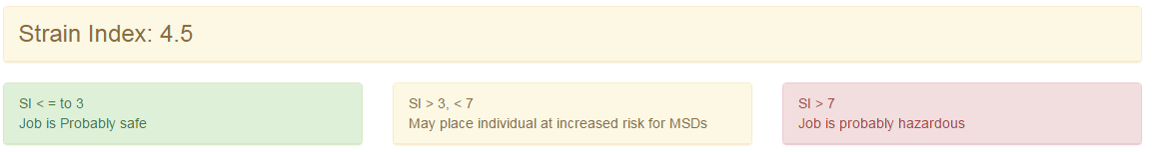
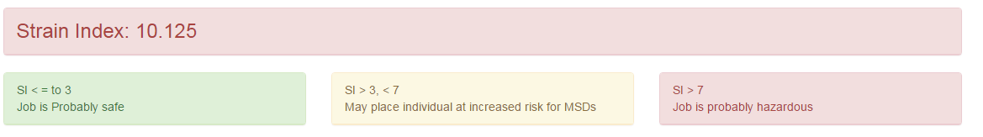
Strain Index
Notes:
If you get a red or even a red score, what does it mean? It means that something needs to change! You need to change the intensity, the duration, the awkward posture and then you need to re-evaluate!

Slide 38
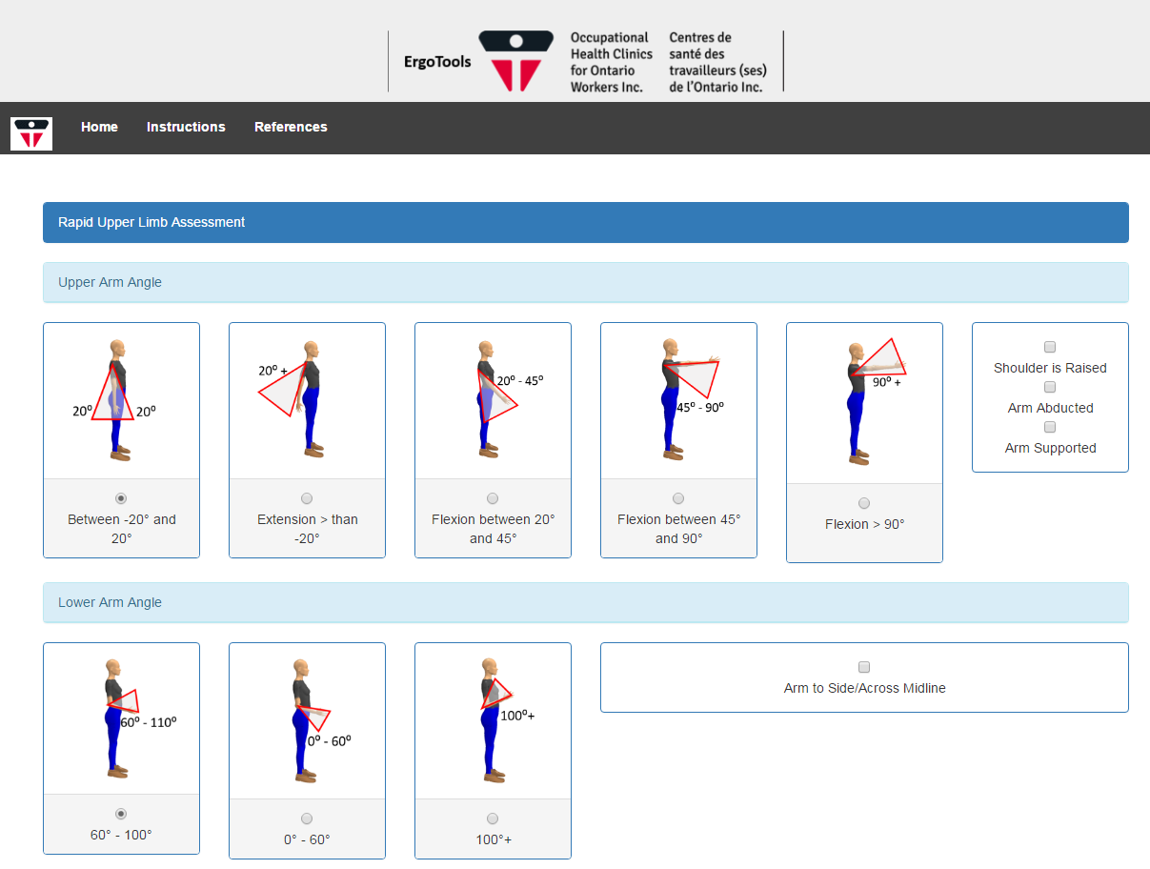
RULA
Postural Assessment
Notes:
A RULA assessment represents a moment in the work cycle and it is important to observe the postures being adopted whilst undertaking the tasks prior to selecting the posture(s) for assessment. Depending upon the type of study, selection may be made of the longest held posture or what appears to be the worst posture(s) adopted.
When taking RULA, you should choose the work task with:
The most difficult postures and work tasks
The posture sustained for the longest period of time, or
The posture where the highest force loads occur.

Slide 39
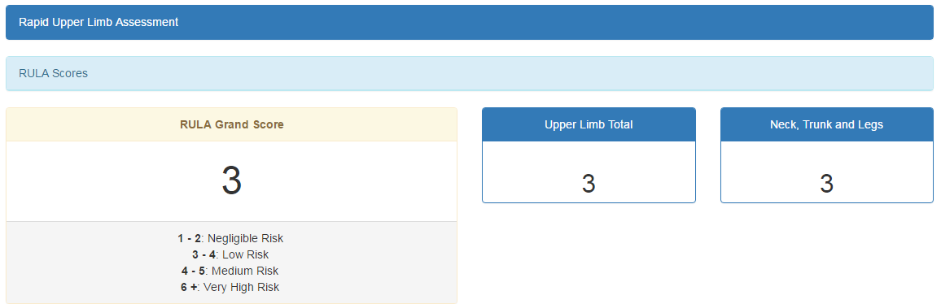
RULA

Slide 40
RULA - Example
http://www.ohcow.on.ca/ergotools/rula/index.php

Slide 41
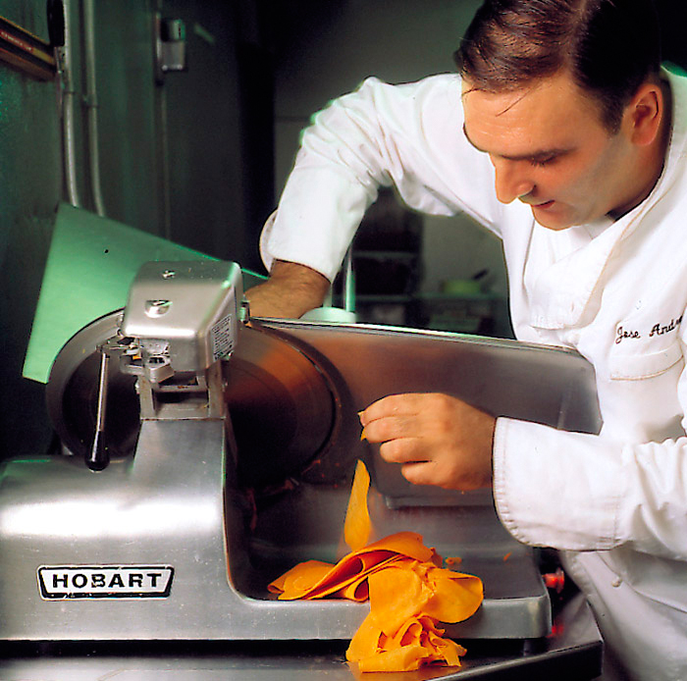
RULA - Example

Slide 42
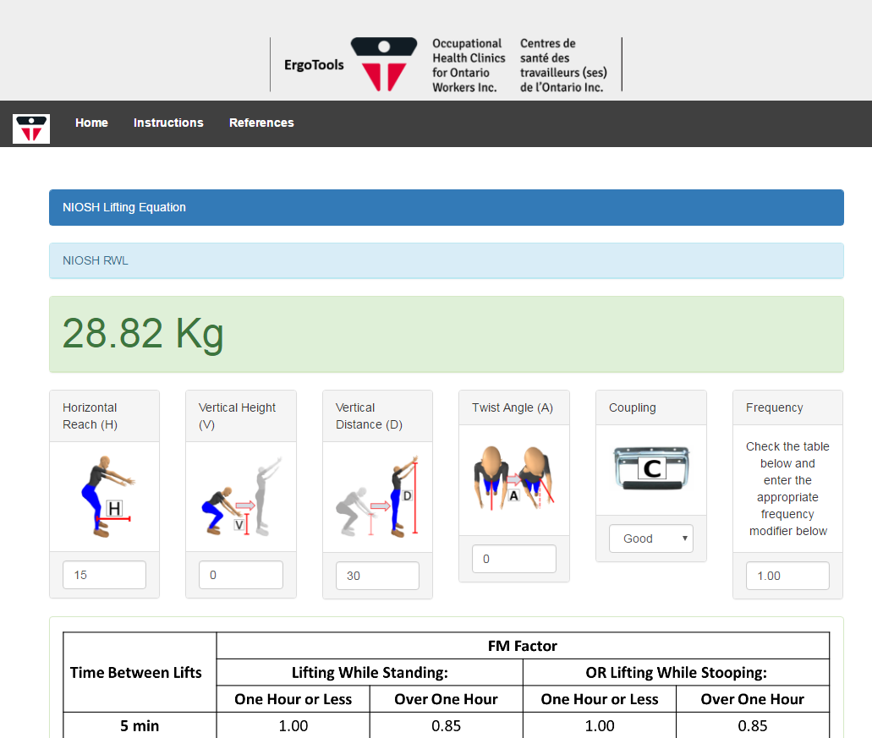
NIOSH Lifting Equation
Biomechanical Lifting Analysis
Notes:
Recommended Weight Limit (RWL), which defines the maximum acceptable weight (load) that nearly all healthy employees could lift over the course of an 8 hour shift without increasing the risk of musculoskeletal disorders (MSD) to the lower back.

Slide 43


MAE Equation
Duty Cycle$=\frac{\# repetitions x time force applied in seconds}{duration of task in seconds}$
Notes:
people can exert up to 5% of their maximum voluntary muscle effort for indefinite periods of time without significant injury or fatigue
x
The proposed equation will have wide applications for ergonomic practitioners performing evaluations of repetitive tasks.
. See Duty Cycle calculations below.
Duty Cycle can be defined as the total force duration divided by cycle time. See Duty Cycle calculations below.
Case 1 Duty Cycle = (5 x 2.5 sec) / 25 sec = 0.5
5 = repetitions; 2.5 = time force applied in seconds; 25 = duration of task in seconds
Case 2 Duty Cycle = (5 x 0.5 sec) / 25 sec = 0.1

Slide 44

Rohmert Rest Allowance
Metabolic Rest Allowance
Notes:
Repetitive tasks
Joint moment what is the current demand
Joint strength – most force you can exert
Or demand over capacity

Slide 45
Ergonomic Implementation
Identify the Concern
Evaluate the concern
Find a Solution
Implement Change
Follow-up

Slide 46
For More Information…
OTTAWA
1545 avenue Carling
Bureau 101
Ottawa, ON
K1Z 8P9
Téléphone: (613) 725-6999
Courriel: ottawa@ohcow.on.ca
www.ohcow.on.ca
Notes:
TREVOR

