Slide 1
Introduction & Eastern Ontario Clinic
Presented by:
Laura Lozanski, Chair of the Local Advisory Committee and BOD
Kimberly O’Connell, Executive Director
Notes:
I am here today to talk to you about the services offered by the occupational health clinics for Ontario workers. I want to make sure you understand why were here and how we can help you and your team.
First of all, how many of you are familiar with OHCOW?

Slide 2
History
USW Local 1005 Hamilton 1981
Building on this success, 1988 pilot sponsored by Ontario Federation of Labour followed by the creation of OHCOW’s first clinics in Toronto and Hamilton in 1989 with a funding agreement Ministry of Labour
Presently funded by Ministry of Labour
Governed by an independent Board of Directors
Local Advisory Committee for each clinic

Slide 3
Mission Statement
The Mission of the Occupational Health Clinics for Ontario Workers (OHCOW) Inc. is to identify and prevent occupational illness, injuries and disabilities, and to promote the highest degree of physical, mental and social well-being of all workers.

Slide 4
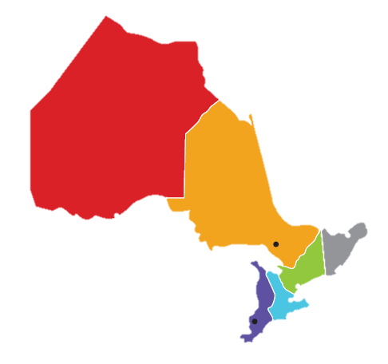
Locations
OHCOW serves all of Ontario through its 7 clinics: Sudbury, Thunder Bay, Hamilton, Toronto, Windsor, Sarnia, and Ottawa.
Thunder Bay (North-Western)
Sudbury (Northern)
Toronto (Central)
Hamilton (South Central)
Sarnia/Windsor (South Western)
Ottawa (Eastern)
Notes:
Ottawa Clinic, Eastern Region
Major communities include: Ottawa, Kingston, Cornwall, Belleville, Hawkesbury, Alexandria, Chalk River, Mattawa, Petawawa, Rockland, Smith Falls, Embrun, Morrisburg, Winchester and more.

Slide 5
Our 5 services
Diagnostics
Groups
Inquiry
Education
Research
www.ohcow.on.ca
WE WORK AS A MULTIDISCIPLINARY TEAM
Notes:
The experience of OHCOW’s occupational health physicians and nurses can help in:
Determining work relatedness of injuries or diseases.
Assist in setting up medical surveillance programs.
Interpret biological monitoring results.
WSIB cases and appeals processes
Answer Questions
Identify risk factors
Help Self sufficiency
Provide recommendations
The Goal:
To identify causes of the health or safety concern.
To provide recommendations (written report) or identify additional areas to be investigated.
OHCOW is involved with numerous research projects, such as shoulder disorders and cashiers.
Published articles on anti-slip devices, MSDs and Custodians, Exercise Balls and Office use, and MSDs and Nurses
Currently working with several unions to research health-related conditions.

Slide 6
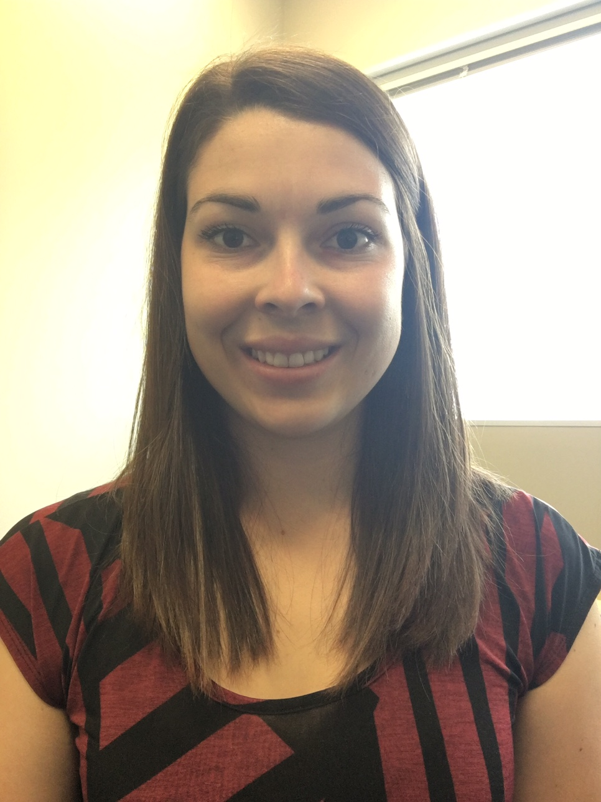
Client Service Coordinator
First point of contact with OHCOW Clinic
Bilingual
Patient intakes, fields inquiries, works with advocates
Coordinates patient visits & correspondence
Welcoming and helpful

Slide 7
Ergonomist
Technical Patient File Review -Ergonomics
Researches potential linkage of exposure to workplace injury/illness
Writes evidence-based reports
Handles inquiries
Assist workplaces to identify hazards & mitigate risks
Knowledge Transfer
Notes:
Chelsie received a Bachelor of Science in Kinesiology in 2014 from Laurentian University, and is currently undertaking a Master of Science in Interdisciplinary Health where she is focusing on determining the effectiveness of personal protective equipment guidelines. Chelsie is an advocate for prevention through intervention and believes that small changes can lead to major improvements in the workplace. Her background has provided her with a strong knowledge of risk assessment, injury mechanisms, and developing improvements. In addition, she serves as a member of the Ergonomic Integrated Planning Advisory Committee (EIPAC), the MSD Prevention Guideline Working Group, and the Centre for Research in Occupational Safety and Health.

Slide 8
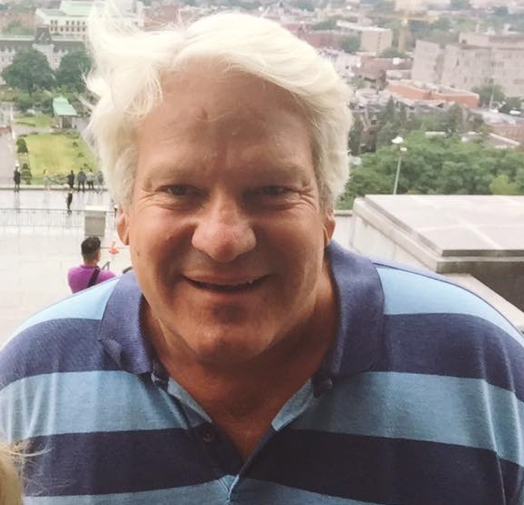
Hygienist
Technical Patient File Review –Occupational Hygiene/Disease
Researches potential linkage of exposure to workplace injury/illness
Writes evidence-based reports
Handles inquiries
Assist workplaces to identify hazards & mitigate risks
Knowledge Transfer
Notes:
Todd has over 29 years of experience as an Environmental, Health and Safety (EHS) professional serving as an internal company resource and external consultant ranging from large multinational organizations to small/medium sized organizations in the private (manufacturing, commercial, R&D) and public sector (Canadian Federal, Provincial and Territorial jurisdictions) . He has master’s degrees in chemical toxicology and occupational health science and is a certified industrial hygienist (CIH). He has extensive experience with the evaluation control of occupational and environmental hazards in a wide variety of settings. His areas of specialized knowledge and expertise include semi-conductor manufacturing and more recently in remote and northern mine/military site remediation and EHS management systems.

Slide 9
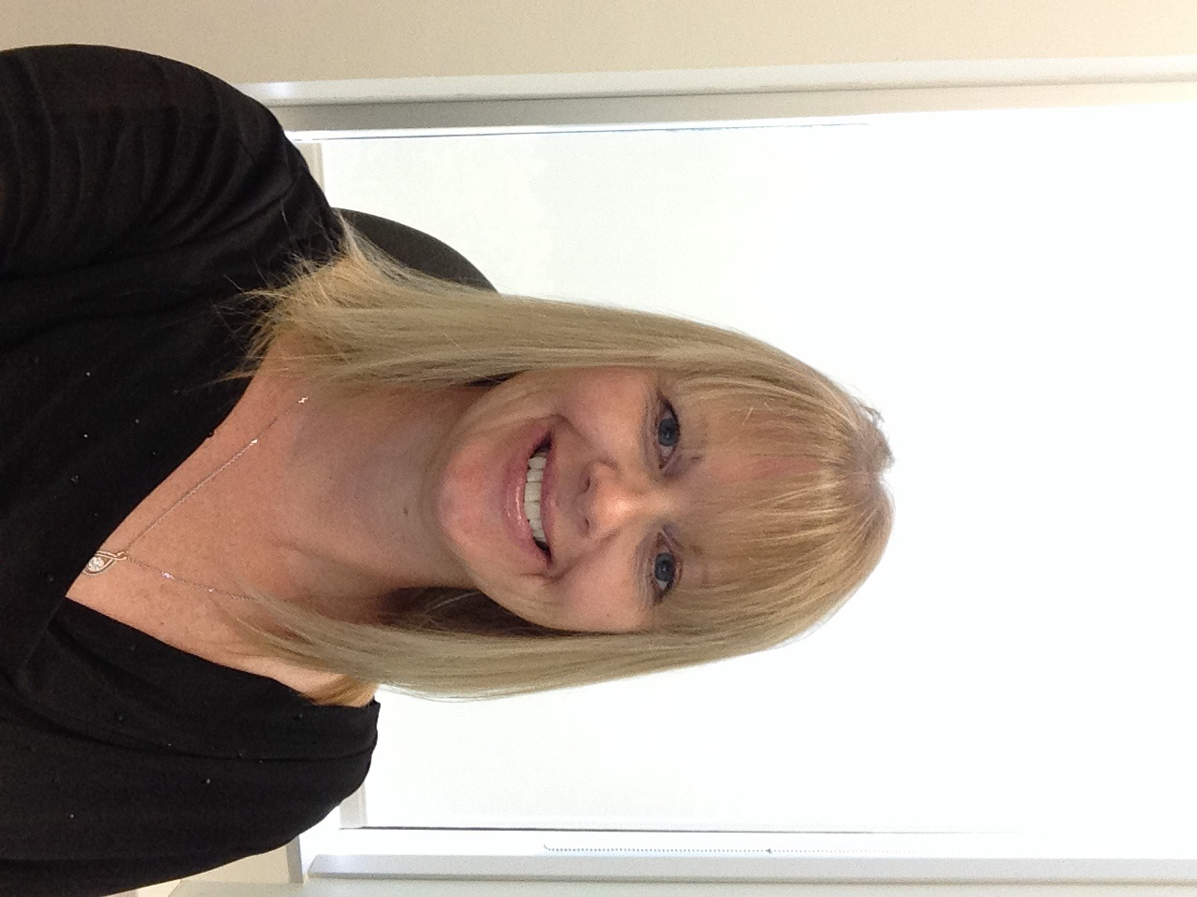
Occupational Health Nurse
Performs initial health assessments on patient files
Manages patient cases for physician review
Researches & consults with local medical community
Supervises nursing student placements
Occ. Health outreach and consulting
Knowledge Transfer
Notes:
Tracey is a graduate of St. Clare’s School of Nursing, based out of St. John’s Newfoundland. Tracey has experience in different healthcare settings, caring for both adults and paediatrics in Newfoundland and Ontario. She has worked in the occupational health speciality since 2008 and has held her CNA certification in occupational health since 2013. Tracey is a member of OOHNA and the Ottawa OHNA group.

Slide 10
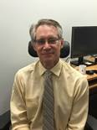
Physicians
Dr. Bourgault and Dr. Wills (no photo) Contract physicians
1-2days/week (avg.) the clinic
Experience & Education in Occupational Medicine
Sees patients, reviews files and diagnoses, researches potential linkage of exposure to workplace injury/illness
Provides written reports to the worker, advocate and/or WSIB
Advises on Occupational Health programs & outreach
Notes:
Dr. Bourgault is an Occupational Health physician from the Ottawa region who has recently joined the newly opened Eastern Region Ottawa Clinic of Occupational Health Clinics for Ontario Workers (OHCOW). In addition to his work with OHCOW Dr. Bourgault acts as Medical Consultant to the RCMP International Peace Operations in Ottawa. Dr. Bourgault completed his undergraduate medical training at the University of Ottawa in 1987 and received his Master’s Degree in Occupational Health Sciences from McGill University in 2011. In addition Dr. Bourgault holds undergraduate degrees in both Biology and Mechanical Engineering from the University of Ottawa and has received his Certificate in Travel Health from the International Society of Travel Medicine.
Dr. Wills is a recognized Occupational Medical Consultant whose practice includes part-time work as a Staff Physician in the Department of Occupational and Environmental Health at St. Michael's Hospital in Toronto, Ontario, and an academic appointment as an Assistant Professor in the Department of Medicine at the University of Toronto. Dr. Wills has extensive clinical experience, including appointments in the Ontario Hydro Health Services Department, including a term as Chief Physician and Manager; Medical Director for the Sunoco Group of Suncor; and Consultant at the Occupational Health Clinics for Ontario Workers. Dr. Wills has conducted several research studies and published numerous papers in the field of Occupational and Environmental Medicine.
der if we can get Dr. Bourgault photo…..?

Slide 11
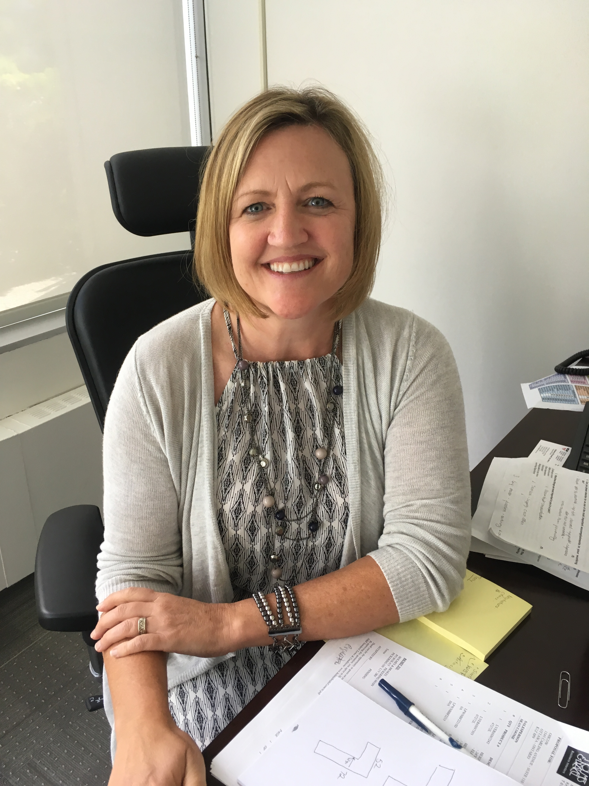
Executive Director
Provides a leadership role in organization and Prevention System
Manages clinical & professional practice
Oversees Implementation of the Eastern Region Operational Plan
Outreach, Knowledge Transfer and fosters Community Partnerships
Receives input and guidance from the Local Advisory Committee
Notes:
Kimberly received her Master of Science (Applied) in Occupational Health specializing in Industrial Hygiene from McGill University. She is a Certified Industrial Hygienist (CIH), Registered Occupational Hygienist (ROH) and Canadian Registered Safety Professional (CRSP). Kimberly also has a broad and in depth technical knowledge of health, safety, environmental and emergency response issues with over 20 years of extensive experience and well as experience in managing teams of Health and Safety professionals.
Her passion for occupational injury and illness prevention stems from the loss of a close family member to a workplace fatality in 1993.

Slide 12
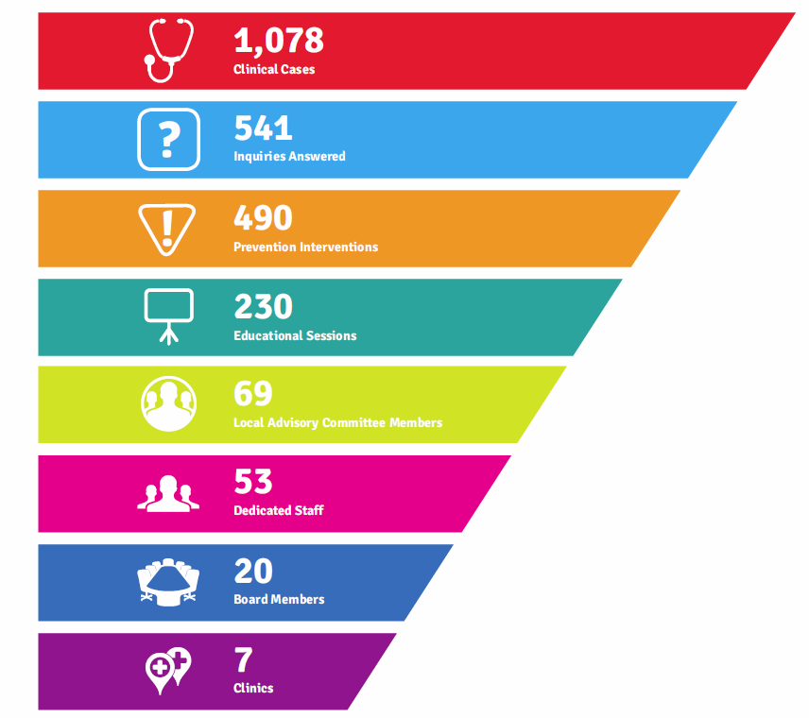

Slide 13
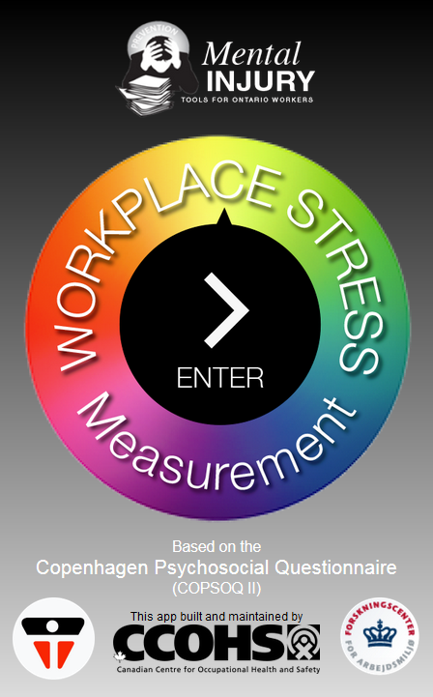
Measure Workplace Stress App
In partnership with the CCOHS, we’ve created an app that allows you to do the survey and have your own personal score
http://www.ohcow.on.ca/measure-workplace-stress.html

Slide 14
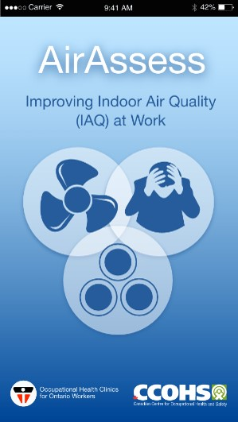
http://www.ohcow.on.ca/painpoint.html
http://www.ohcow.on.ca/airassess.html
Notes:
PainPoint in now available in all three app stores
Please download it and try it out

Slide 15
Tools: New App Development
http://www.ohcow.on.ca/avoidnoise/

Slide 16
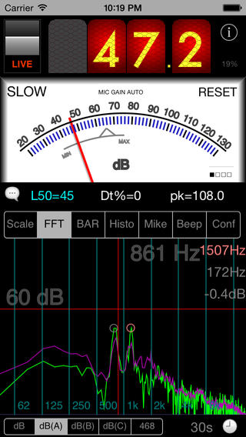
Noise App
NIOSH has reviewed various noise measurement apps and found that some do a reasonable job of measuring sound (and some not so reasonable)
SPLnFFT
Costs about $5-$7

Slide 17
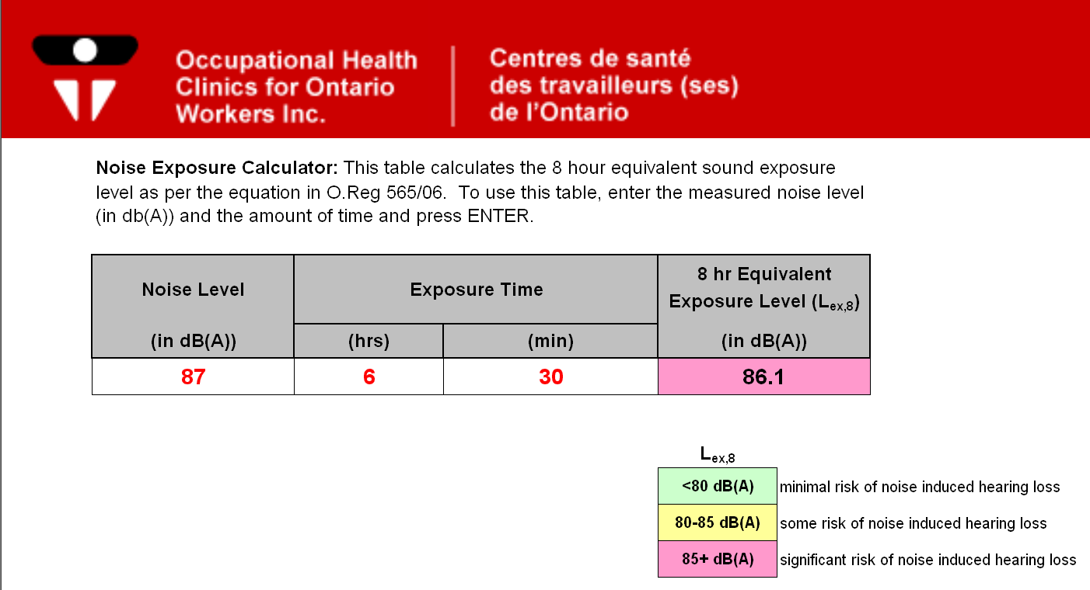
solution: on-line calculator …
http://www.ohcow.on.ca/edit/files/general_handouts/noisecalculator.xls

Slide 18
Group Work
CUPE Local 4000 (x2)
Facilitate Diesel Particulate and Air Monitoring –Local Industry
Association des colleges et universities de la francophonie canadienne (x14)
Frontenac Paramedics- CO exposure
RF/EMF exposure assessment peer review
OPP Dispatch Centre (over 100 employees)

Slide 19
Knowledge Transfer
CUPE local 4000/USW Local 6500 – Ergonomics for hospital JHSC members
Hygiene Tools- Picton Spring School -KDLC
Association des colleges et universities de la francophonie canadienne – Ergonomics: How to Purchase the Right Equipment
House of Commons: OHCOW Services
Children’s Aid Society - Office Ergonomics: How to Setup your Workstation

Slide 20
Community Outreach
RSI + Day – Worldwide Webcast February 28
McIntyre Intake Clinic Support in Timmins & Sudbury
Ottawa Valley Health & Safety Boot Camp-Occupational Disease
Partners in Prevention Regional Conference – Trade Show Booth
Webinar – Dealing with MSD’s: A guide to Prevention and Return to Work
Day of Mourning
PSAC Fall Tradeshow

Slide 21
Patient Cases
DeQuervain’s Tendonitis in Hospital Nurse
Back Strain in Sheet Metal Worker
Shoulder Tear in Custodian
Brain Cancer in Forestry Worker
NIHL in Mechanical Shop

Slide 22
Costs
OHCOW is a non-profit organization.
Most services are free of charge, however
Medical monitoring and air quality testing may have laboratory fees.
The client is informed of the cost prior to testing.

Slide 23
Who Can Use OHCOW?
Workers
Management
Joint Health and Safety Committees
Students
Retired Workers
Health Professionals
Any issue that falls within OHCOW’s mandate
Notes:
- Individuals can self-refer to OHCOW. We often get requests from workers who are either injured or concerned about getting injured. We can advise on an appropriate course of action. We prefer to work closely with Joint Health and Safety Committees because we have common goals – ensure safety in the workplace. We want to involve you in every step of the process so that you can learn. We have created partnerships with many organizations – both government and private. In many of these workplaces, a member of the JHSC follows us on all our assessments. They learn so much. After watching dozens of assessments, they become so knowledgeable. We really believe in knowledge through education and that’s what we aim to achieve.

Slide 24
OHCOW Eastern Region
Team Operational Objectives (preliminary)
Clinical/Diagnostic Work
Migrant Farm Worker Clinic- Prince Edward County
OHCOW Conference (NAOSH Week)
Office Ergo App development (How to measure “Ideal Measurements” Ergo Assessment
Indigenous Communities Workshop
Nanotechnology Working Group
CME Event- Physician’s Education
Notes:
- Individuals can self-refer to OHCOW. We often get requests from workers who are either injured or concerned about getting injured. We can advise on an appropriate course of action. We prefer to work closely with Joint Health and Safety Committees because we have common goals – ensure safety in the workplace. We want to involve you in every step of the process so that you can learn. We have created partnerships with many organizations – both government and private. In many of these workplaces, a member of the JHSC follows us on all our assessments. They learn so much. After watching dozens of assessments, they become so knowledgeable. We really believe in knowledge through education and that’s what we aim to achieve.

Slide 25
Local Advisory Committee
Help OHCOW respond to the unique needs of Eastern Ontario
Key local or regional issues
Volunteer support
Represent Clinic /Spread the Word
Honour Roll
Notes:
- Individuals can self-refer to OHCOW. We often get requests from workers who are either injured or concerned about getting injured. We can advise on an appropriate course of action. We prefer to work closely with Joint Health and Safety Committees because we have common goals – ensure safety in the workplace. We want to involve you in every step of the process so that you can learn. We have created partnerships with many organizations – both government and private. In many of these workplaces, a member of the JHSC follows us on all our assessments. They learn so much. After watching dozens of assessments, they become so knowledgeable. We really believe in knowledge through education and that’s what we aim to achieve.

Slide 26
We are Here to Help

Slide 27
For More Information…
OTTAWA
1545 avenue Carling
Bureau 101
Ottawa, ON
K1Z 8P9 (613) 725-6999
ottawa@ohcow.on.ca
www.ohcow.on.ca

Slide 28
Questions?

