Slide 1
Noise:
Health Effects and Methods to Reduce Exposure – What can we do!

Slide 2
“Blindness cuts people off from things; deafness cuts people off from people”.
Helen Keller
(Source: Walker, 1986 cited in Berger et al. 2003)
Without hearing – ?
Can’t be part of a conversation (isolation).
Music
We can’t throw our hearing away!

Slide 3

Objectives of presentation
This presentation does not provide training on occupational noise management. It shares “up to date” information.
Provides an overview of detecting the noise hazard and controlling noise exposure – everyone is responsible!
It promotes International Noise Awareness Day 22nd anniversary INAD 2017: Wednesday, April 26, 2017. All over the world, people, organizations, and governments will commemorate the 22nd Annual International Noise Awareness Day (INAD) on Wednesday, April 26, 2017. The Center for Hearing and Communication (CHC) founded this yearly event in 1996 to encourage people to do something about bothersome noise where they work, live, and play.

Slide 4
For proper training
Refer to CSA Z 1007 – 16 section 10.3 (table 6) where a training matrix is provided for all persons involved in the noise program.
For international refer to the Occupational Hygiene Training Association (OHTA) – OH.learning.com

Slide 5
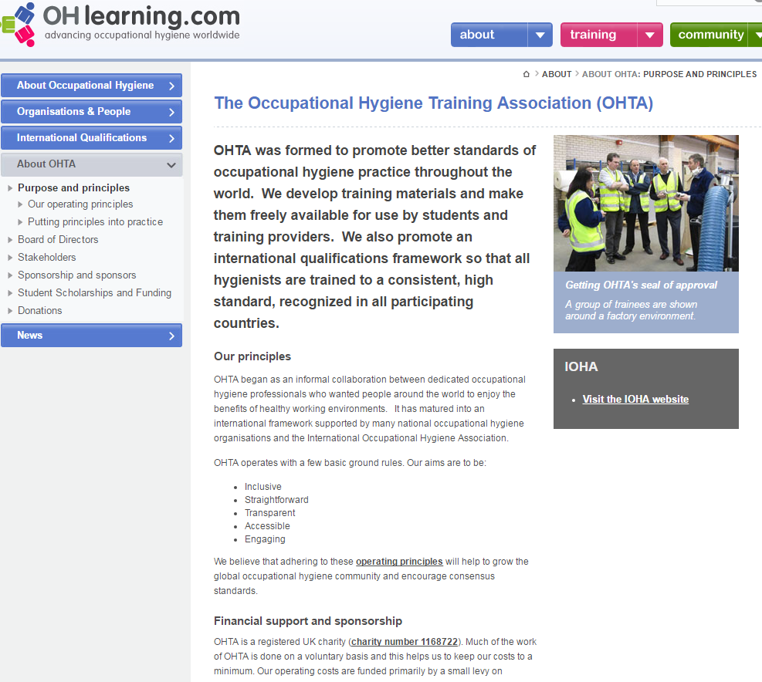
http://www.ohlearning.com/about-ohta/purpose-and-principles.aspx

Slide 6
Develop a program
Important - noise in the workplace must be managed through hearing loss prevention program (HLPP) management.
A new Canadian Standards Association Standard Z1007 – 16 provides a framework / guidance for developing this program.
According to this the Standards Australia Standard AS/NZS 1269.0 was used as a seed document for developing part of this document.

Slide 7
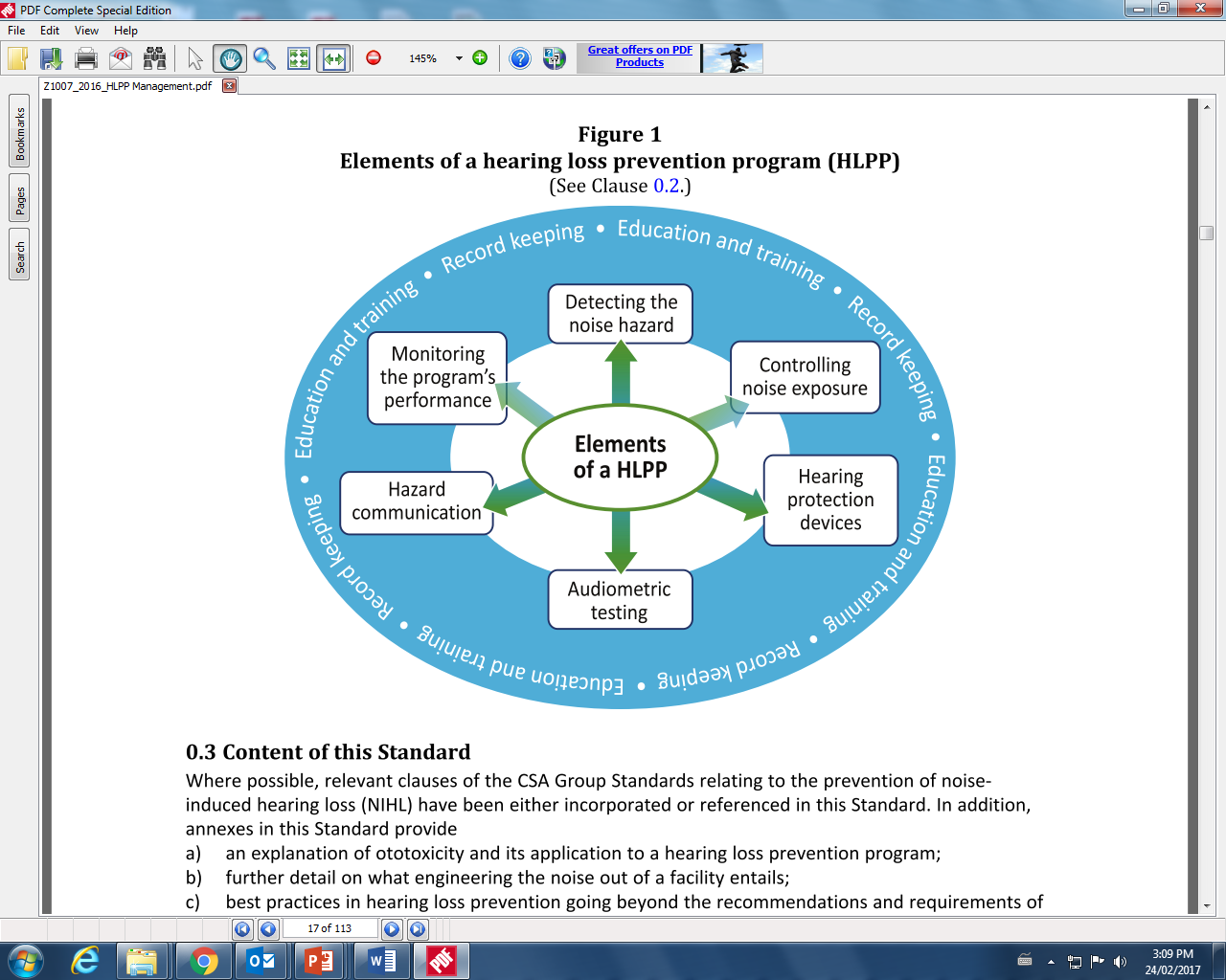
CSA Z1007 – 16: Hearing loss prevention program (HLPP) Management – Note there are different elements of a hearing loss prevention program
Canadian Standards Association – Hearing loss prevention program (HLPP) Z1007 - 16

Slide 8
What is noise?

Slide 9
Properties of Sound
There is more than one way to measure Amplitude (loudness)
Wavelength
OH.learning.com

Slide 10
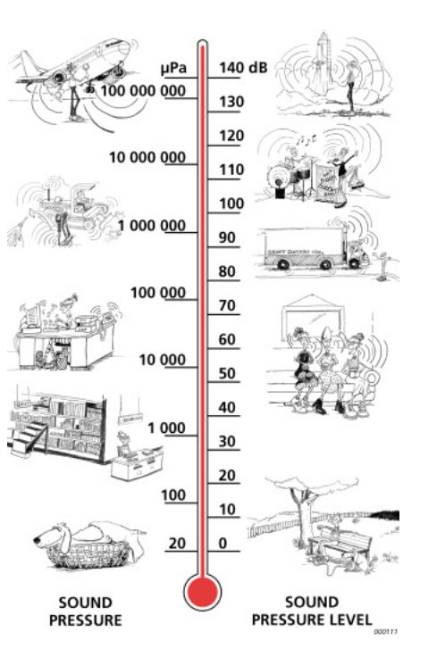
Our hearing covers a surprisingly wide range of sound pressures. The decibel (dB) scale makes the numbers manageable.
Brüel & Kjær
https://www.bksv.com/media/doc/br1626.pdf

Slide 11
Health effects – Noise Induced Hearing Loss (NIHL)?

Slide 12
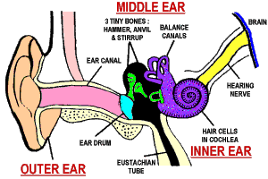

Slide 13
… just to be clear about what we’re trying to prevent …
normal hearing cells
damaged hearing cells

Slide 14
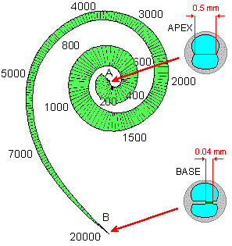
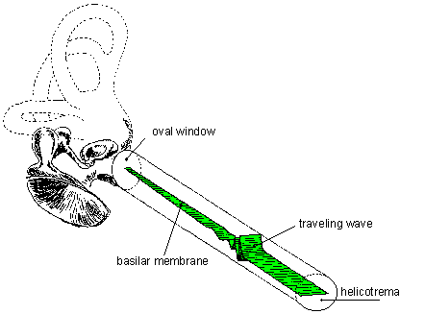
Pitch and Loudness Perception
The point at which the traveling wave peaks corresponds to the frequency of the sound.
Source oh.learning: http://www.ohlearning.com/about-ohta/purpose-and-principles.aspx

Slide 15
Statistics
“last five years, the annual costs for noise induced hearing loss claims for all sectors in Ontario exceeded $50 million per year,” (MOL 2014)
the WSIB showed a steady increase in NIHL registered claims from 3653 claims in 2005 to 5416 claims in 2009 (WSIB, 2011)
Masterson et al. (2013) found 18% of 1,122,722 worker audiograms collected from the NIOSH OHL Surveillance Project met the NIOSH criteria for NIHL
Stekelenburg (1982) noted that: “… even if 80 dB(A) is taken as a time weighted average limit … 10% of the exposed population will not be protected against impaired social hearing caused by noise.” (page 408)

Slide 16
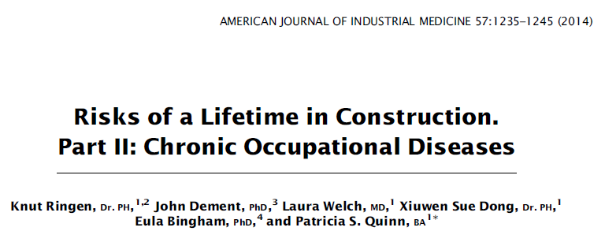
“Over a 45-year working life,
  16% of construction workers developed COPD,
  11% developed parenchymal radiological abnormality, and
  73.8% developed hearing loss.”

Slide 17
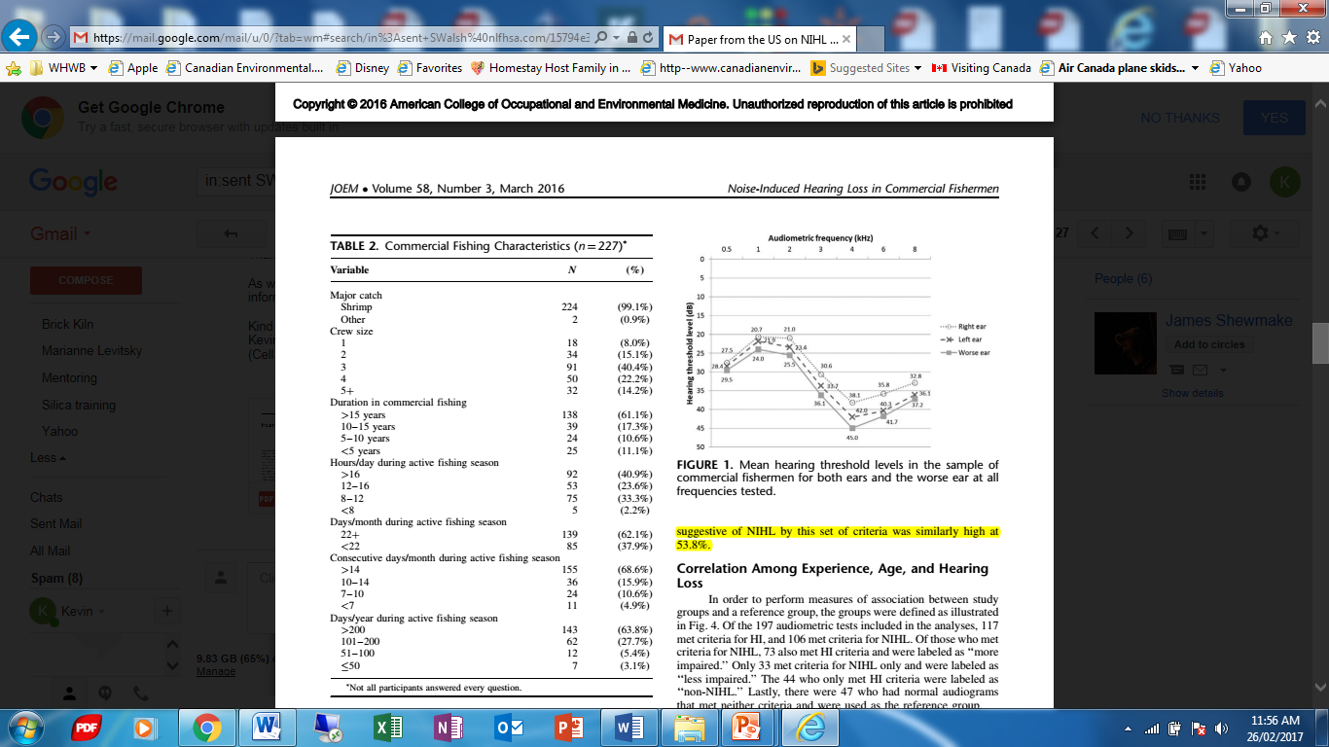
more than half (53.8%) of these fishermen have been diagnosed with hearing impairment.
Levin et al. 2016, Hearing Loss and Noise Exposure Among Commercial Fishermen in the Gulf Coast, J. Occup Environ Med 2016 Mar;58(3):306-13 , p.309, viewed 26 February 2017
https://www.ncbi.nlm.nih.gov/pubmed/26949882

Slide 18
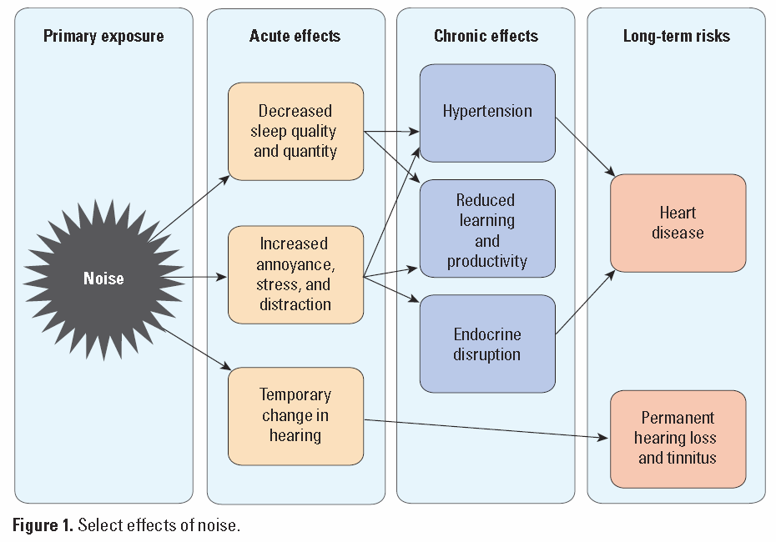
Fatigue - incidents
http://ehp.niehs.nih.gov/1307272/

Slide 19
Legislation (Ontario)
July 1, 2016 O.Reg. 381/15 finally extended the noise requirements to all workers in Ontario
The first efforts to do this began in 1979
However, we know that some workers will still lose their hearing at between 80-85 dBA L_{ex,8hr}
http://www.ohcow.on.ca/news/submission-to-the-ministry-of-labour-on-noise-proposals.html

Slide 20
employers take all measures reasonably necessary in the circumstances to protect workers from exposure to hazardous sound levels.
protective measures against noise exposure include engineering controls, work practices and personal protective equipment.
assessment of noise levels shall be done without regard to any use of personal protective equipment.
every employer shall ensure that no worker is exposed to a sound level greater than an equivalent sound exposure level of 85 dBA, L_{ex,8}.

Slide 21
American Conference of Governmental Industrial Hygienists (ACGIH) Threshold Limit Values
    LAeq,8h of 85 dB(A)
    LC,peak of 140 dB(C)

Slide 22
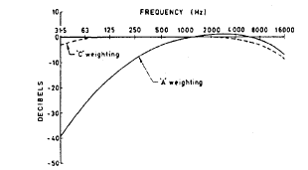

Slide 23
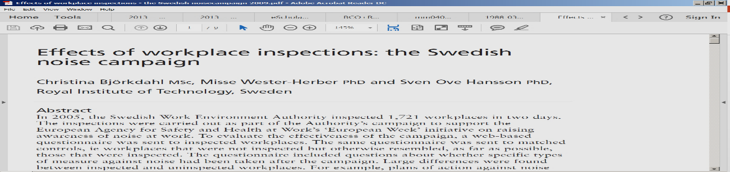

What activity is effective?
“In 2005, the Swedish Work Environment Authority inspected 1,721 workplaces in two days. To evaluate the effectiveness of the campaign, a web-based questionnaire was sent to inspected workplaces.
The same questionnaire was sent to matched controls, i.e. workplaces that were not inspected but otherwise resembled, as far as possible, those that were inspected.
On average, inspected workplaces had implemented 2.5 types of action against noise after the campaign, whereas the controls had implemented only 0.8.
83%of the inspected workplaces reported that the activities of the Authority were the reason for the actions they had taken against noise.
The study shows that the inspection campaign was highly successful in getting organisations to introduce noise prevention measures.”

Slide 24
What gets measured gets noticed. What gets noticed gets action!

Slide 25
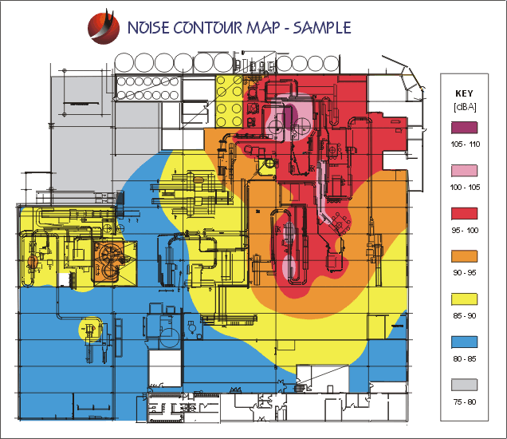
Hazard communication
http://www.fosterohs.com/

Slide 26

Guidance
The SOBANE Approach
  Screening
    Observation
        Analysis
          Expertise

Slide 27
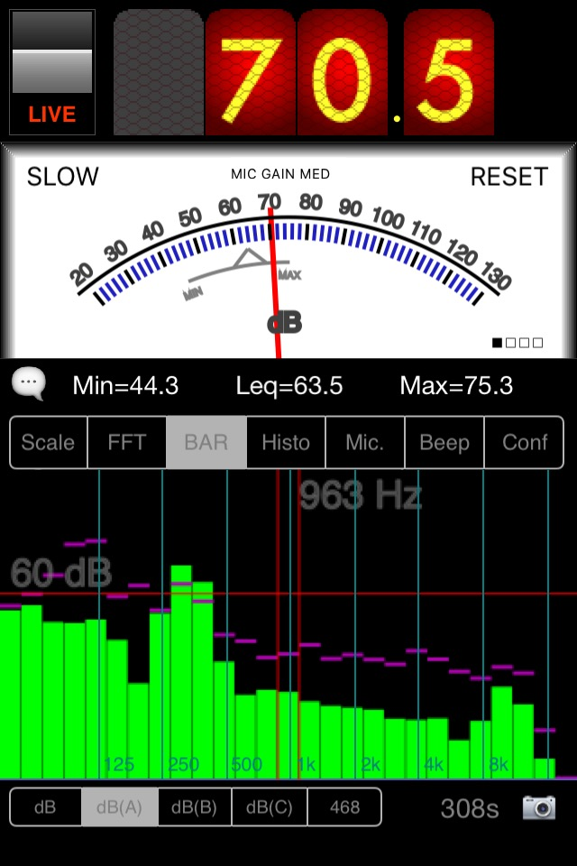
anyone can screen for hazardous noise….. to indicate that there is problem – good for “before” and “after” controls are implemented
NIOSH has reviewed various noise measurement apps and found that some do a reasonable job of measuring sound (and some not so reasonable)
e.g. SPLnFFT (US$5.49)
http://www.cdc.gov/niosh/surveyreports/pdfs/349-12a.pdf
https://itunes.apple.com/ca/app/splnfft-noise-meter/id355396114?mt=8
https://www.youtube.com/watch?v=jGVN7m3Wd1M

Slide 28
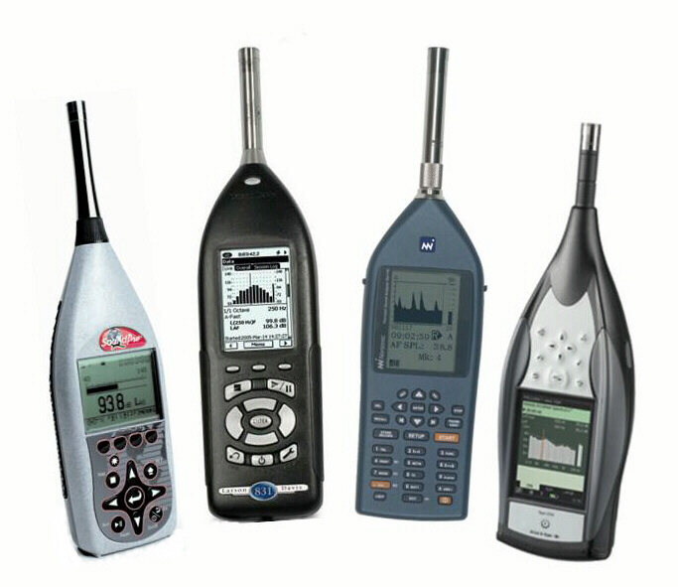
Modern digital filtering has seen the capabilities of Sound Level Meters (SLM) significantly enhanced while prices have dropped.

Slide 29
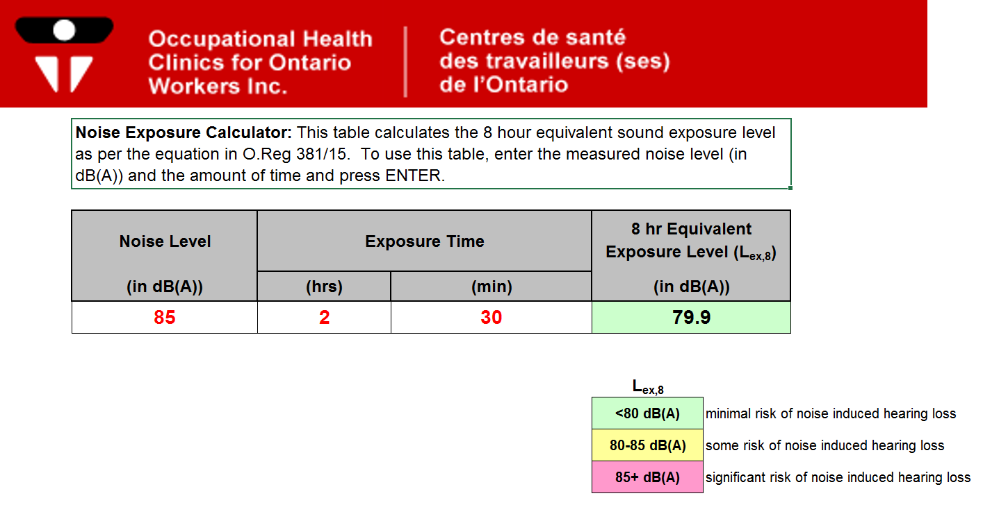
solution: on-line calculator …

Slide 30
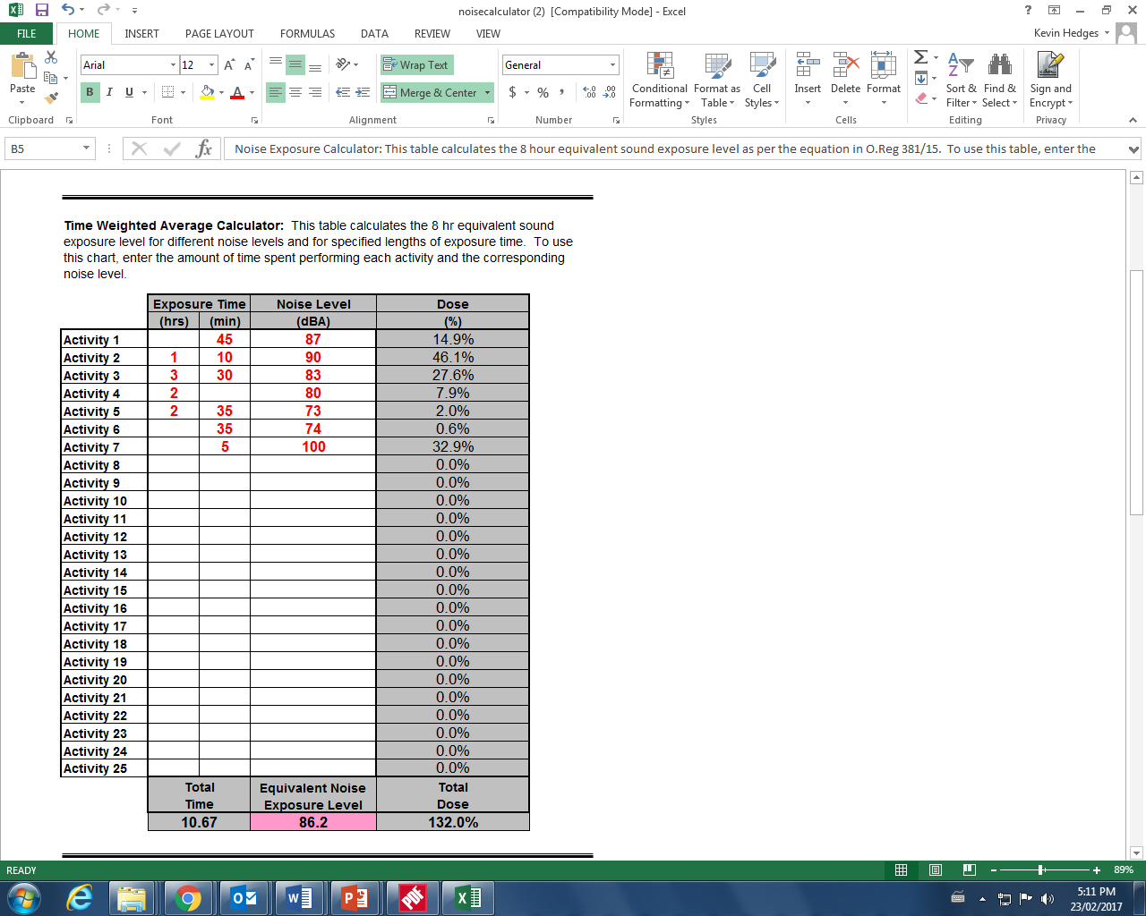

Slide 31
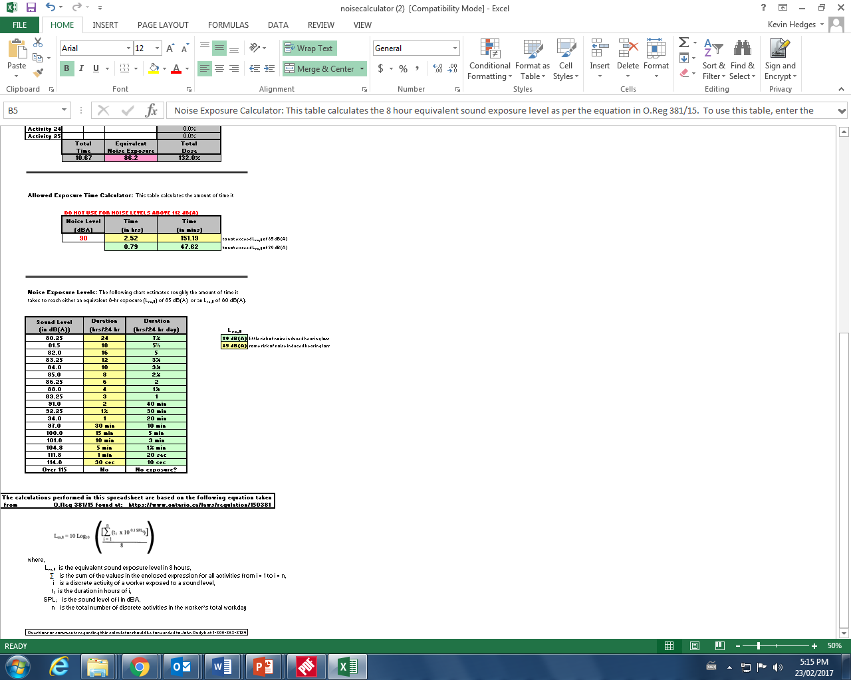

Slide 32

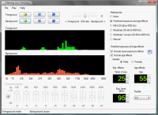
Videos / tools / apps
NAPO,
NIOSH Hearing Loss Simulator,
WorkSafeBC, The Hearing Video,
HSE Noise Induced Hearing Loss Simulation

Slide 33
app to measure reverberation
RevMeter Pro – an app to estimate the reverberation time in a room (≈ $7)
ANSI S12.60-2002. Acoustical Performance Criteria, Design Requirements, and Guidelines for Schools
  “Unoccupied classroom levels must not exceed 35 dBA
  The signal-to-noise ratio should be at least +15 dB
  Unoccupied classroom reverberation must not surpass 0.6 seconds in smaller classrooms or 0.7 seconds in larger rooms”
http://www.asha.org/public/hearing/American-National-Standard-on-Classroom-Acoustics/
https://itunes.apple.com/ca/app/revmeter-pro/id357421594?mt=8

Slide 34
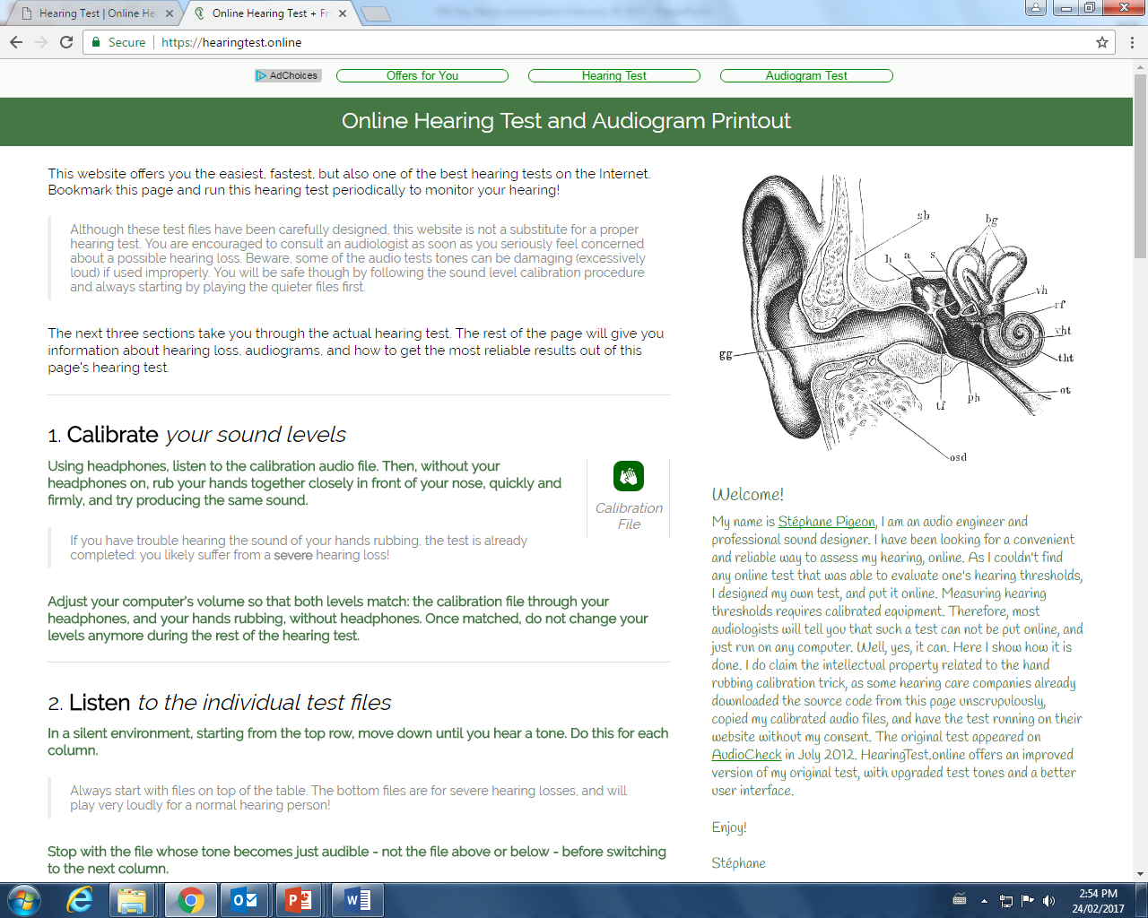
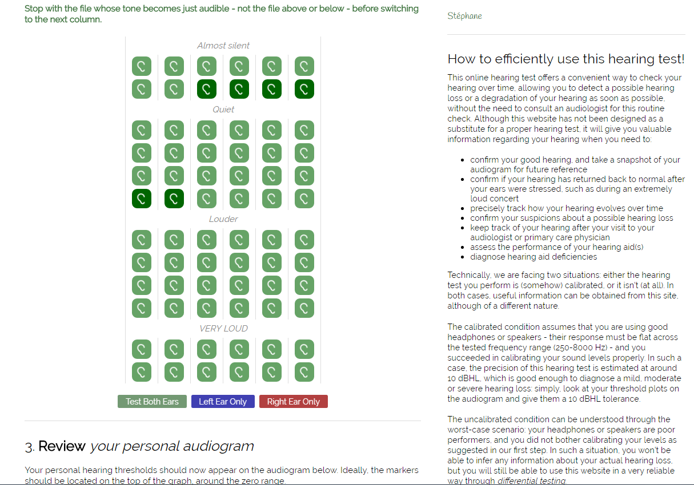
Online Audiometric test:
https://hearingtest.online/

Slide 35
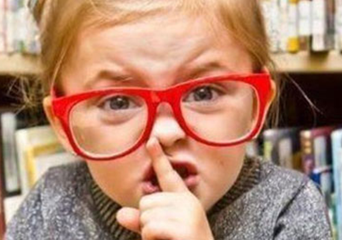

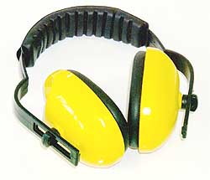
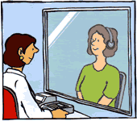
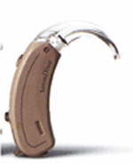
Prevention Opportunities
Best
Good
Temporary
check on effectiveness
of controls
source > path > exposure > target > disease
too late!!
Notes:
at the source ⇒ BEST
eliminate, enclose, silencers, fix, specify
along the path ⇒ GOOD
barriers, curtains, absorbers
at the worker ⇒ TEMPORARY
PPE, audiometry, rotating exposures

Slide 36


“Buy Quiet”
http://www.hse.gov.uk/noise/buy-quiet/index.htm
“To buy quiet in today’s market purchasers need a high level of understanding of noise and noise control and must have a high degree of determination to achieve noise control in their workplace.
Purchasers who successfully buy quiet seek out quieter machines and critically review the noise information supplied with them, which is often flawed.
Such purchasers sometimes need to write, and check conformity with, their own specification for noise.”
Brereton & Patel, “Buy Quiet as a Means of Reducing Workplace Noise”, Acoust Aust DOI 10.1007/s40857-016-0051-x, online Mar 29,2016
http://www.cdc.gov/niosh/topics/buyquiet/

Slide 37

Think about pathways
Two different pathways:
Directly as noise transmitted through air
Structure borne mechanical vibration
Courtesy Gary Foster http://www.fosterohs.com/

Slide 38
Courtesy Gary Foster http://www.fosterohs.com/

Slide 39
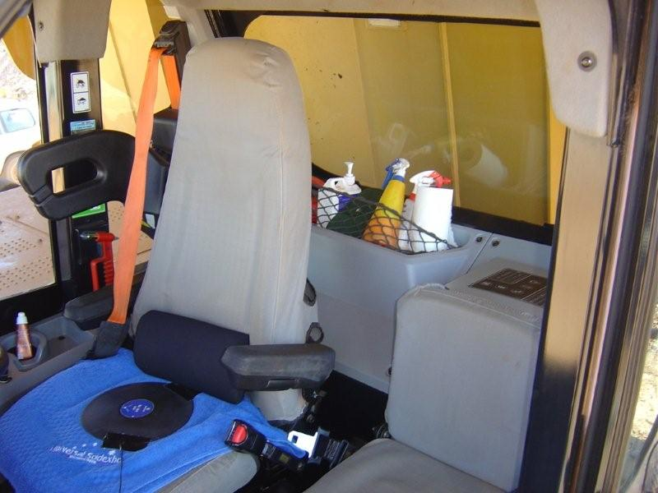
Truck Cabin
Noise through windows, noise through floor and sides, noise through connections, noise through door and window seals
Courtesy Gary Foster http://www.fosterohs.com/

Slide 40
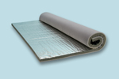

Loaded vinyl – sound blocking & absorption
Courtesy Gary Foster http://www.fosterohs.com/

Slide 41
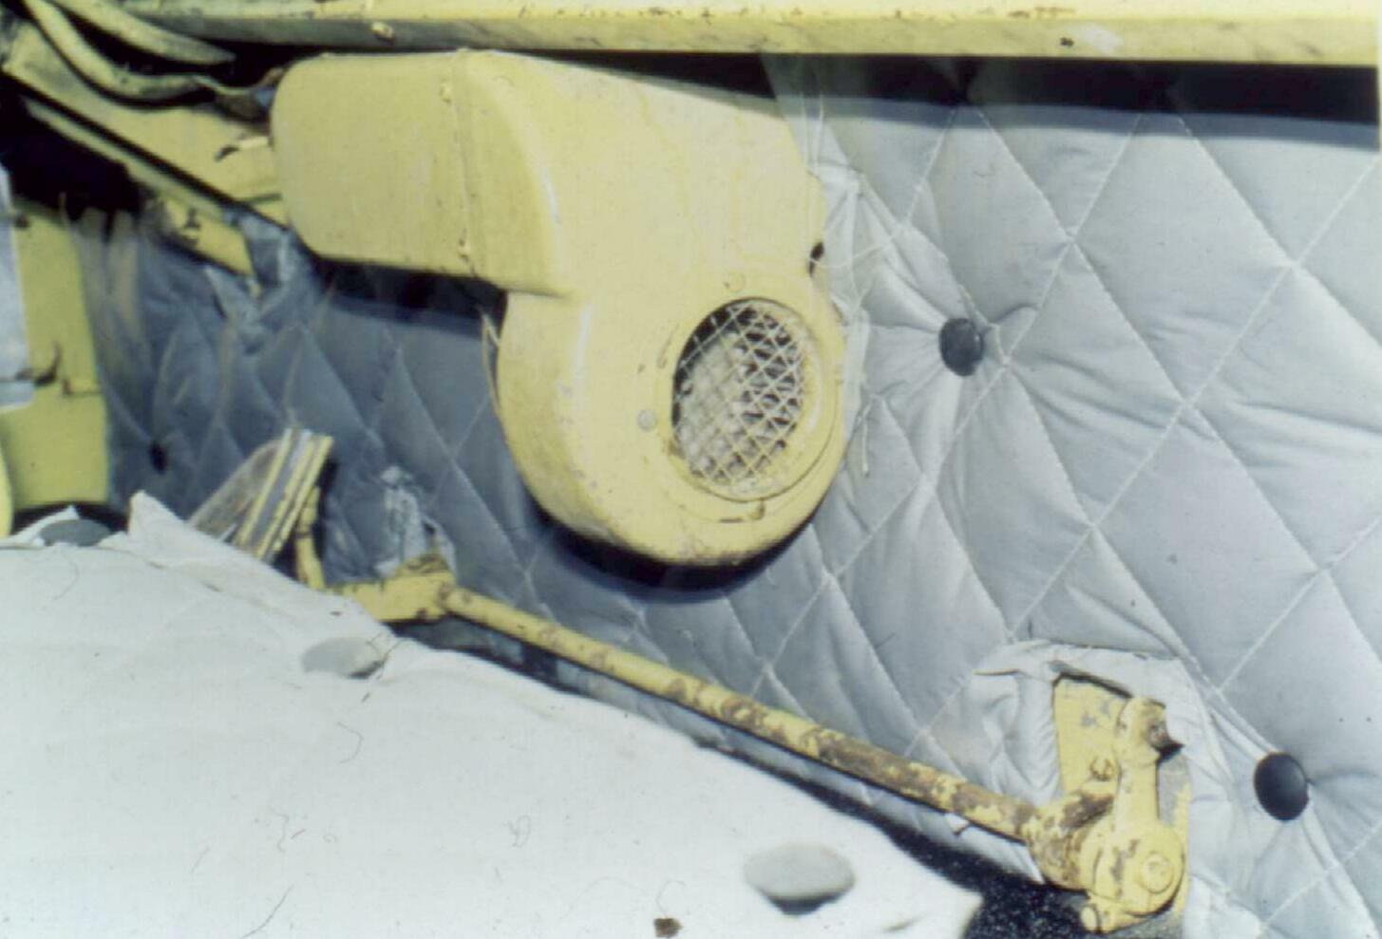
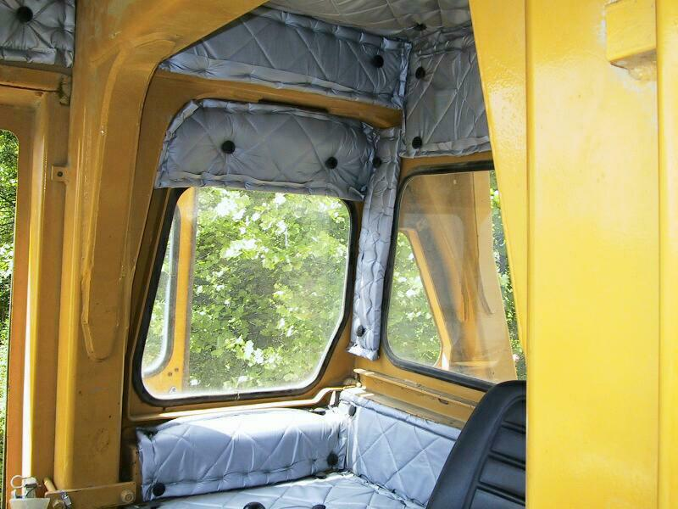
Absorption
Courtesy Gary Foster http://www.fosterohs.com/

Slide 42
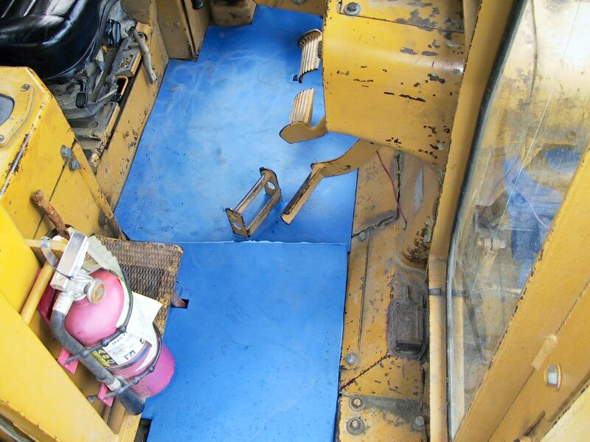
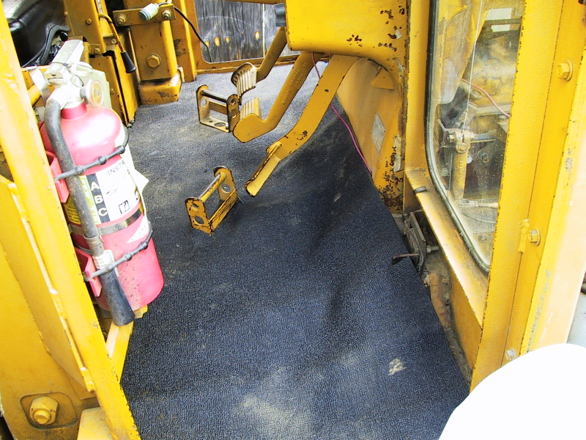
Damping material on floor covered with acoustical floor mat
Courtesy Gary Foster http://www.fosterohs.com/

Slide 43
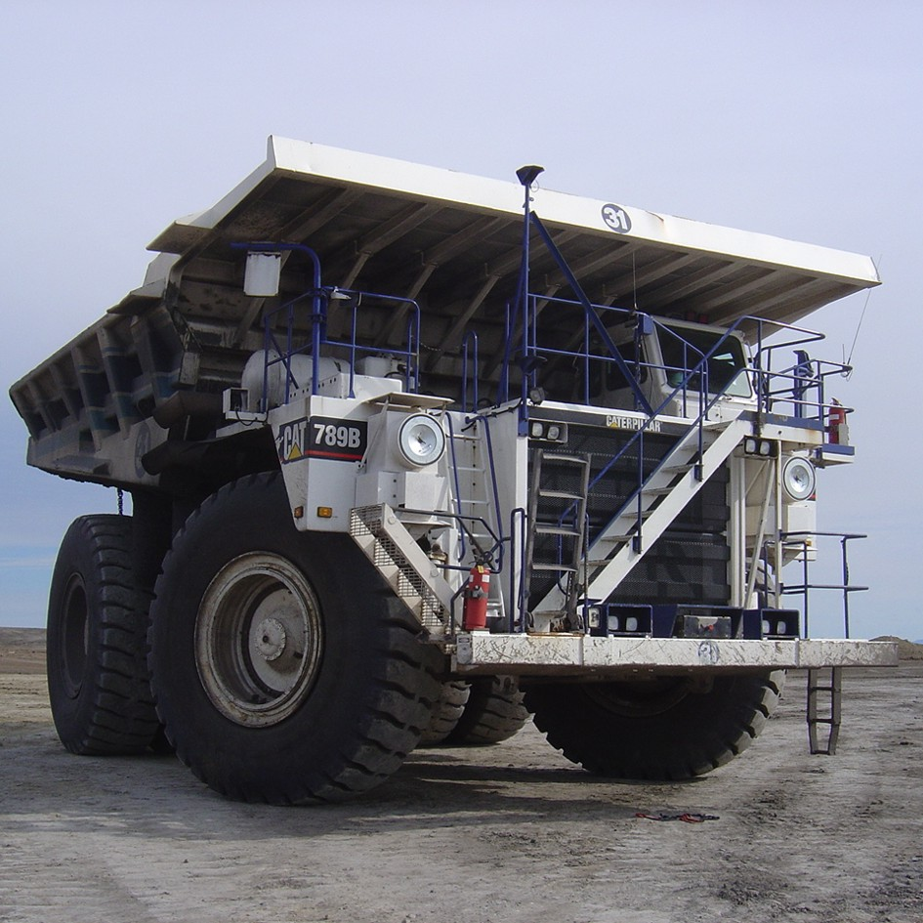
Dump Truck Example
Problem: Internal cab noise of 95 dB. Vehicles have long working life
Solution: Damping pads to resonant surfaces, sound barrier mat to floor and engine bulkhead, line cab with absorptive foam
Result: 11 dB reduction
Courtesy Gary Foster http://www.fosterohs.com/

Slide 44
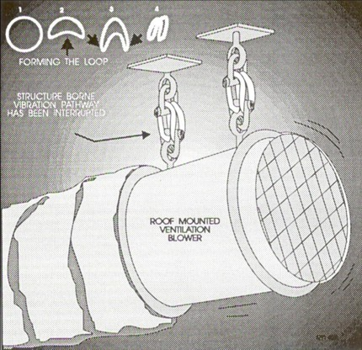
Ceiling mounts
Isolate vibrating surface from pipes and components of machinery from connecting wall or ceiling
Correct selection of isolators is very important
Courtesy Gary Foster http://www.fosterohs.com/

Slide 45
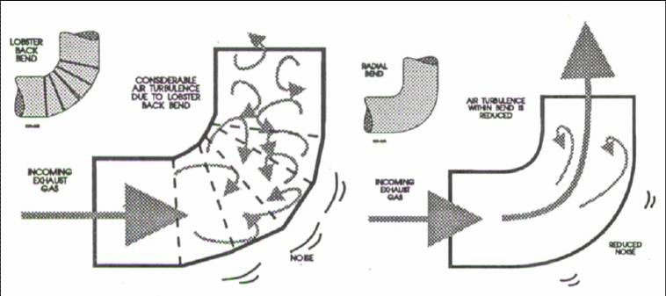
Air turbulence – Control at source
Application of long radius bends to reduce air turbulence in haul truck exhaust
Courtesy Gary Foster http://www.fosterohs.com/

Slide 46
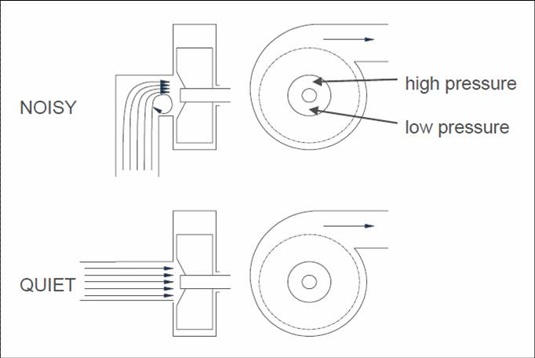
Centrifugal fan installation
Courtesy Gary Foster http://www.fosterohs.com/

Slide 47
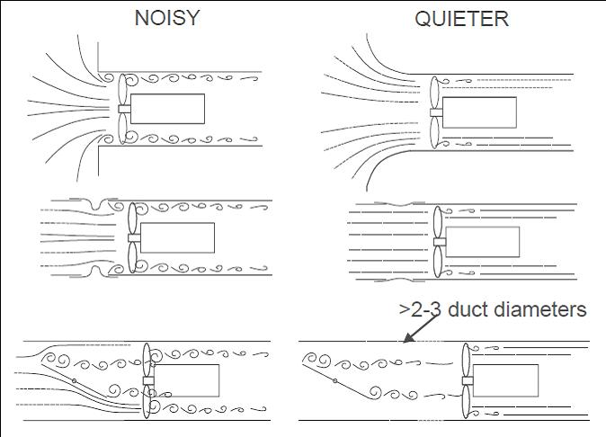
Axial fan installation
Courtesy Gary Foster http://www.fosterohs.com/

Slide 48

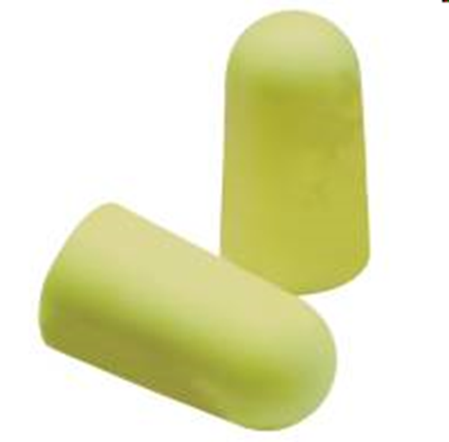
What’s the most common used solution to noise concerns?

Slide 49
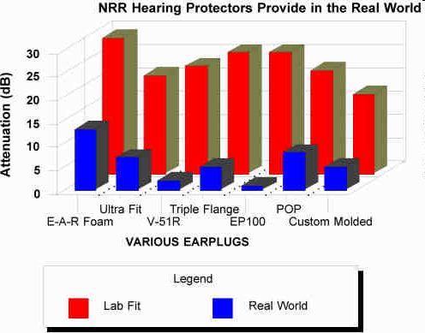
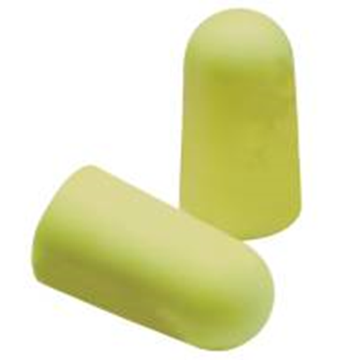
effectiveness of hearing protectors
www.cdc.gov/niosh/docs/96-110/personal.html

Slide 50
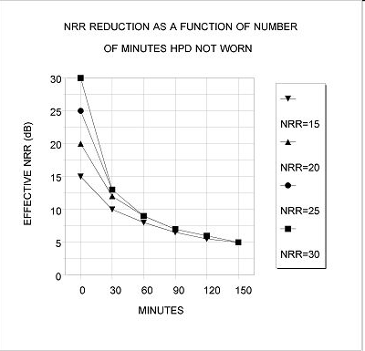

effectiveness of hearing protectors
13 dB

Slide 51

Whatever way you look at it, this is not the permanent solution!

Slide 52
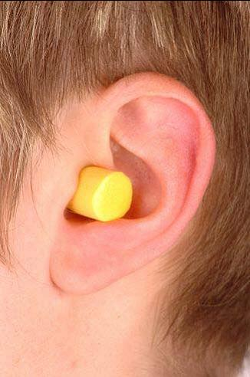
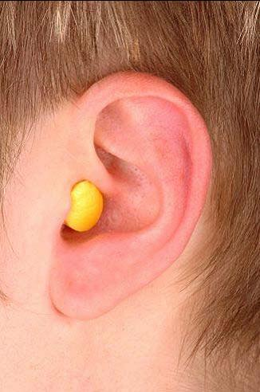

Slide 53
In any case an effective fit should be shown!

Slide 54
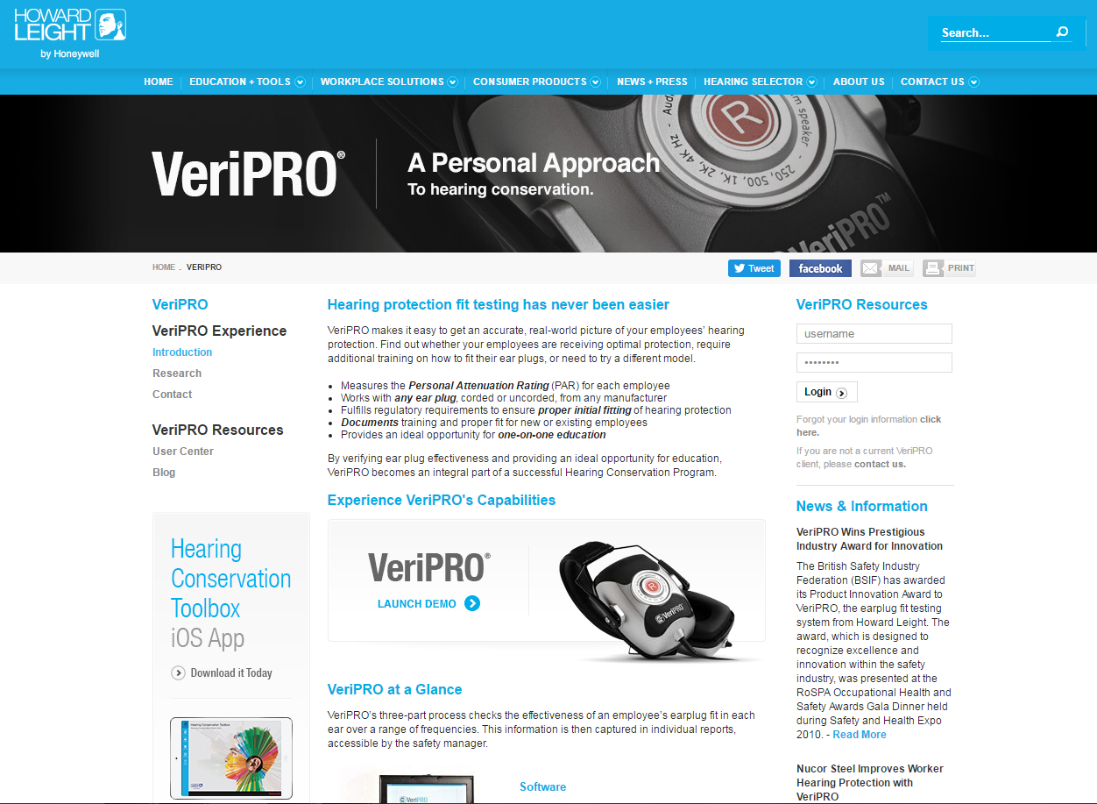
Fit testing of ear plugs
https://www.howardleight.com/veripro

Slide 55
Crowd-source dB(A) levels:
International Noise Awareness Day (last Wednesday in April (April 26, 2017))
Make it known (social media?)
Coordinate data collection; e-mail your results to:
    Supervisor, H&S rep,
    Union,
    OHCOW,
    MOL?
    Your Regulator
By April 26 2017 OHCOW will have a survey available
on the web http://www.ohcow.on.ca/
    location, job, firm, noise sources, number of workers exposed, time exposed
    levels over 85 dBA (what about 80 dBA?)
    is there a sign up?
    type of hearing protection? how often used? training?
    have engineering controls been considered (provide list)?
    audiometric testing?

Slide 56
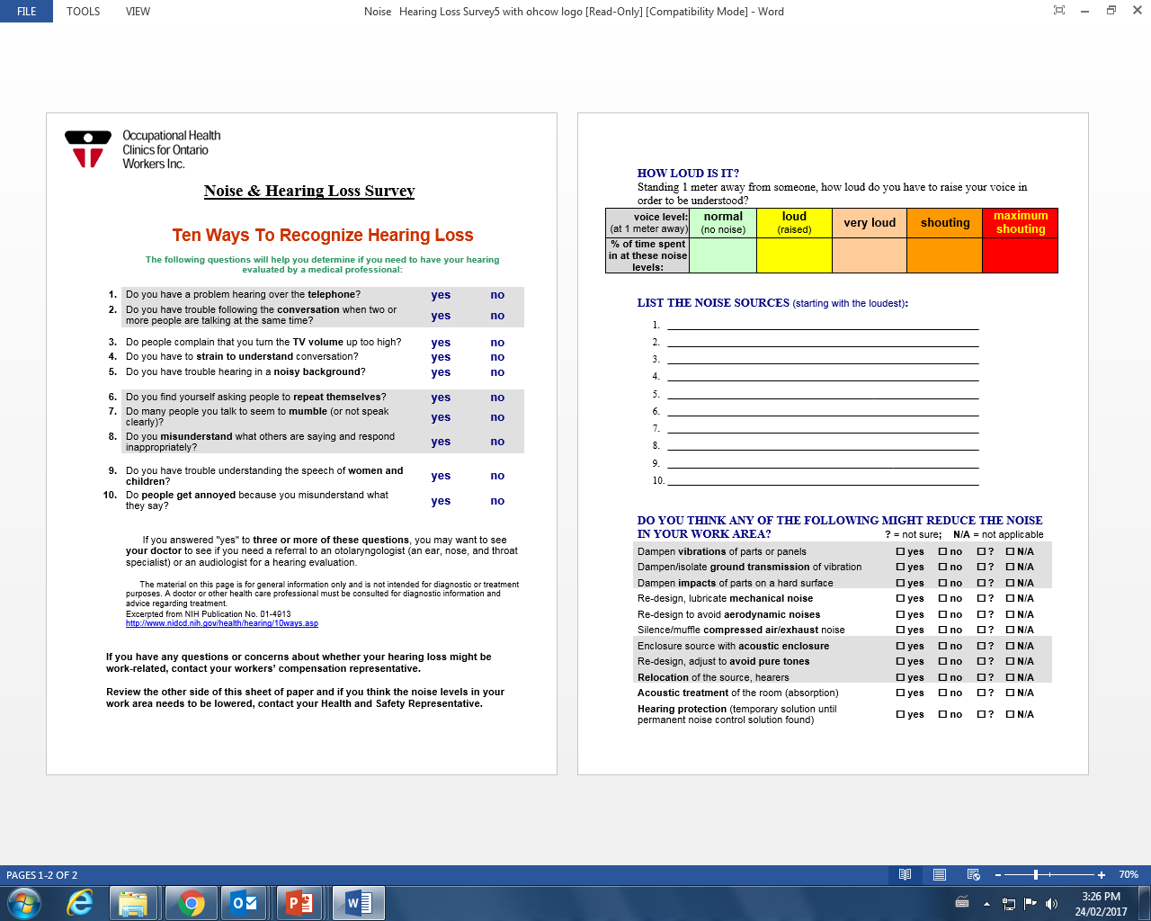
Adapted from: Hearing Loss and Older Adults NIH Publication No. 01-4913 March 2016

Slide 58
Periodic assessment of HLPP performance
(Visual inspection CSA – Z1007-16, annex j, p.101 - suggested)
Criteria | Yes | No | If no, action or modification
All equipment appears to be operating normally compared to the last inspection.
The condition of the existing noise controls is good and they are effective.
All signs designating noise areas are in place and visible.
Workers appear to be wearing their HPDs properly inserted and at all times when in hazardous noise areas.
Controls, whether administrative or engineering, are in place and operating as designed.

Slide 59
Periodic assessment of HLPP performance
(Worker interviews CSA – Z1007-16, annex j, p.101 - suggested)
Criteria | Yes | No | If no, action or modification
Tell me about a change to production methods, equipment, operating conditions or hours of operation that might affect noise exposure.
Have any changes in noise levels been noted? What are they?
Have any of the noise controls failed to operate as usual?
Have any of the HPDs being used interfered with other PPE or communication?
Is the hearing protection being worn comfortable?
Was training regarding noise and the potential for hearing loss provided and understood?
Were the results of the most recent audiometric test results and recommendations provided in writing? (Do not let them simply say that they know them?)

Slide 60
Overall Program Evaluation
Australian / New Zealand Standard AS/NZS 1269 provides comprehensive checklists that are useful to help meeting the requirements of the standard.
AS/NZS 1269.0 (2016) | Occupational Noise Management | Audit / assessment checklists
AS/NZS 1269.1 (2016 reconfirmed) | Measurement and assessment | √
AS/NZS 1269.2 (2005) | Noise control | √
AS/NZS 1269.3 (2016 reconfirmed) | Hearing protector program | √
AS/NZS 1269.4 (2014) | Auditory assessment | √
AS1269.0 “Audit each part of the overall program at least (annually)

Slide 61
Any one can screen for noise - everyone is responsible!
It is about noise control - preferably at source.
Don’t forget International Noise Awareness Day Wednesday, April 26, 2017 - OHCOW will have a noise data collection app. available by then.

Slide 62
Additional resources links:
Organisation | Information and link
Canadian Centre for Occupational Health and Safety (CCOHS) | Canadian legislative context
WorkSafeBC | Noise
Health Canada | Recommendation on buying quiet equipment
NIOSH | Noise and hearing loss prevention
NIOSH | Controls for noise exposure
NIOSH | Protecting workers that are exposed to exceptionally high noise levels (Firing Ranges)
IRRST | IRRST Report R-747, Effect of chemical substances on hearing – interactions with noise
Institut National de Santé Publique du Québec | Effects of Workplace Noise during Pregnancy (French)
Safe Work Australia | Managing Noise and Preventing Hearing Loss at Work
AIOH | Position paper – Occupational Noise and its Potential for Health Issues
Howard Leight | The VeriPRO system
3M | Hearing Conservation
3M | 3M™ E‐A‐Rfit™ Validation System

Slide 63
Questions?
Kevin Hedges, CIH, COH
email: khedges@ohcow.on.ca
Occupational Hygienist – Sudbury ON, Canada
OHCOW

