Slide 1
IAQ and Noise tools
Masood Ahmed MS, CIH, CRSP
Occupational Hygienist
OHCOW – South Central/Hamilton

Slide 2
THERMAL
COMFORT
(temp, RH, temp
fluctuations)
2. VENTILATION
(outdoor air intake,
air movement)
CHEMICAL
CONTAMINANTS
(from inside or outside)
7. PERSONAL
FACTORS
(age, sex, allergies,
smoking)
4. BIOLOGICAL
CONTAMINANTS
(allergens)
HOW I FEEL AT WORK
IN MY BUILDING
5. ERGONOMIC
FACTORS
(lighting, noise,
workstation design)
6. WORKPLACE
STRESS
(job content, pace,
control, support)

Slide 3
IAQ starts with symptoms:
Increased prevalence of non-specific, common symptoms:
  headache
  fatigue
  irritated eyes, nose, throat and/or skin
  symptoms clear when away from building
commonly called “Sick Building Syndrome” (SBS)
but more accurately referred to as “building related non-specific symptoms” (BRS) or specifically (e.g. mucous membrane irritation)

Slide 4
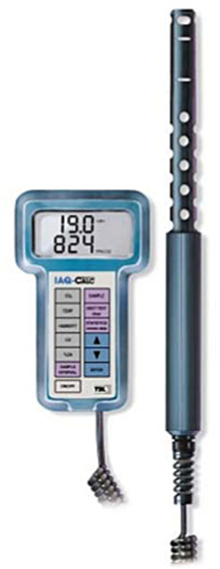
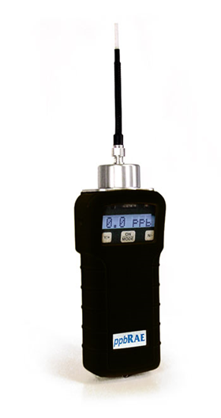
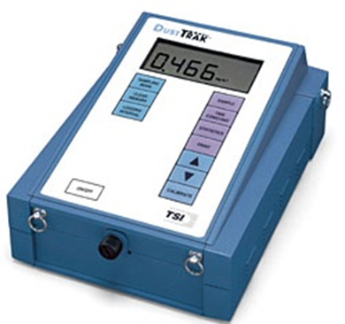
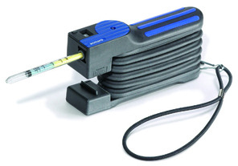
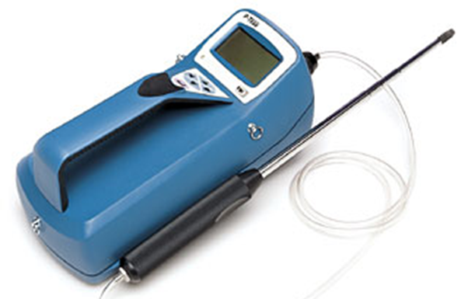
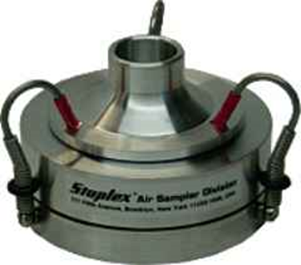
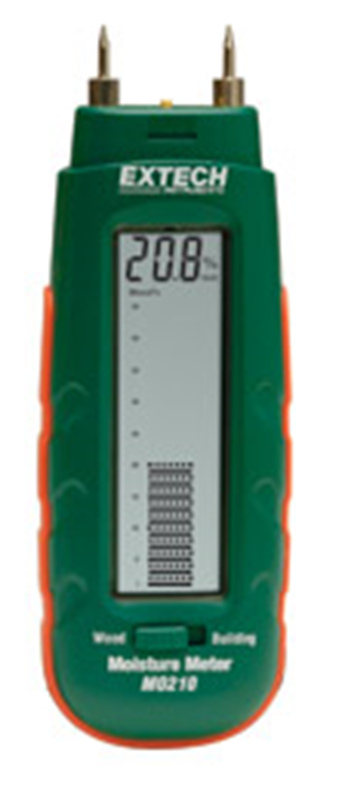
How do you measure this?

Slide 5
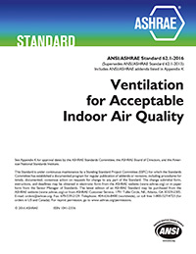
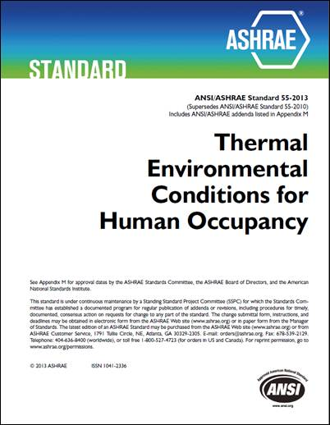
What’s the “gold standard”?
ASHRAE 62.1-2016 “Ventilation for Acceptable Indoor Air Quality” states:
3. ”acceptable indoor air quality: air in which there are no known contaminants at harmful concentrations as determined by cognizant authorities and with which a substantial majority (80% or more) of the people exposed do not express dissatisfaction.”
ASHRAE Standard 55-2013 “Thermal Environmental Conditions for Human Occupancy” states:
3. “environment, acceptable thermal: a thermal environment that a substantial majority (more than 80%) of the occupants find thermally acceptable.”

Slide 6
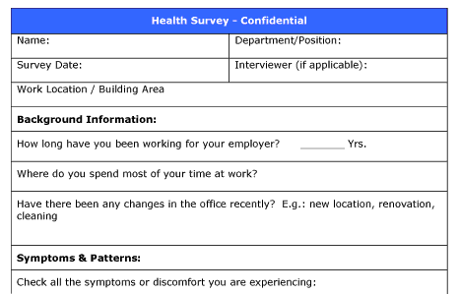
OHCOW’s experience with IAQ surveys:
In 1993 we tried using the Ontario Ministry of Labour’s IAQ questionnaire – (1987? - 6 pages)
Also tried the NIOSH survey developed for an investigation of the Library of Congress – Madison Building (January 1991) (11 pages)
Found the Kjell Andersson’s MM-040 Indoor Climate (1988 - 2 page) – preferred because it was the shortest
Since 1993 we have used the survey in over 120 buildings and collected over 7000 surveys
Currently have a version available through SurveyMonkey along with a spreadsheet that produces an automated report
http://www.ccohs.ca/oshanswers/chemicals/iaq_intro.html

Slide 7
Survey Instrument & Methodology:
http://www.mmquestionnaire.se/mmq/mmq.html
use Swedish “MM-040 Questionnaire”:
      Andersson K., and Fagerlund I., “Questionnaire as an Instrument when Evaluating Indoor Climate”, Healthy Buildings ’88, Vol 3 p139-145 (1988)
compare with data for buildings without air quality problems (206 respondents):
      Hill B., Craft B., and Burkart, J., “Carbon Dioxide, Particulates and Subjective Human Responses in Office Buildings Without Histories of Indoor Air Quality Problems”, Appl Occup Environ Hyg J 7:101-111 (1992)

Slide 8
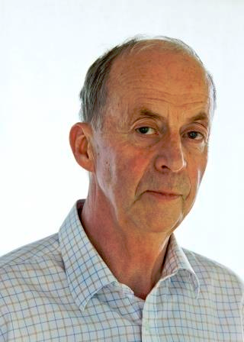
Kjell Andersson
“Kjell Andersson, Doctor and Civil Engineer, Miljömedicin MM Konsult AB
Kjell is a specialist in Occupational and Environmental Medicine and has mainly worked with indoor air issues and risk communication.
He worked over 27 years in the Medical Service of Environmental Medicine and Epidemiology at the Environmental Medicine Development at the Örebro University Hospital.
Kjell worked with method development and education and is behind the development of the so-called Örebro Forms for mapping indoor environments.”
http://www.swegonairacademy.com/author/kjell-andersson/

Slide 9
MM-040 Contents:
Background factors (demographics)
Work environment (12)
Work conditions (stress – stimulating work, workload, influence, help from co-workers)
Health Conditions (asthma, hay fever, eczema)
Present symptoms (12 + “other”)

Slide 10
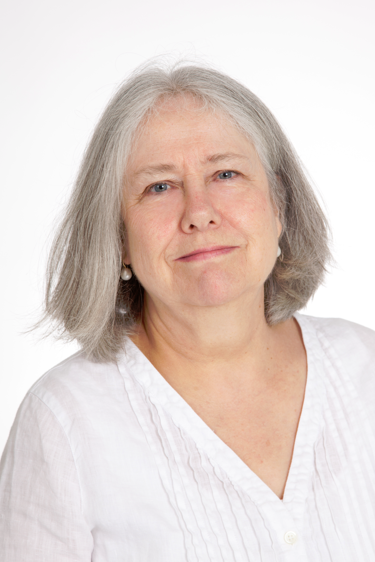
Asthma Symptom Screening:
We added a validated set of asthma screening questions put together by Kate Venables et al., “Respiratory Symptoms Questionnaire for Asthma Epidemiology: Validity and Reproducibility”, Thorax 48:214-219 (1993)
http://www.stx.ox.ac.uk/people/fellow/dr-katherine-venables

Slide 11
Asthma Screening Questions:
During the last four (4) weeks: | Yes | No
If you run, or climb stairs fast do you ever cough? wheeze? get tight in the chest? |  ₁  ₁  ₁ |  ₂  ₂  ₂
Is your sleep ever broken by wheeze? difficulty with breathing? |  ₁  ₁ |  ₂  ₂
Do you ever wake up in the morning with wheeze? difficulty with breathing? |  ₁  ₁ |  ₂  ₂
Do you ever wheeze if you are in a smoky room? if you are in a dusty place? |  ₁  ₁ |  ₂  ₂

Slide 12
MM-040 stress vs. JCQ
In order to use the demand/control dimensions we used the MM-040 questions and correlated them with the OHCOW JCQ survey results (used JCQ since 2000)
Robert Karasek did not want us to include any of the JCQ questions
MM-040 “too much work” question correlated with the JCQ demands scale (r = 0.55 for females; r = 0.49 for males)
A combination of the MM-040 “influence”+ “interesting work” questions correlated with the JCQ latitude/ control scale (r = 0.55 for females; r = 0.59 for males)

Slide 13
JCQ Theory:
active learning,
motivation to develop
new behaviour patterns
LOW STRAIN
ACTIVE
PASSIVE
HIGH STRAIN
risk of psychological strain
and physical illness
Source: http://www.workhealth.org/strain/jsdef2.html

Slide 14
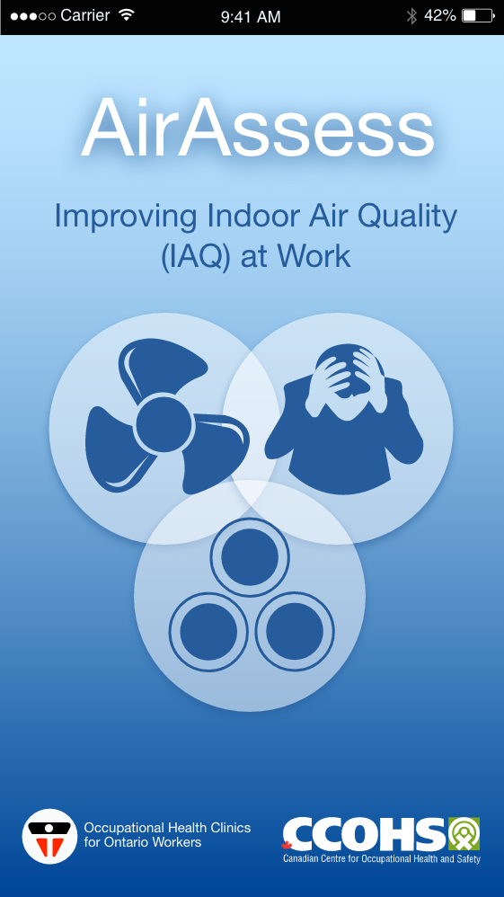
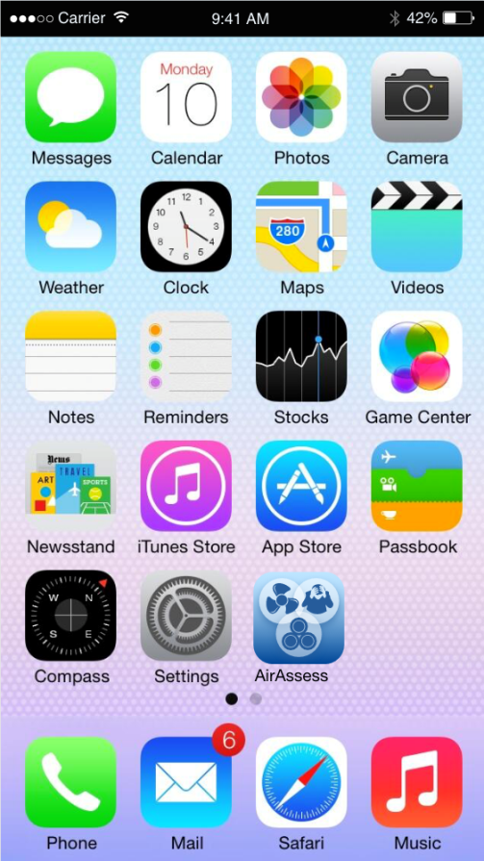

Here’s how it works:

Slide 15
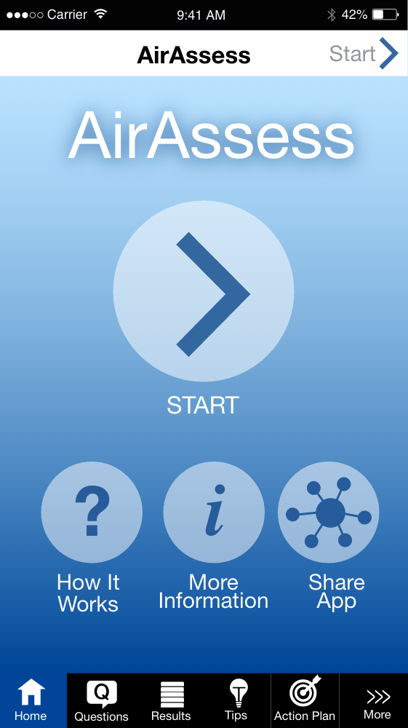
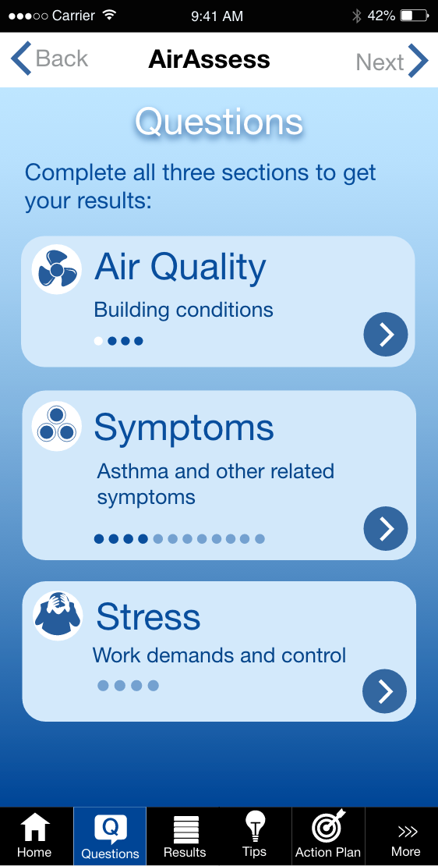

Slide 16
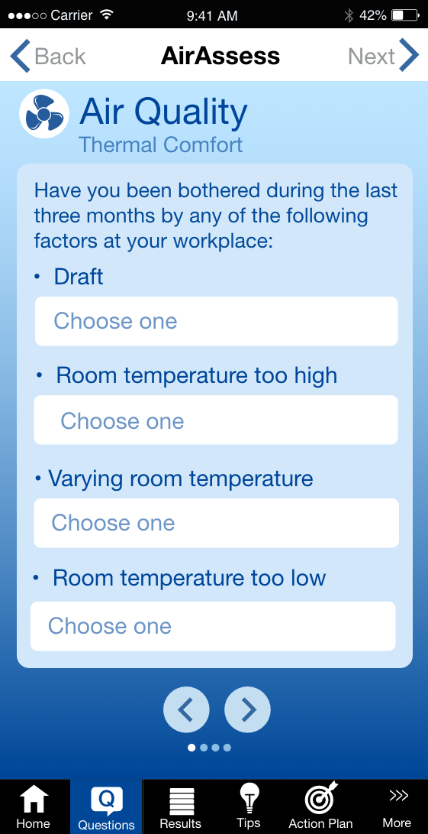
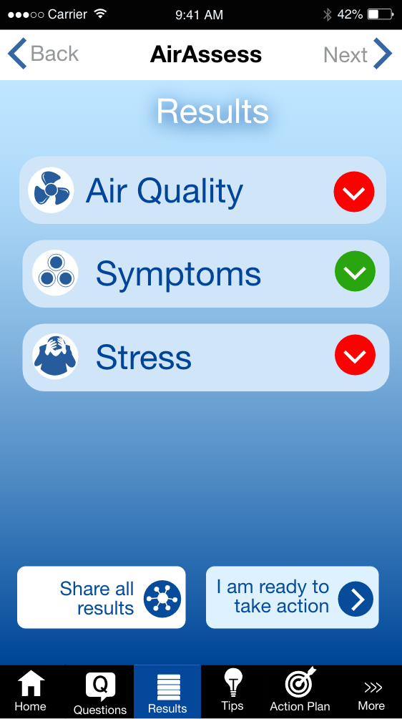

Slide 17
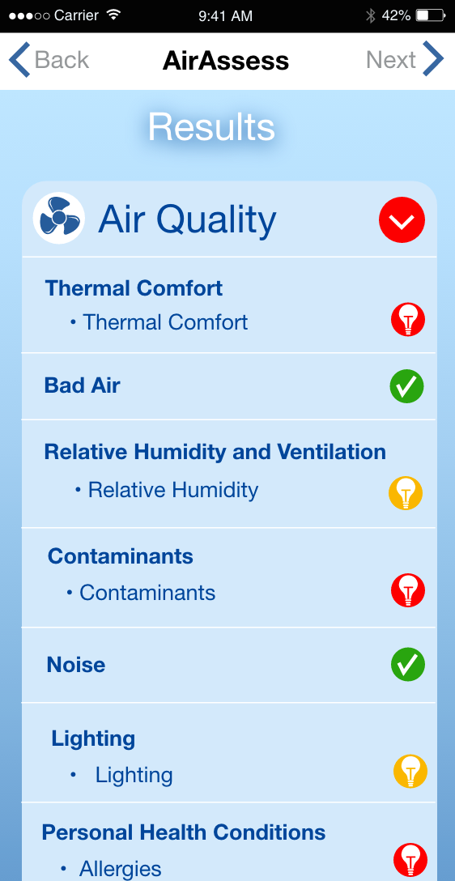
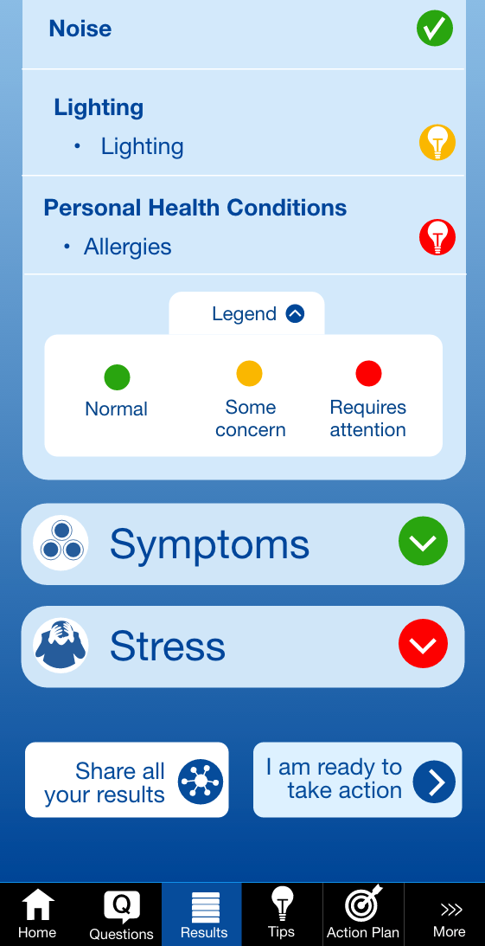

Slide 18
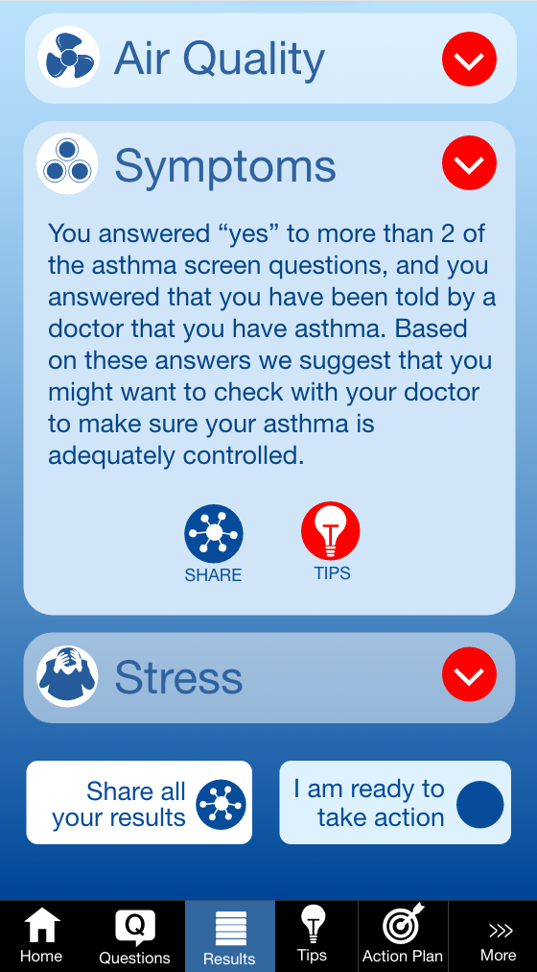
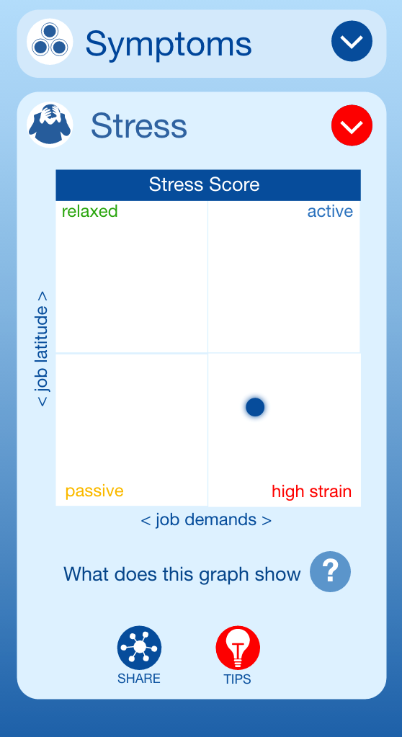

Slide 19
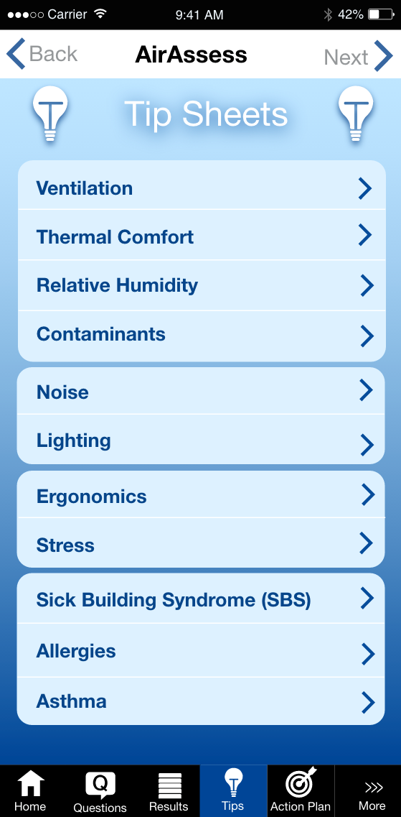

Slide 20
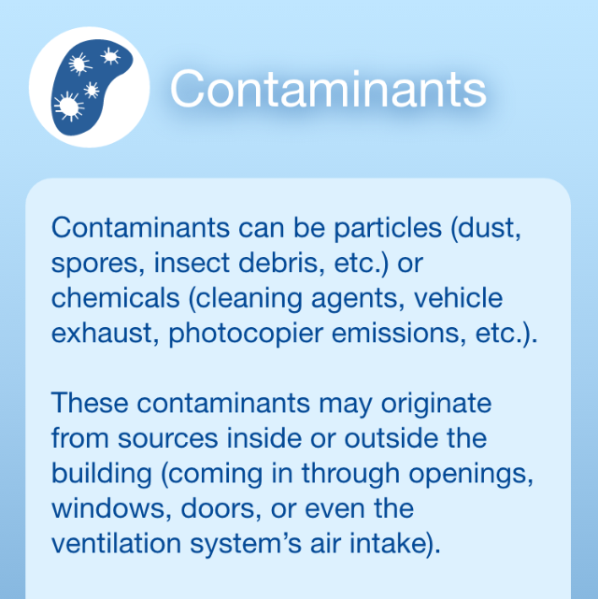
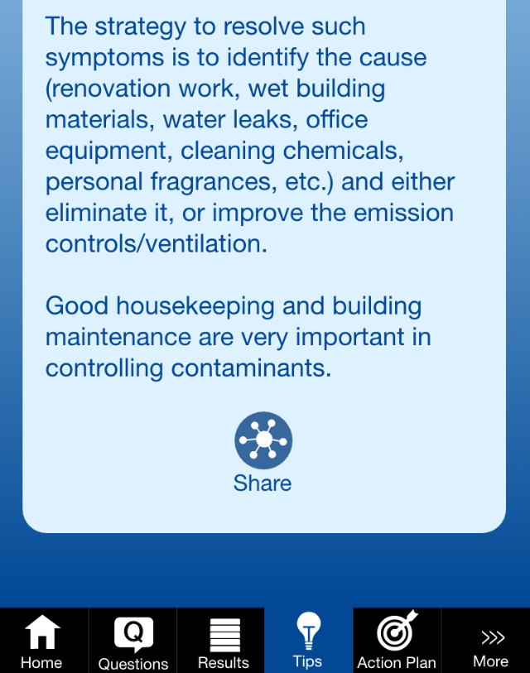
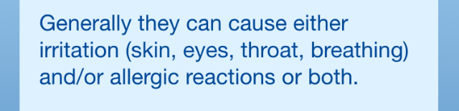

Slide 21
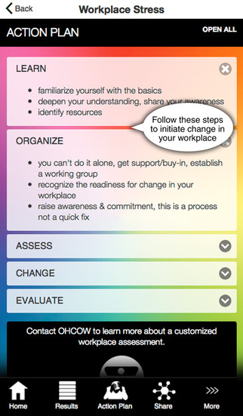
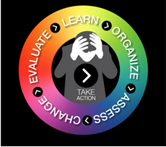
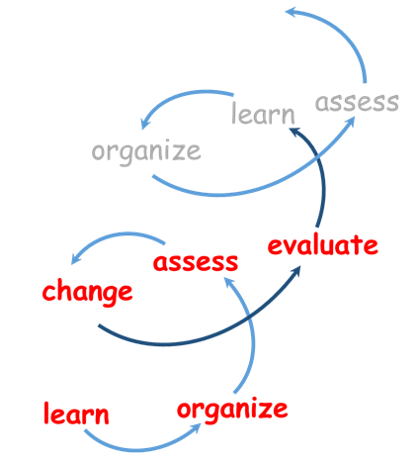

Slide 22
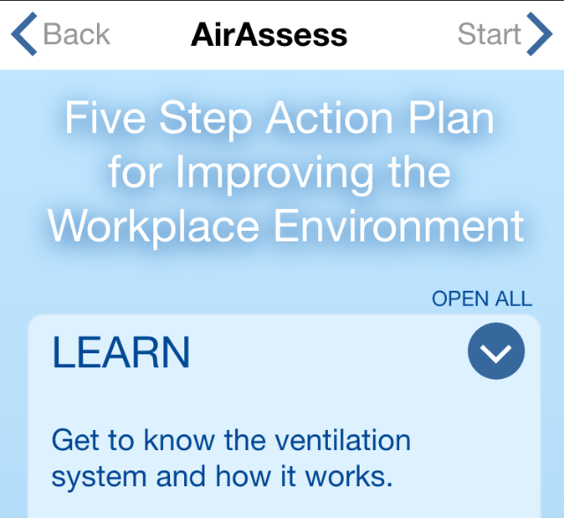
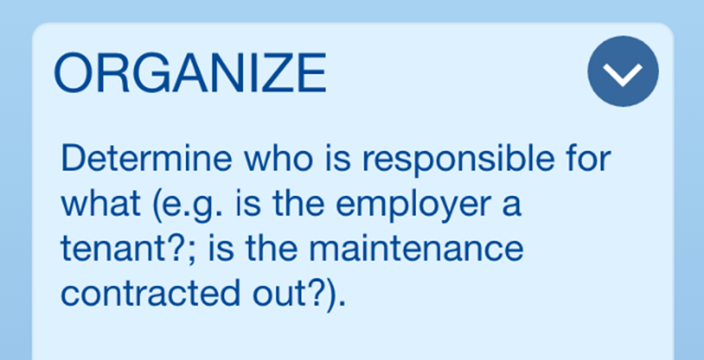
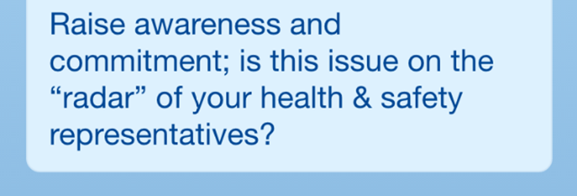
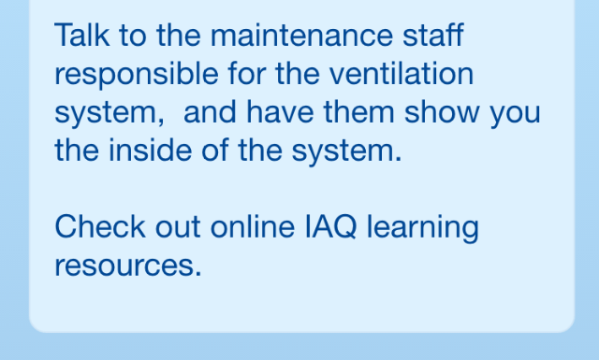

Slide 23
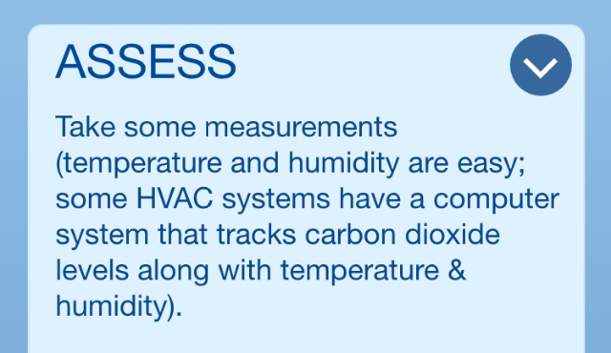
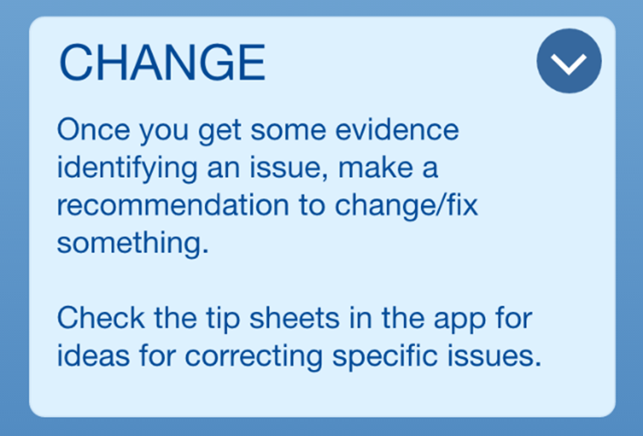
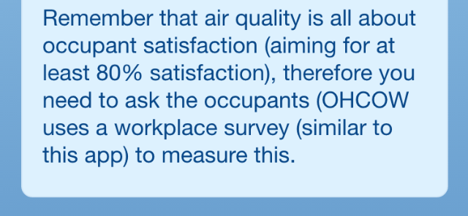

Slide 24
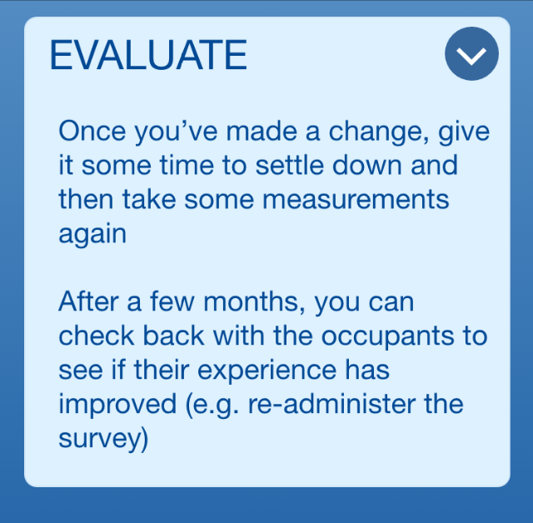
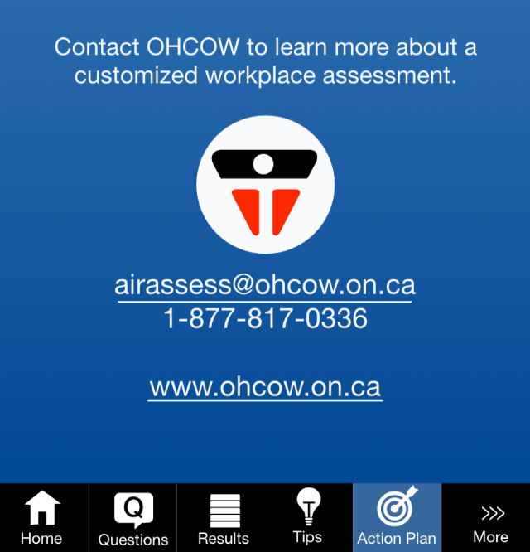

Slide 25
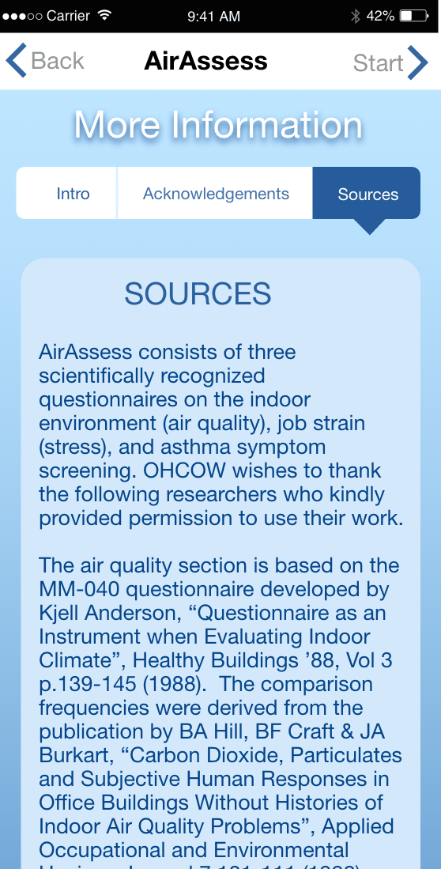
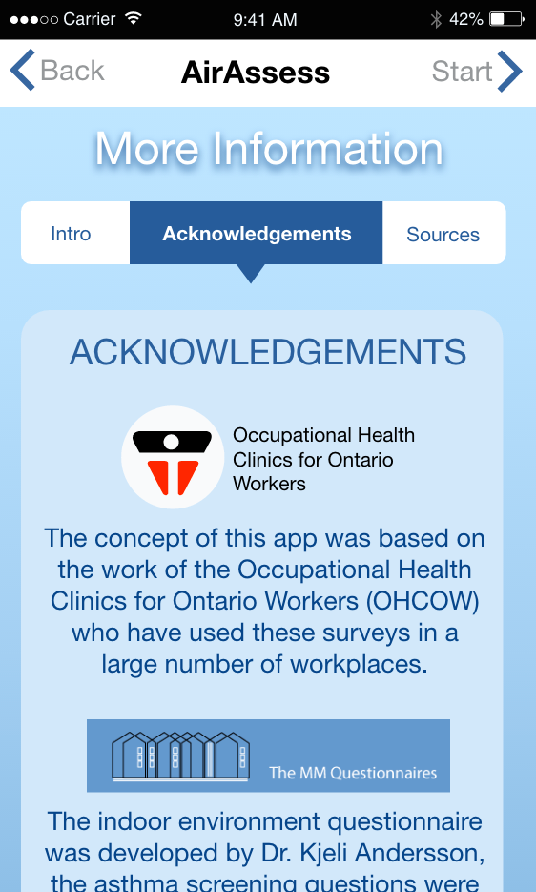

Slide 26

Preventing Noise-Induced
Hearing Loss
Say what?!?

Slide 27

stats
“last five years, the annual costs for noise induced hearing loss claims for all sectors in Ontario exceeded $50 million per year,” (MOL 2014)
the WSIB showed a steady increase in NIHL registered claims from 3653 claims in 2005 to 5416 claims in 2009 (WSIB, 2011)
Masterson et al. (2013) found 18% of 1,122,722 worker audiograms collected from the NIOSH OHL Surveillance Project met the NIOSH criteria for NIHL
Stekelenburg (1982) noted that: “… even if 80 dBA is taken as a time weighted average limit … 10% of the exposed population will not be protected against impaired social hearing caused by noise.” (page 408)

Slide 28
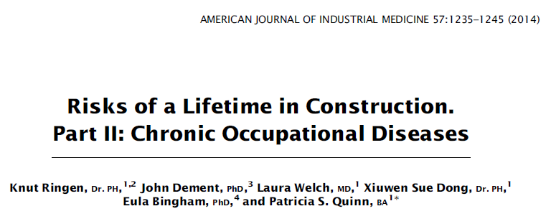
“Over a 45-year working life,
  16% of construction workers developed COPD,
  11% developed parenchymal radiological abnormality, and
  73.8% developed hearing loss.”

Slide 29
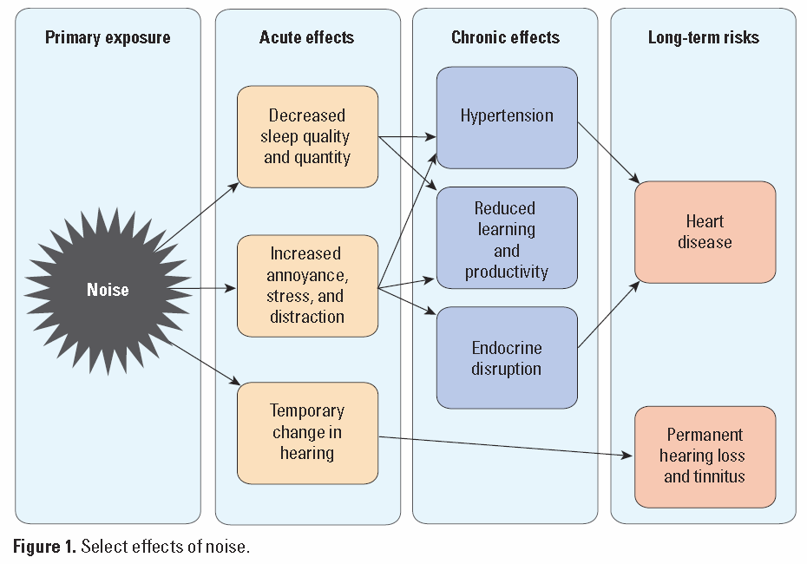
Vocal Cord Nodules - teachers
http://ehp.niehs.nih.gov/1307272/

Slide 30

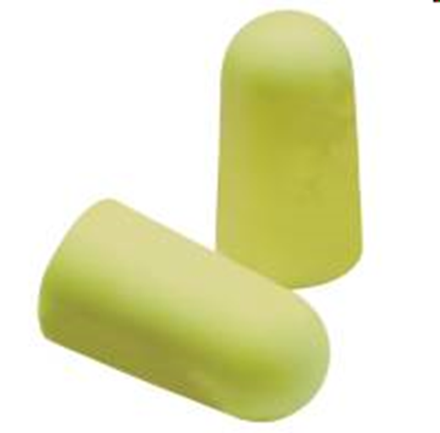
What’s the most common used solution to noise concerns?

Slide 31
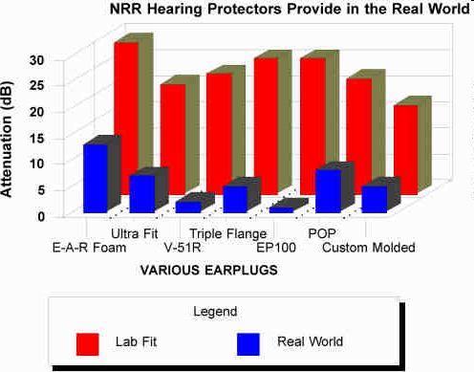
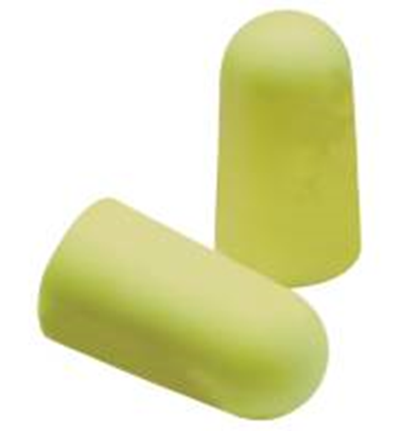
effectiveness of hearing protectors
www.cdc.gov/niosh/docs/96-110/personal.html

Slide 32
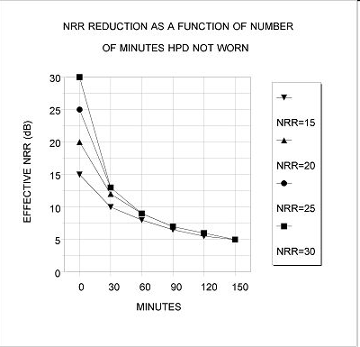

effectiveness of hearing protectors
13 dB

Slide 33

Whatever way you look at it, this is not the permanent solution!
… nor even a very effective temporary one.

Slide 34


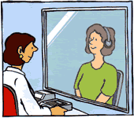
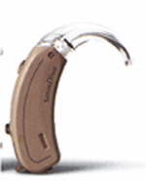
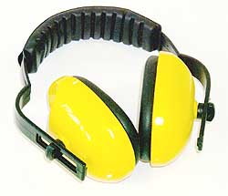
Prevention Opportunities
Best
Good
Temporary
check on effectiveness
of controls
source > path > exposure > target > disease
too late!!
Notes:
at the source ⇒ BEST
eliminate, enclose, silencers, fix, specify
along the path ⇒ GOOD
barriers, curtains, absorbers
at the worker ⇒ TEMPORARY
PPE, audiometry, rotating exposures

Slide 35
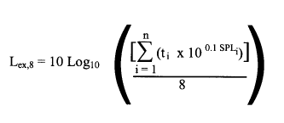
Noise Legislation: O.Reg. 381/15
employers take all measures reasonably necessary in the circumstances to protect workers from exposure to hazardous sound levels.
protective measures against noise exposure include engineering controls, work practices and personal protective equipment.
assessment of noise levels shall be done without regard to any use of personal protective equipment.
every employer shall ensure that no worker is exposed to a sound level greater than an equivalent sound exposure level of 85 dBA, L_{ex,8}.

Slide 36

solution: on-line calculator …
http://www.ohcow.on.ca/edit/files/general_handouts/noisecalculator.xls

Slide 38

Who can measure?

Slide 42

anyone can measure noise …
NIOSH has reviewed various noise measurement apps and found that some do a reasonable job of measuring sound (and some not so reasonable)
e.g. SPLnFFT (US$5.49)
http://www.cdc.gov/niosh/surveyreports/pdfs/349-12a.pdf
https://itunes.apple.com/ca/app/splnfft-noise-meter/id355396114?mt=8
https://www.youtube.com/watch?v=jGVN7m3Wd1M

Slide 43

SoundMeter App
https://itunes.apple.com/ca/app/soundmeter/id287615105?mt=8

Slide 44
app to measure reverberation
RevMeter Pro – an app to estimate the reverberation time in a room (≈ $7)
ANSI S12.60-2002. Acoustical Performance Criteria, Design Requirements, and Guidelines for Schools
  “Unoccupied classroom levels must not exceed 35 dBA
  The signal-to-noise ratio should be at least +15 dB
  Unoccupied classroom reverberation must not surpass 0.6 seconds in smaller classrooms or 0.7 seconds in larger rooms”
http://www.asha.org/public/hearing/American-National-Standard-on-Classroom-Acoustics/
https://itunes.apple.com/ca/app/revmeter-pro/id357421594?mt=8

Slide 45

whole body vibration app
free app which measures whole body vibration (WBV)
well researched with published study to show validity
i-Tunes store search for WBV
https://itunes.apple.com/ca/app/wbv/id797629017?mt=8

Slide 46

Online Audiometric test:
http://hearingtest.online/

Slide 47


Slide 48
Crowd-source dB(A) levels:
pick a date: how about International Noise Awareness Day (last Wednesday in April (April 26, 2017))
make it known (social media?)
coordinate data collection; e-mail your results to:
    supervisor, H&S rep,
    union,
    OHCOW,
    MOL?
create a form to accompany measurements:
    location, job, firm, noise sources, number of workers exposed, time exposed
    levels over 85 dBA (what about 80 dBA?)
    is there a sign up?
    type of hearing protection? how often used? training?
    have engineering controls been considered (provide list)?
    audiometric testing?

Slide 49
Questions? mahmed@ohcow.on.ca

