Slide 1

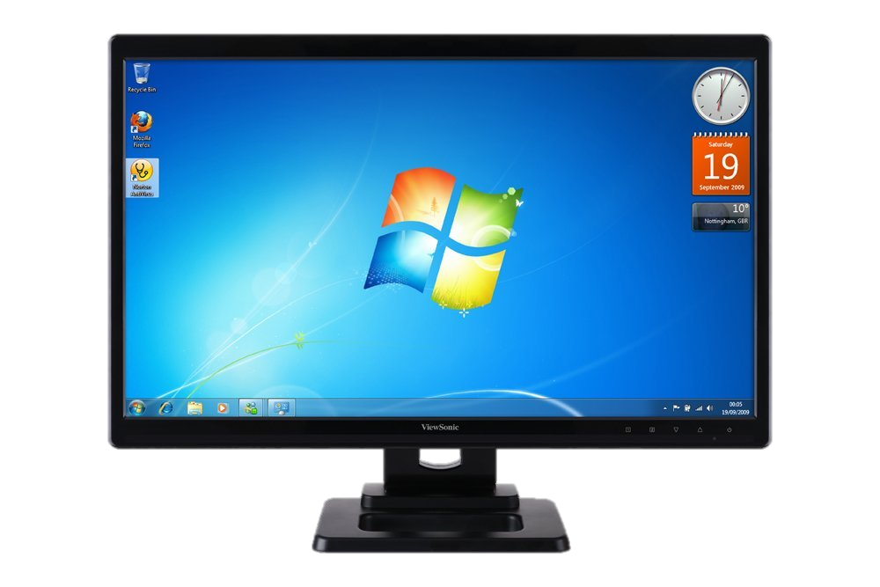
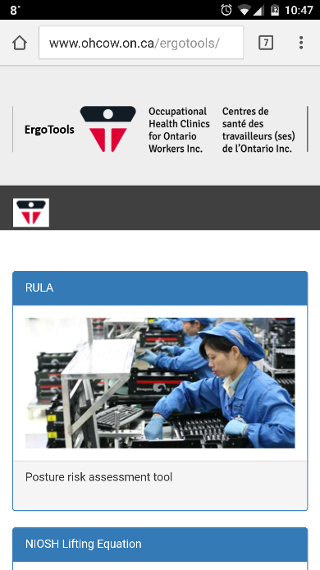
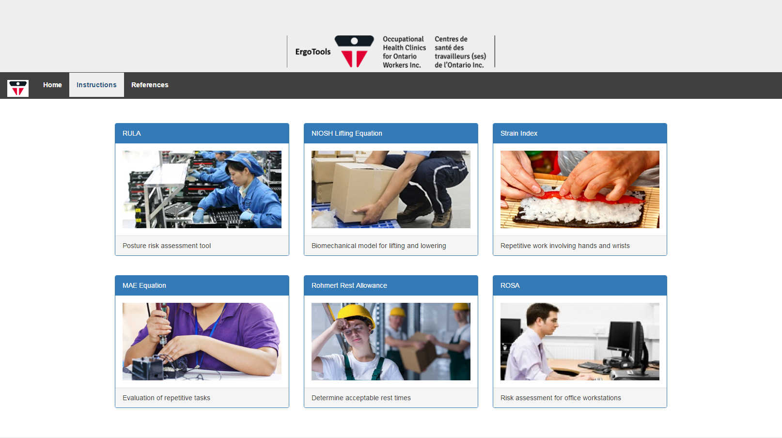
ErgoTools: Desktop and Mobile Applications for MSD Prevention
Mike Sonne, PhD, CCPE
Ergonomist
Occupational Health Clinics for Ontario Workers,
Hamilton, ON

Slide 2
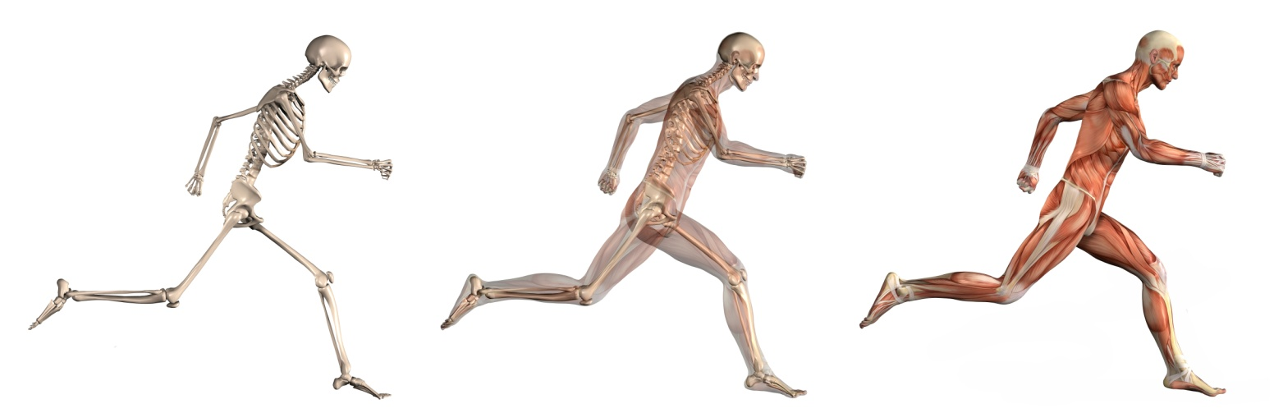
What is an MSD?
Your body is made up of muscles, tendons, nerves, joints, spinal discs and other tissues. This is the musculoskeletal system.
When you injure a part of this system as a result of particular workplace hazards it is called a Musculoskeletal Disorder or MSD.
Image Source: Istockphoto.com

Slide 3
The Most Common Type of Injury in Ontario
Cost Ontario workplaces $1.2 Billion per year
MSDs account for 44% of injuries where a worker missed work
Preventing MSDs means more employees go home healthy and safe at the end of the day
$1.2 Billion
44%

Slide 4
MSD Hazards
Duration
Awkward/Fixed
Posture
Repetition
Force
Notes:
Gather workplace specific examples of force, repetition and posture to share with participants as needed:
Force :
Repetition:
Posture :
Secondary Hazards:

Slide 5

Ergonomics Tools
Pen and Paper
Desktop Only
RULA
ROHMERT
ROSA
STRAIN INDEX
MAE
NIOSH

Slide 6


Presenting: ErgoTools!
Combination of 6 commonly used Ergonomics tools
RULA
ROSA
MAE Equation
Rohmert Rest Allowance
Strain Index
NIOSH Lifting Equation
Works well on desktops, as well as cell phones and tablets
Give a preliminary idea into if jobs are acceptable for known MSD prevention standards

Slide 7
ErgoTools - Use
Tools require some training – targeted at ergonomists, or JHSC members with ergo training
Can be used to do screening assessments: ROSA Example

Slide 8
ErgoTools - ROSA
The Rapid Office Strain Assessment – Allows a quick evaluation of the office workstation, provides a 1-10 scale representing risk level (10 is higher)

Slide 9
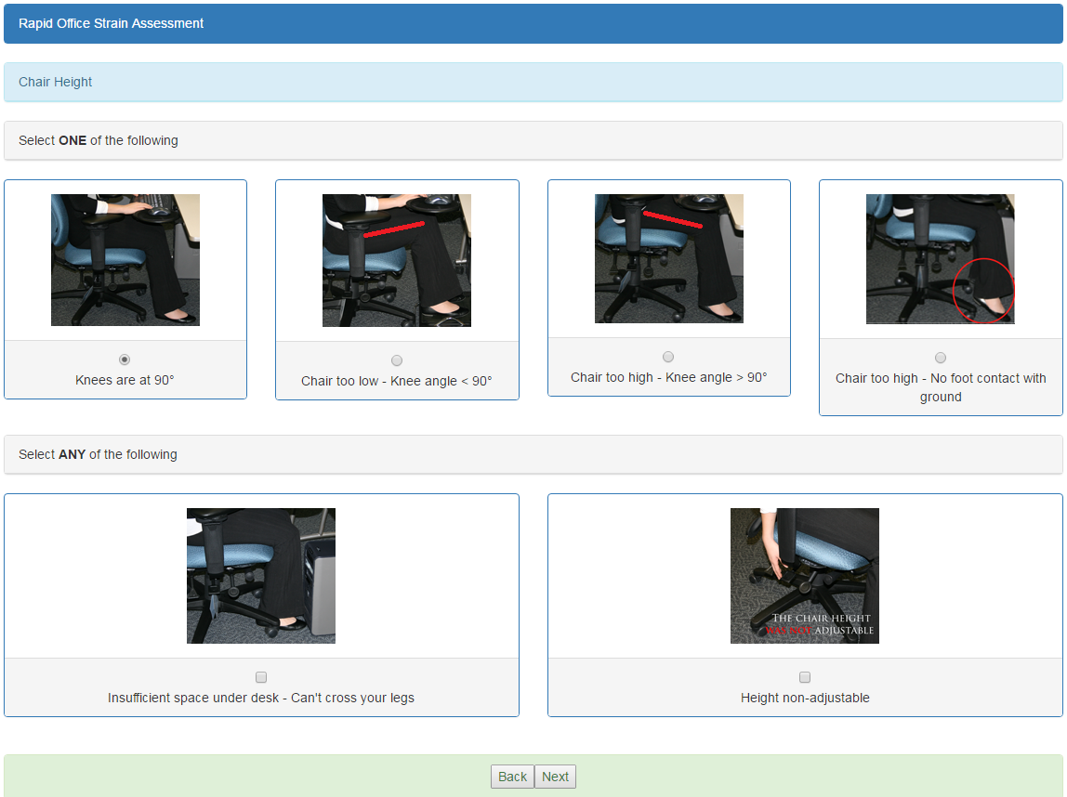

Slide 10
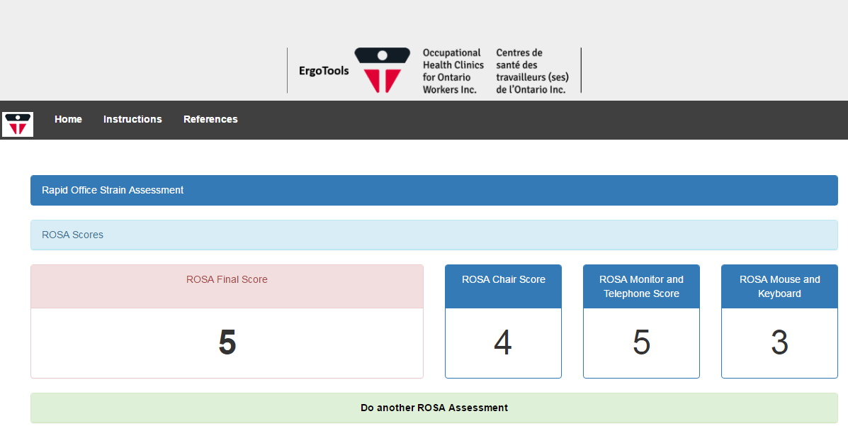
ErgoTools - ROSA
Scores of 5 or greater – ↑ Discomfort
Have an Ergonomics Assessment completed

Slide 11
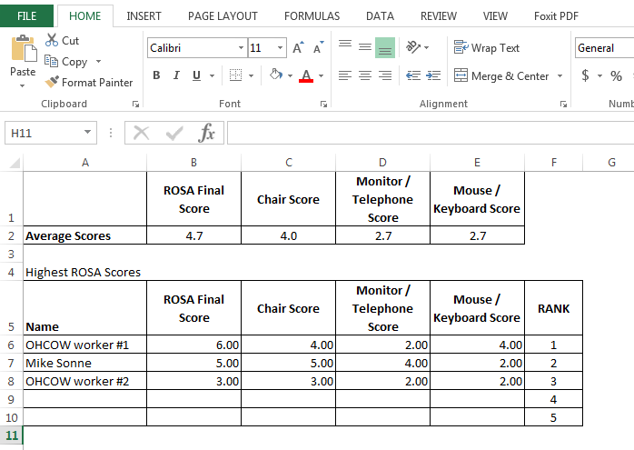
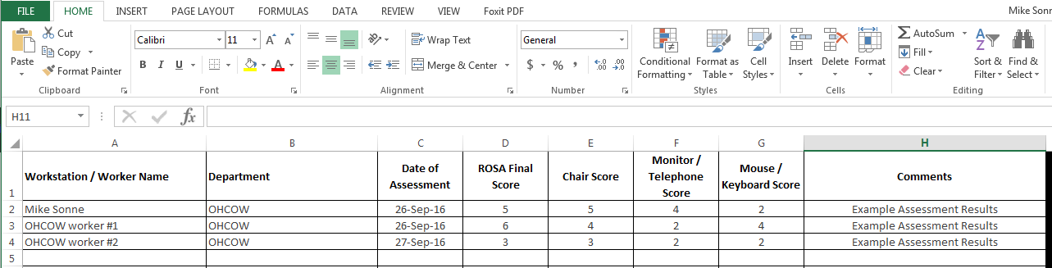
ErgoTools – ROSA
Excel Worksheet

Slide 12
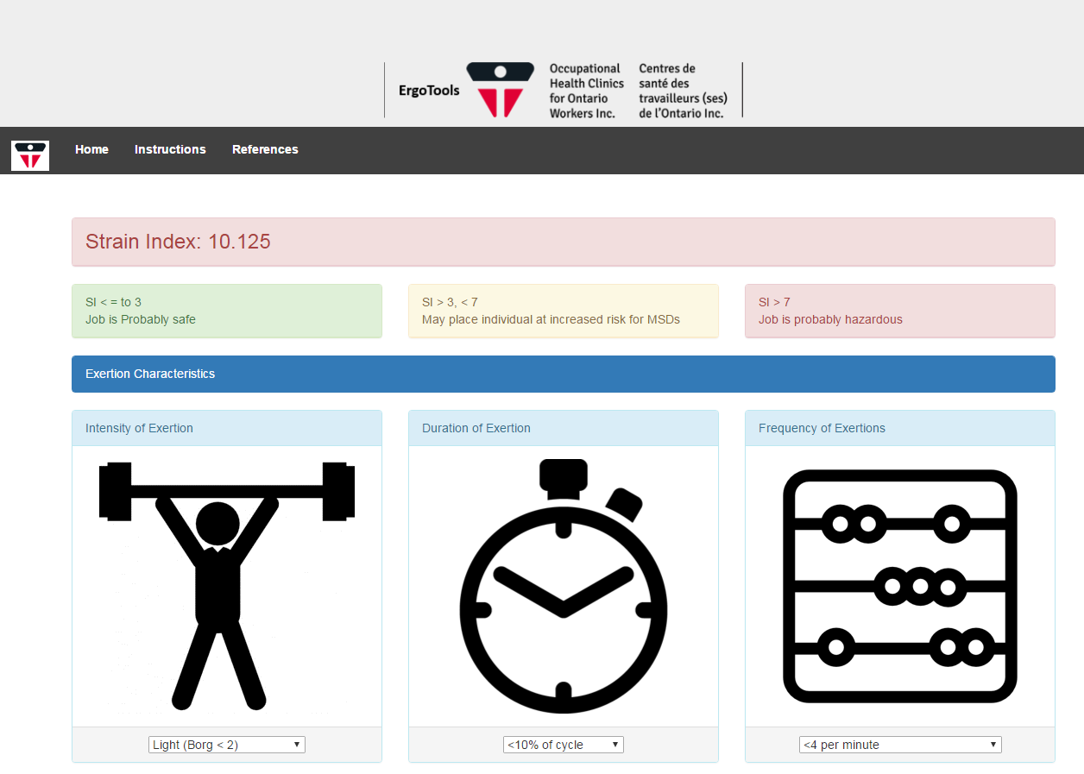
Other Tools – Strain Index
Repetitive, Upper Extremity Tasks

Slide 13
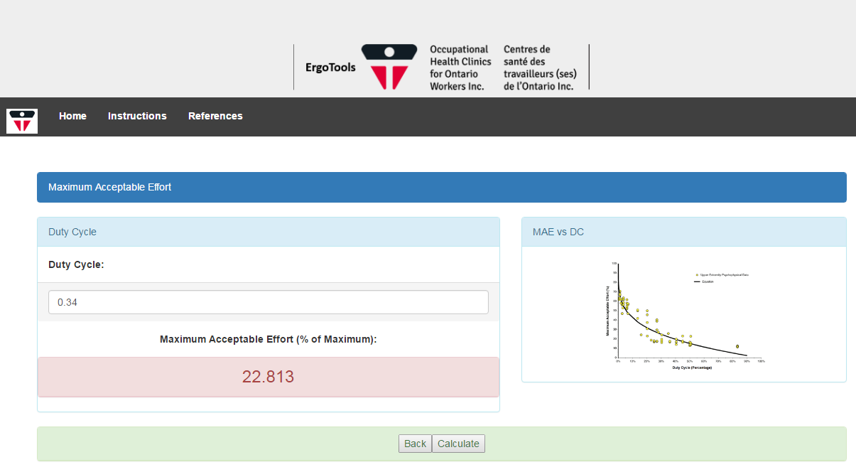
MAE Equation
Repetitive Work Assessment

Slide 14
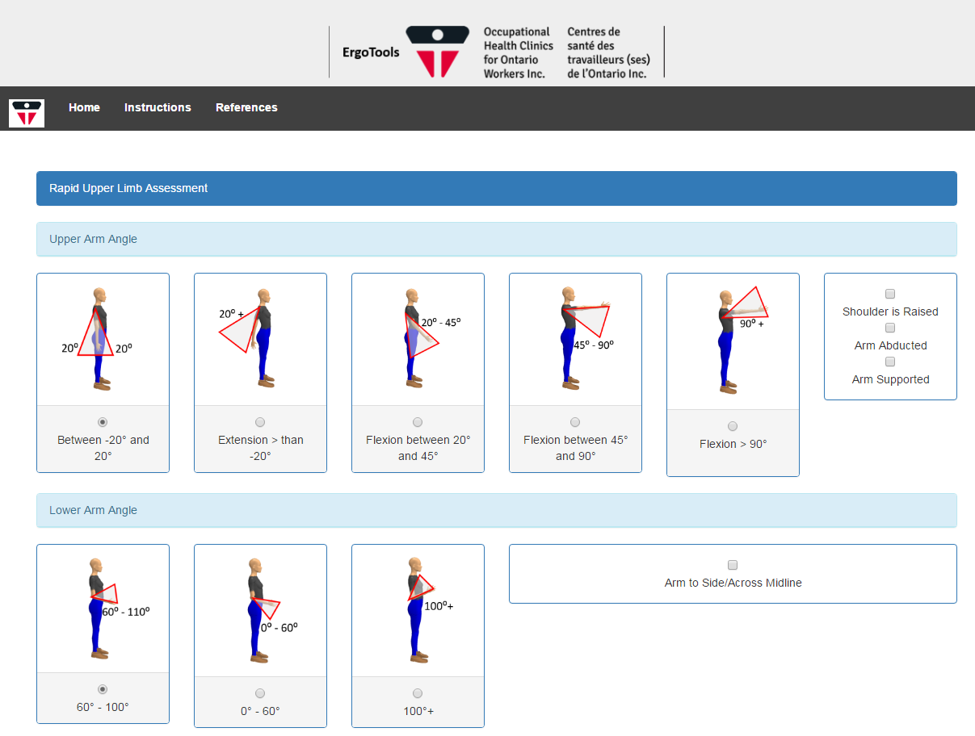
RULA
Postural Assessment

Slide 15
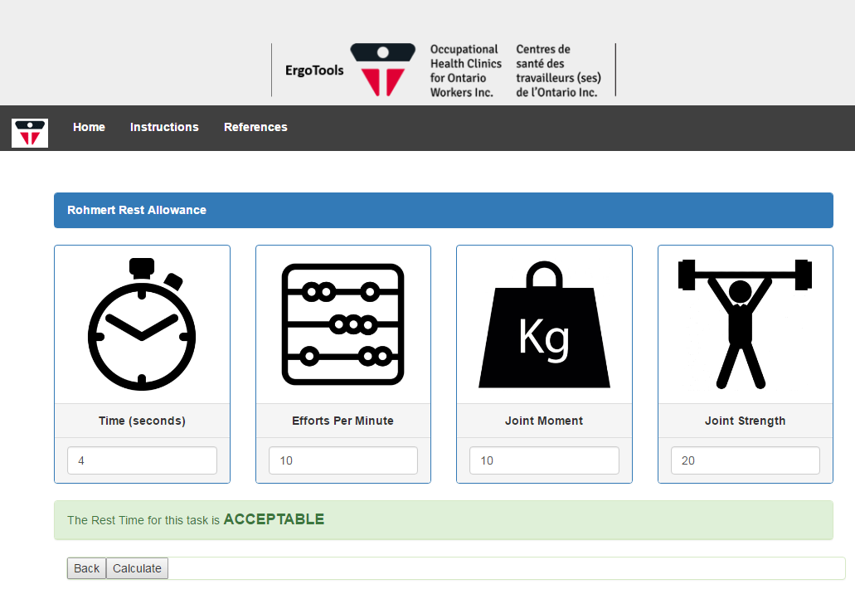
Rohmert Rest Allowance
Metabolic Rest Allowance

Slide 16
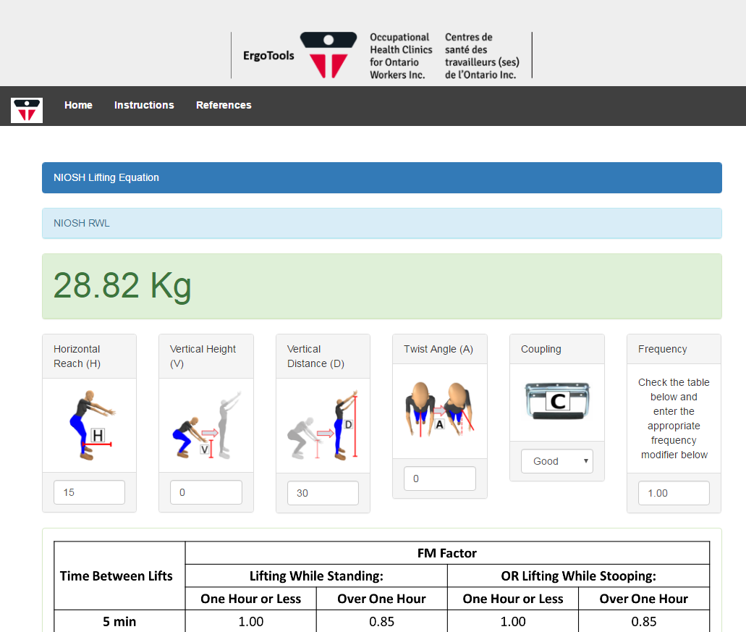
NIOSH Lifting Equation
Biomechanical Lifting Analysis

Slide 17
Future Work
Incorporate Strain Index volume 2
Integrate database for assessment storage
Recommendations for assessment results

Slide 18
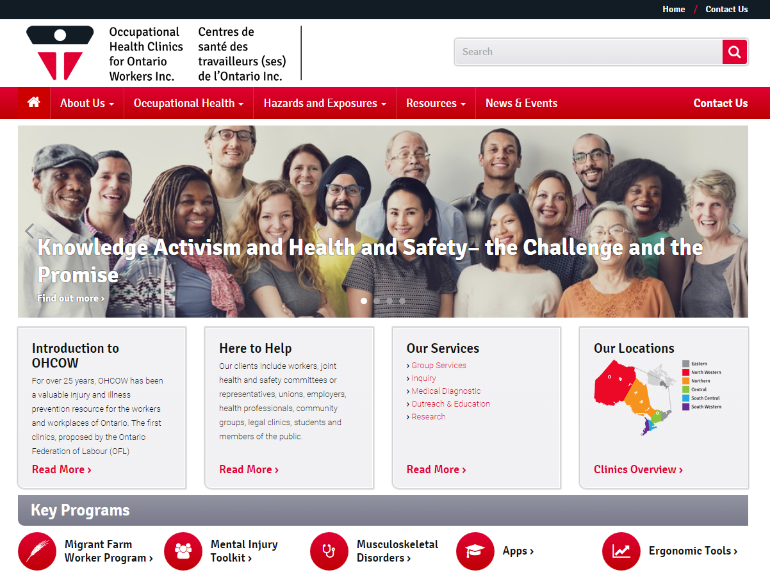
OHCOW - ErgoTools

Slide 19
OHCOW - ErgoTools
www.ohcow.on.ca/ergotools
Mike Sonne, PhD, CCPE
msonne@ohcow.on.ca
1-877-817-0336 ext. 2232
Thanks!

