Slide 1

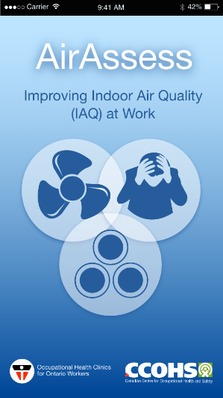
AirAssess
A Smartphone App to help workers identify & resolve Indoor Air Quality (IAQ) issues

Slide 2
How common are IAQ problems?

Slide 3
IAQ starts with symptoms:
Increased prevalence of non-specific, common symptoms:
  headache
  fatigue
  irritated eyes, nose, throat and/or skin
  symptoms clear when away from building
commonly called “Sick Building Syndrome” (SBS)
but more accurately referred to as “building related non-specific symptoms” (BRS) or specifically (e.g. mucous membrane irritation)

Slide 4
THERMAL
COMFORT
(temp, RH, temp
fluctuations)
2. VENTILATION
(outdoor air intake,
air movement)
CHEMICAL
CONTAMINANTS
(from inside or outside)
4. BIOLOGICAL
CONTAMINANTS
(allergens)
HOW I FEEL AT WORK
IN MY BUILDING
7. PERSONAL
FACTORS
(age, sex, allergies,
smoking)
5. ERGONOMIC
FACTORS
(lighting, noise,
workstation design)
6. WORKPLACE
STRESS
(job content, pace,
control, support)

Slide 5
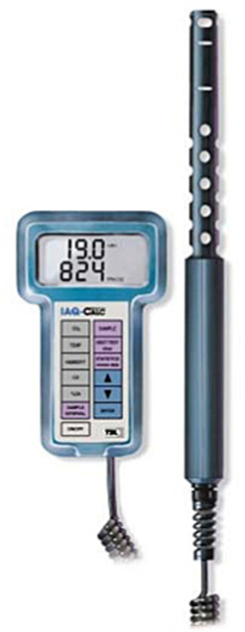
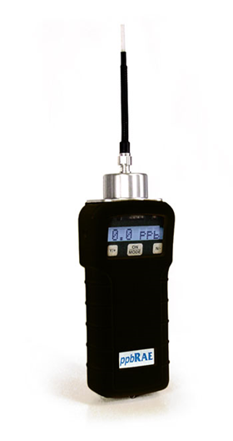
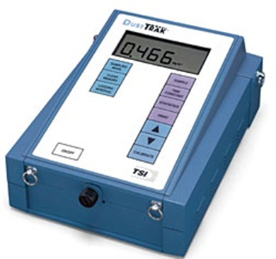
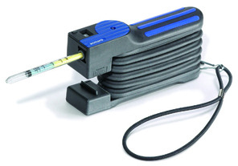
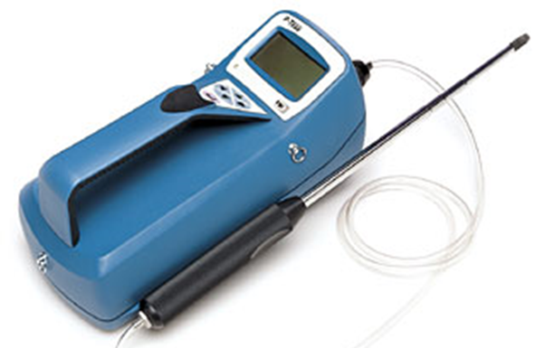
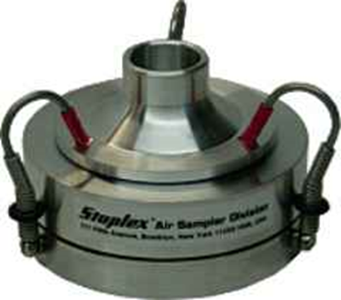
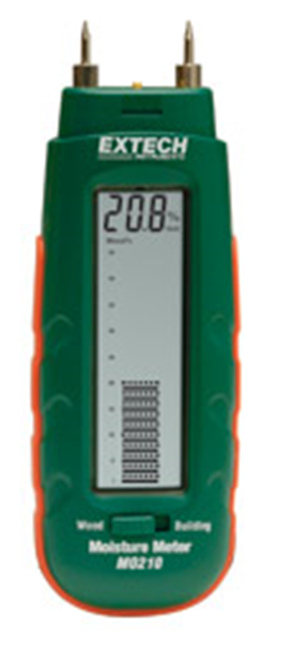
How do you measure this?

Slide 6
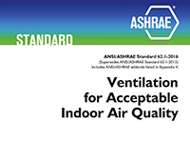
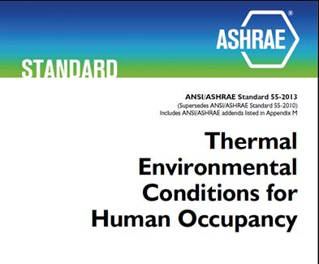
What’s the “gold standard”?
ASHRAE 62.1-2016 “Ventilation for Acceptable Indoor Air Quality” states:
3. ”acceptable indoor air quality: air in which there are no known contaminants at harmful concentrations as determined by cognizant authorities and with which a substantial majority (80% or more) of the people exposed do not express dissatisfaction.”
ASHRAE Standard 55-2013 “Thermal Environmental Conditions for Human Occupancy” states:
3. “environment, acceptable thermal: a thermal environment that a substantial majority (more than 80%) of the occupants find thermally acceptable.”

Slide 7
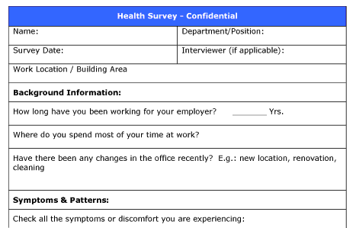
OHCOW’s experience with IAQ surveys:
In 1993 we tried using the Ontario Ministry of Labour’s IAQ questionnaire – (1987? - 6 pages)
Also tried the NIOSH survey developed for an investigation of the Library of Congress – Madison Building (January 1991) (11 pages)
Found the Kjell Andersson’s MM-040 Indoor Climate (1988 - 2 page) – preferred because it was the shortest
Since 1993 we have used the survey in over 120 buildings and collected over 7000 surveys
Currently have a version available through SurveyMonkey along with a spreadsheet that produces an automated report
http://www.ccohs.ca/oshanswers/chemicals/iaq_intro.html

Slide 8
Survey Instrument & Methodology:
http://www.mmquestionnaire.se/mmq/mmq.html
use Swedish “MM-040 Questionnaire”:
      Andersson K., and Fagerlund I., “Questionnaire as an Instrument when Evaluating Indoor Climate”, Healthy Buildings ’88, Vol 3 p139-145 (1988)
compare with data for buildings without air quality problems (206 respondents):
      Hill B., Craft B., and Burkart, J., “Carbon Dioxide, Particulates and Subjective Human Responses in Office Buildings Without Histories of Indoor Air Quality Problems”, Appl Occup Environ Hyg J 7:101-111 (1992)

Slide 9

Kjell Andersson
“Kjell Andersson, Doctor and Civil Engineer, Miljömedicin MM Konsult AB
Kjell is a specialist in Occupational and Environmental Medicine and has mainly worked with indoor air issues and risk communication.
He worked over 27 years in the Medical Service of Environmental Medicine and Epidemiology at the Environmental Medicine Development at the Örebro University Hospital.
Kjell worked with method development and education and is behind the development of the so-called Örebro Forms for mapping indoor environments.”
http://www.swegonairacademy.com/author/kjell-andersson/

Slide 10
MM-040 Contents:
Background factors (demographics)
Work environment (12)
Work conditions (stress – stimulating work, workload, influence, help from co-workers)
Health Conditions (asthma, hay fever, eczema)
Present symptoms (12 + “other”)

Slide 11

Asthma Symptom Screening:
We added a validated set of asthma screening questions put together by Kate Venables et al.,“Respiratory Symptoms Questionnaire for Asthma Epidemiology: Validity and Reproducibility”, Thorax 48:214-219 (1993)
http://www.stx.ox.ac.uk/people/fellow/dr-katherine-venables

Slide 12
Asthma Screening Questions:
During the last four (4) weeks: | Yes | No
If you run, or climb stairs fast do you ever cough? wheeze? get tight in the chest? |  ₁  ₁  ₁ |  ₂  ₂  ₂
Is your sleep ever broken by wheeze? difficulty with breathing? |  ₁  ₁ |  ₂  ₂
Do you ever wake up in the morning with wheeze? difficulty with breathing? |  ₁  ₁ |  ₂  ₂
Do you ever wheeze if you are in a smoky room? if you are in a dusty place? |  ₁  ₁ |  ₂  ₂

Slide 13
MM-040 stress vs. JCQ
In order to use the demand/control dimensions we used the MM-040 questions and correlated them with the OHCOW JCQ survey results (used JCQ since 2000)
Robert Karasek did not want us to include any of the JCQ questions
MM-040 “too much work” question correlated with the JCQ demands scale (r = 0.55 for females; r = 0.49 for males)
A combination of the MM-040 “influence”+ “interesting work” questions correlated with the JCQ latitude/ control scale (r = 0.55 for females; r = 0.59 for males)

Slide 14
JCQ Theory:
active learning,
motivation to develop
new behaviour patterns
LOW STRAIN
ACTIVE
PASSIVE
HIGH STRAIN
risk of psychological strain
and physical illness
Source: http://www.workhealth.org/strain/jsdef2.html

Slide 15
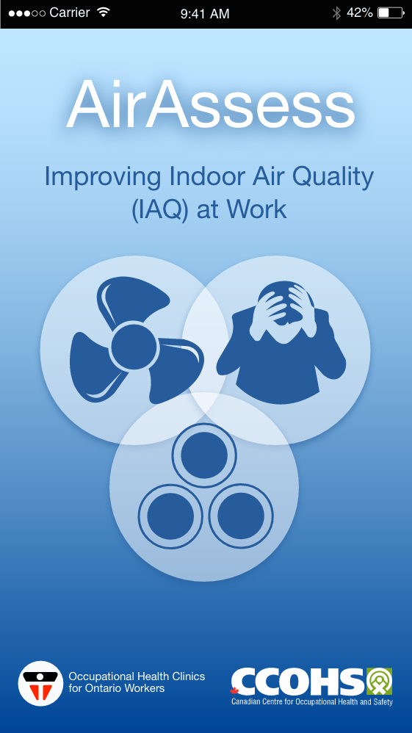


Here’s how it works:

Slide 16
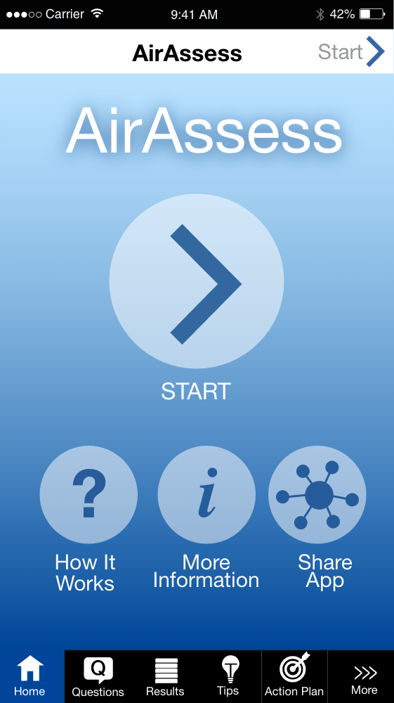
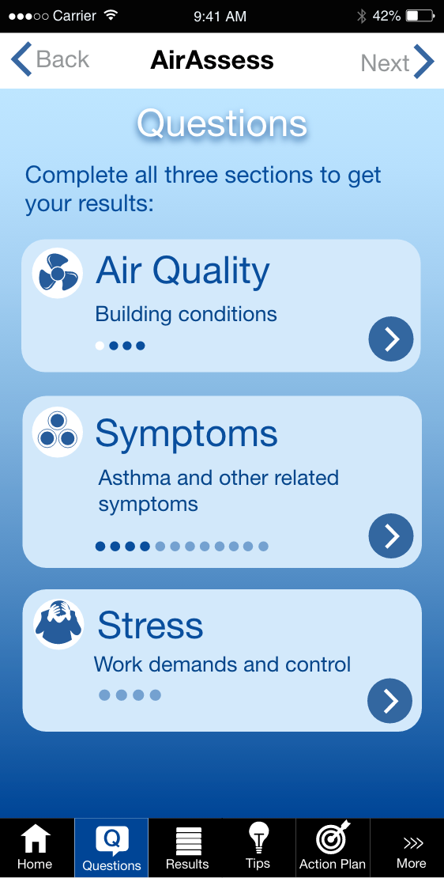

Slide 17
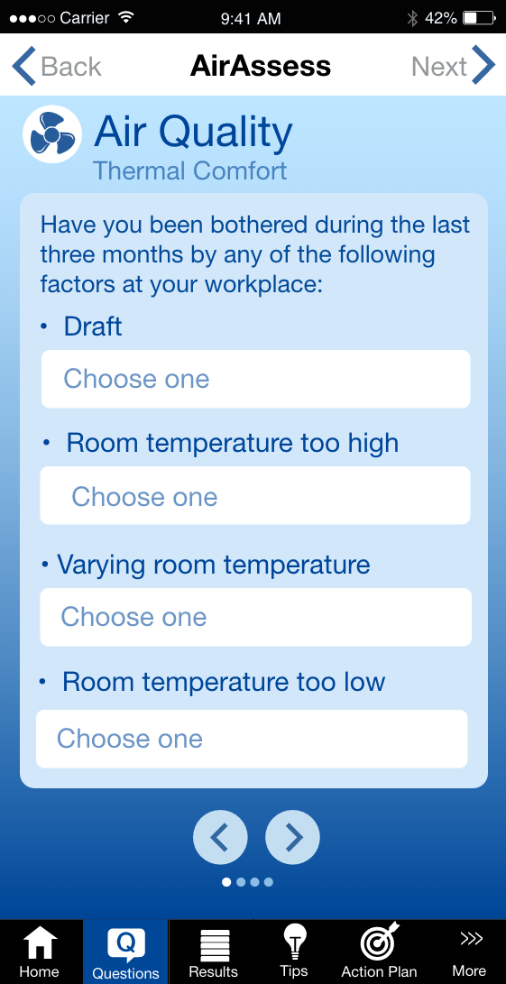
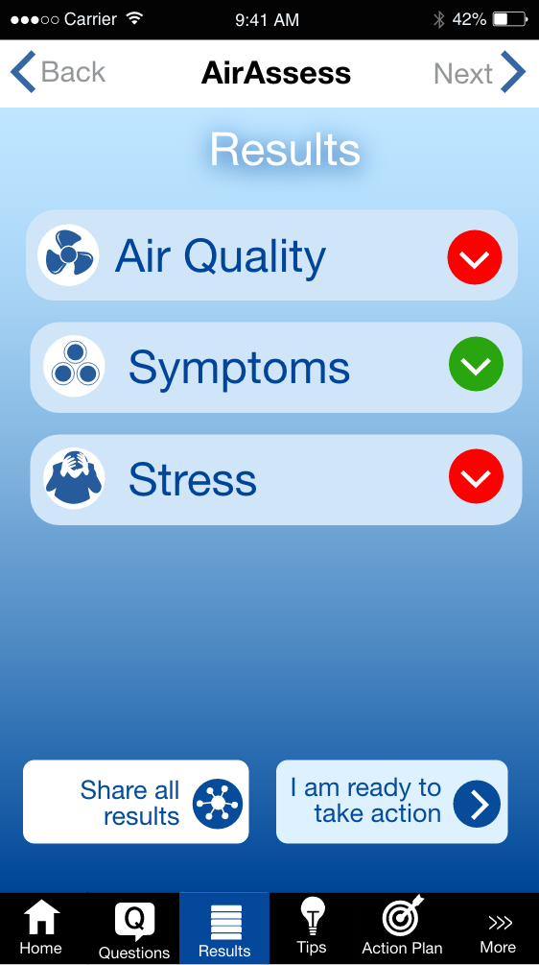

Slide 18
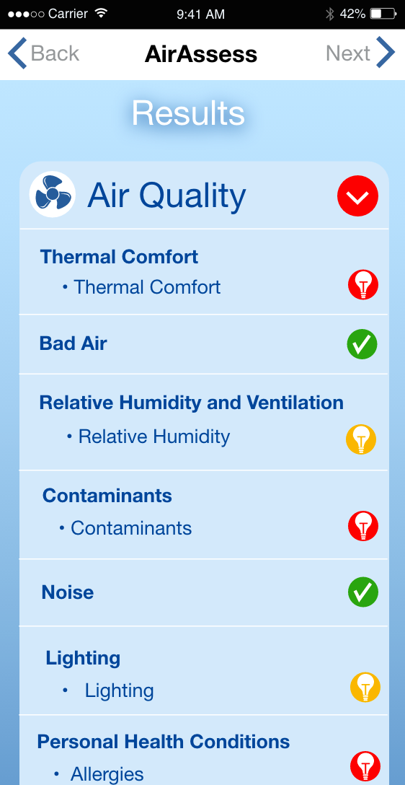
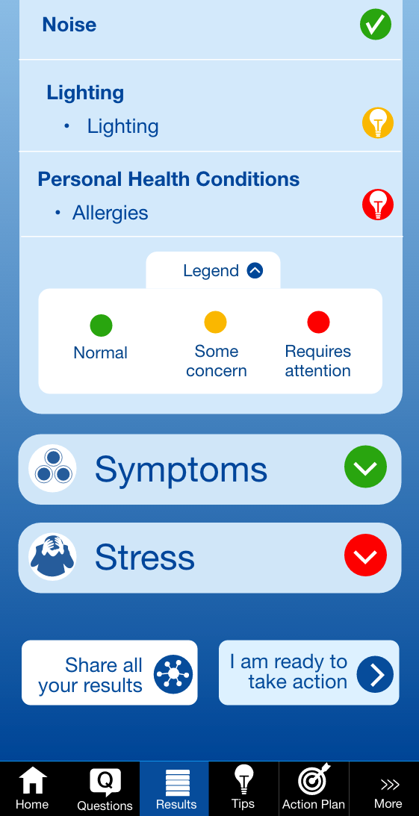

Slide 19
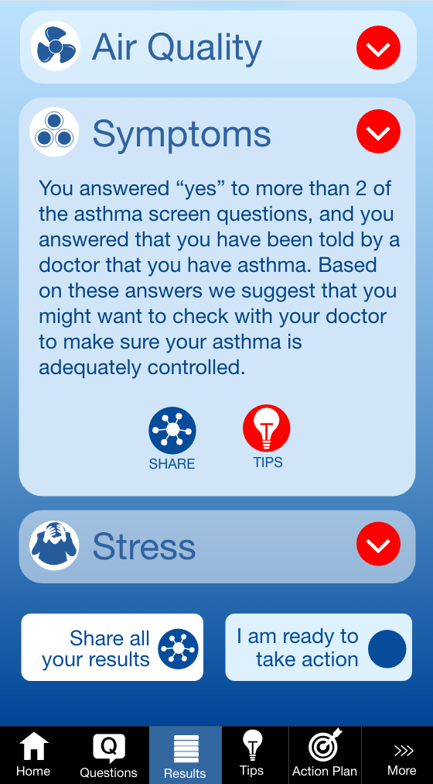
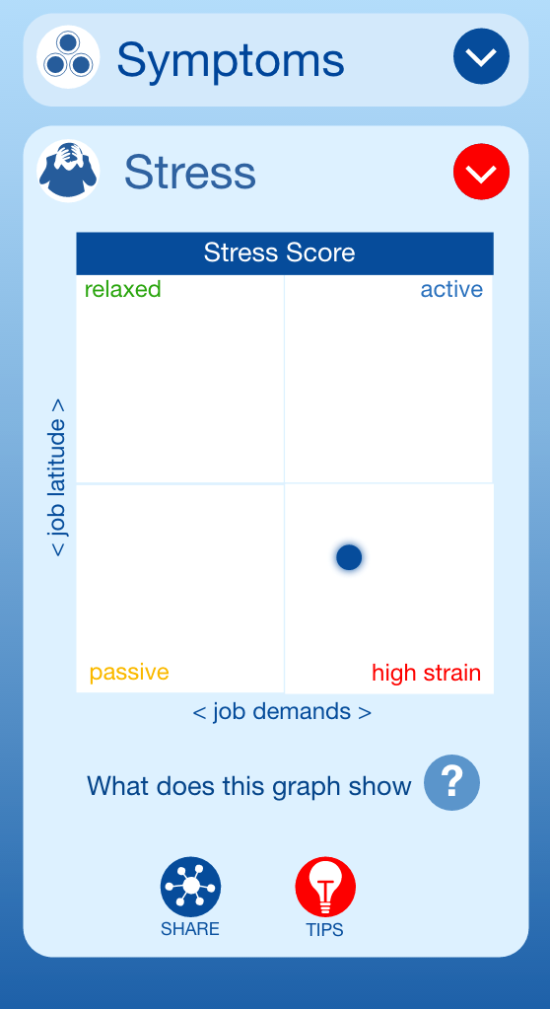

Slide 20
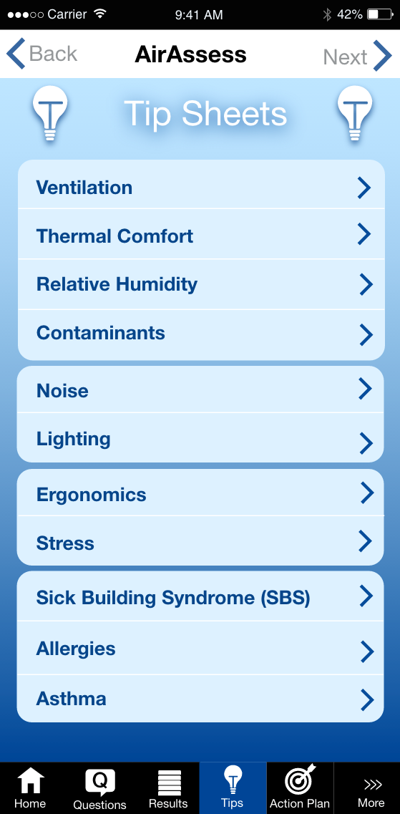

Slide 21
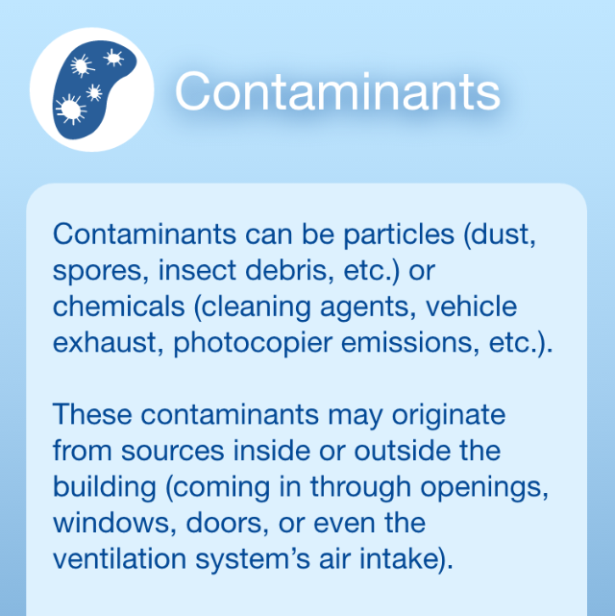
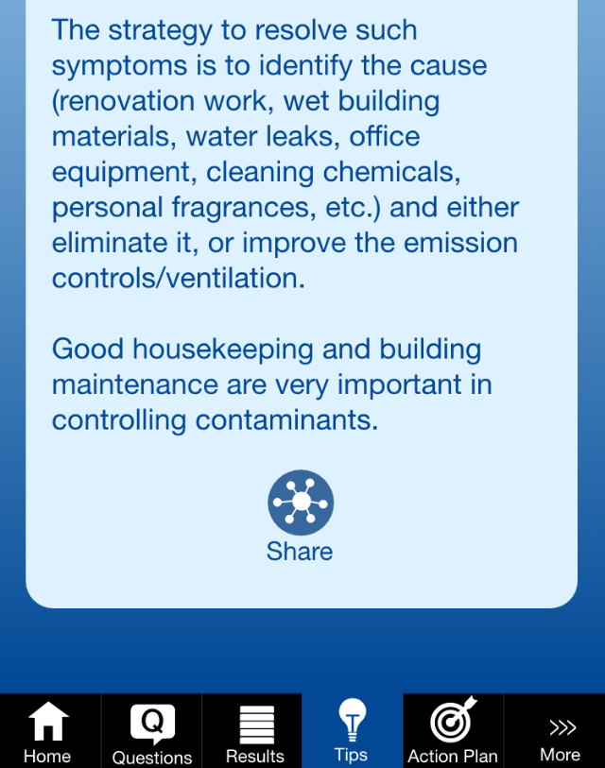
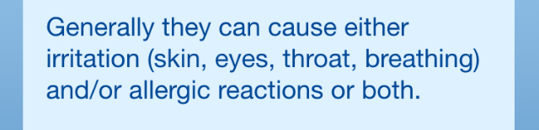

Slide 22
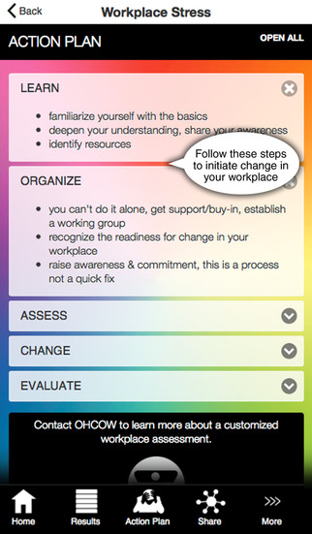

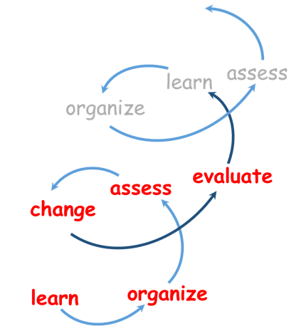

Slide 23
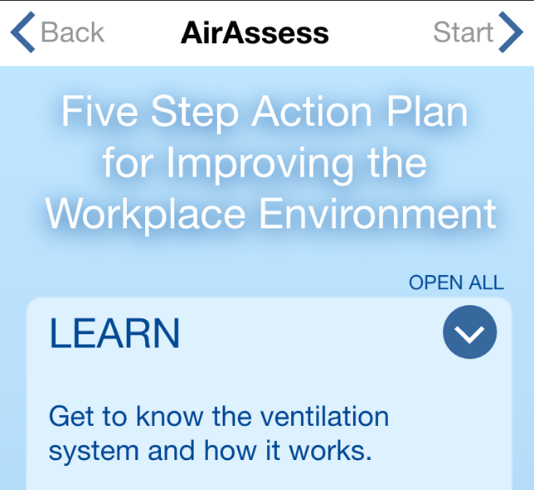
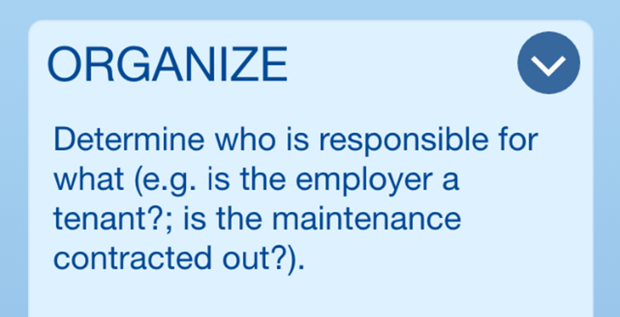
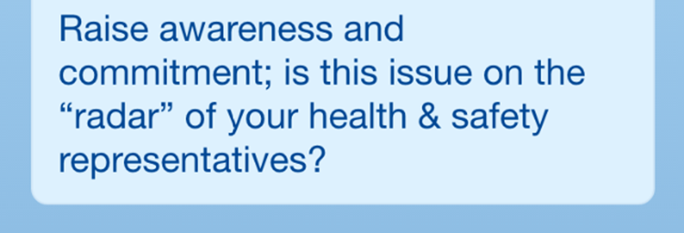
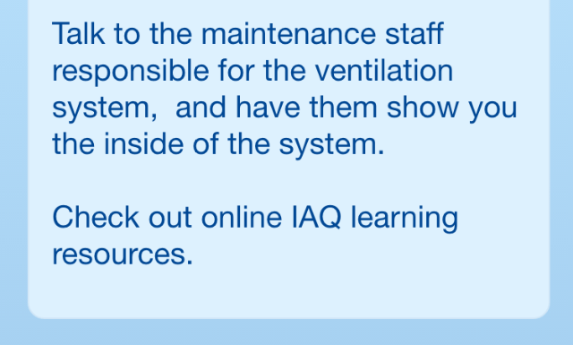

Slide 24
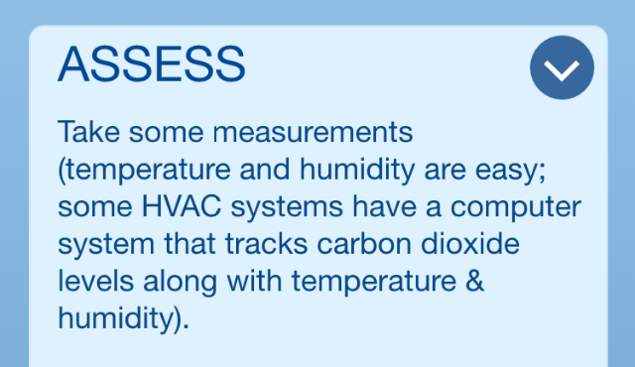
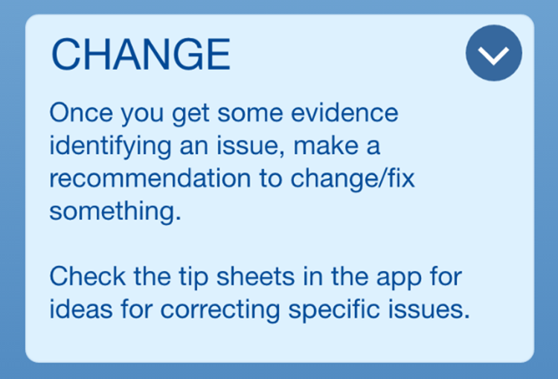
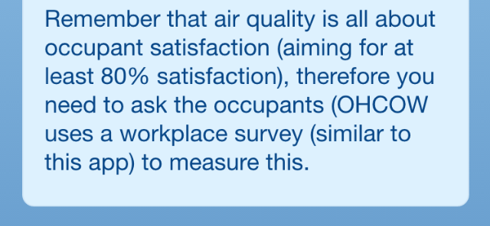

Slide 25
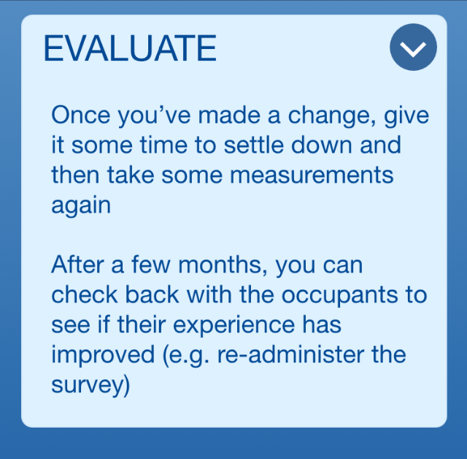


Slide 26
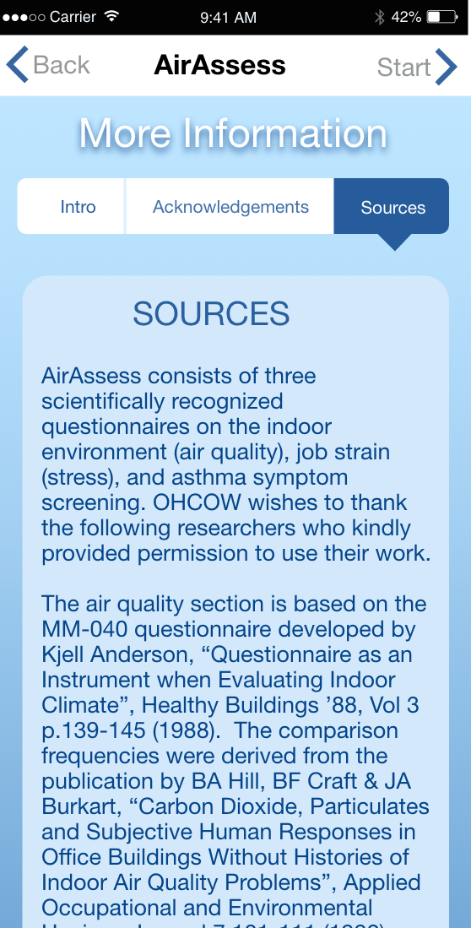
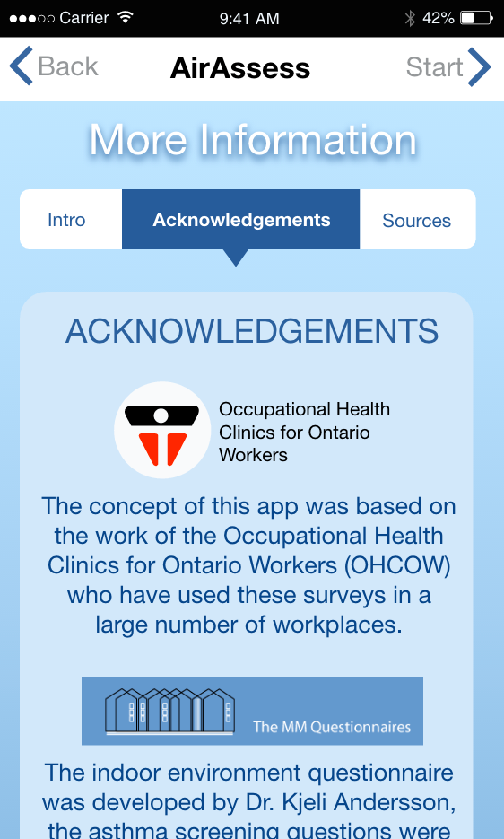

Slide 27
Beta version access:
Try it out at:
http://app.ccohs.ca/ohcow_iaq/www/
Let us know what you think … any suggestions?
Thank you CCOHS!

Slide 28
The future …
Real-time, intelligent ventilation systems linked to occupants via an app
Konis & Zhang, “Occupant-Aware Energy Management - Simulated Energy Savings Achievable Through Application of Temperature Setpoints Learned Through End-User Feedback”, ASHRAE and IBPSA-USA SimBuild 2016: Building Performance Modeling Conference, Salt Lake City, UT, 2016

