Slide 1
LEARNING OBJECTIVE
Understanding Permanent Impairment Awards
sf/cope343

Slide 2
WORKERS’ COMPENSATION
Workers’ Compensation in Ontario is governed by the Workplace Safety and Insurance Act (WSIA) and managed by Workplace Safety and Insurance Board (WSIB).
sf/cope343

Slide 3
HISTORY OF LEGISLATIVE CHANGE
Three distinct eras of compensation
Entitlement is dictated by era
Era determined by date of accident
Pre 1990
1990-1997
Post 1998
sf/cope343
Notes:
Say/Explain:
3 distinct eras & each has its own specific entitlements:
• Pre 1990 – s. 37 benefits, (TT, TP), PPD’s, s. 147 supplements
• 1990-1997 – FEL, NEL
• Post 1998 – LOE
Entitlement to benefits is based on the original date of injury

Slide 4
HISTORY OF BENEFITS
1915
1920
1950
1985
1998
55% gross
7-day waiting period
66% gross
75% gross
90% NAE
No waiting period
85% NAE
NAE = net average earnings
sf/cope343
Notes:
Review Slide
Say/Explain:
As of 1985 the waiting period was removed & the employer pays for the day of accident and compensation kicks in the following day
There have been suggestions that the Ontario system revert back to a 3 day waiting period

Slide 5
WORKERS’ COMPENSATION
The Workers' Compensation system is designed to protect workers from the financial hardships associated with work-related injuries and occupational diseases.
Payments for:
Loss of Earnings/wages
Benefits & Services
Payments for:
Impairment, (loss of function)
sf/cope343

Slide 6
MAXIMUM MEDICAL RECOVERY (MMR)
Once a worker is healed as good as to be expected they may receive a pension/award
Pre - 1990
Permanent Partial Disability Award(PPD)
1990 – 1997
Non-Economic Loss Award (NEL)
Post - 1998
Non-Economic Loss Award (NEL)
Entitlement is dictated by era
Era determined by date of accident
sf/cope343

Slide 7
NEL PROCEDURE
Determining MMR:
recent clinical evidence indicates any change in the work-related injury/disease,
the worker is receiving or will receive treatment that is likely to improve the work-related injury/disease, or
the worker is receiving treatment or using medication to maintain the current level of recovery.
If required, a clinical opinion may be obtained to assist in determining when MMR has been reached.
sf/cope343
Notes:
Review Slide

Slide 8
NEL PROCEDURE
Determining ongoing impairment
a physical abnormality
a physical loss
a functional abnormality
a functional loss
a disfigurement
psychological damage
sf/cope343
Notes:
Review Slide
Say/Explain: Board interpretation
physical abnormality = a change to or damage to a body part or organ system
physical loss = a loss of some or all of a body part or organ system
functional abnormality = a malfunction of a body part or organ system
functional loss = a loss of some or all of the functioning of a body part or organ system
disfigurement = an altered or abnormal appearance such as an alteration of color, shape, structure, or a combination of these.
psychological damage = the loss of or abnormal psychological functioning.

Slide 9
NEL PROCEDURE
Determining work-relatedness
whether the current diagnosis is the same as or compatible with the initial work-related injury/disease diagnosis,
whether the clinical evidence of impairment is related to the current diagnosis, and
whether a pre-existing condition or other non-work-related factor is causing or contributing to the impairment.
sf/cope343
Notes:
Review Slide

Slide 10
NEL PROCEDURE
Degree of impairment
Prescribed rating schedule
Impairment listed
Impairment not listed decision-maker uses body parts, systems or functions which are most similar
The degree of impairment is expressed as a percentage of total impairment of whole person.
sf/cope343
Notes:
Say/Explain:
Prescribed rating schedule = AMA Guide, 3rd edition

Slide 11
NEL PROCEDURE
NEL rated by a NEL Clinical Specialist.
Independent medical assessment may be required.
The degree of PI is expressed as a “whole person impairment” percentage.
sf/cope343
Notes:
Review Slide
Say/Explain:
Whole Person Impairment Percentage Example:
Complete amputation of the index finger = 100% impairment of the finger.
The 100% impairment of the finger = 20% impairment of the hand.
The 20% impairment of the hand = 18% impairment of the arm.
The 18% impairment of the arm = 11% impairment of the whole person.

Slide 12
NEL CALCULATION
% of impairment
Age at the time of Permanent Impairment (PI)
$45,000 base rate for worker age 45
+/- $1,000 for each year younger or older than 45
sf/cope343
Notes:
Review Slide
Say/Explain:
American Medical Association (AMA) Guide to Evaluating Permanent Impairments, version 3 is used for organic impairments (physical injuries)
Policy is used for non-organic impairments (CPD, psychotraumatic, etc.)

Slide 13
POST-1990 NON-ECONOMIC LOSS AWARD (NEL)
Worker age 45
10 % Permanent Impairment
$45,000 base rate
45 x 10% = $4500 NEL award
Worker age 35
10% Permanent Impairment
$55,000 base rate (increased by $1000 every year under 45 years of age)
55 x 10% = $5500 NEL award
sf/cope343
Notes:
Say/Explain:
Compare this to a NEL for same age worker. Worker now gets Base amount for 2018 = $59,981.69 x 10 % = $5,998.17 NEL once.
Excellent Flip Chart:
Do the calculations side by side (below) & walk through with participants
Then ask – what if the worker with the PPD lives to be 75?
(30 years x 12 months/year = 360 months x $ 200/month = $ 72,000 vs the NEL benefit)
2018 NEL Pre-1990 PPD
Age 45 Age 45
10% PI 10% PI
Base Amount Monthly Comp Rate
= $ 59,981.69 = $ 2,000
X 10% X 10%
= $ 5,998.17 = $ 200/month
ONCE FOR LIFE

Slide 14
One week earlier ...
sf/cope343

Slide 15
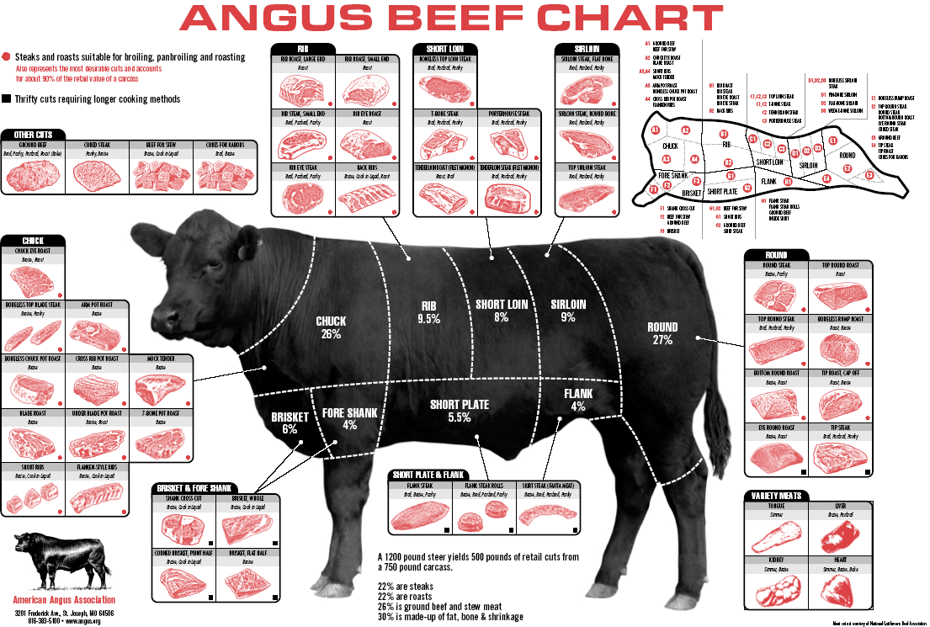
sf/cope343
Notes:
Yes meat chart just like in the butcher shop

Slide 16
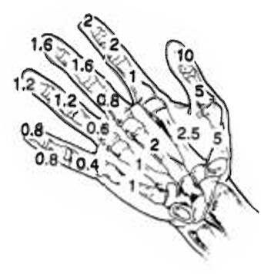
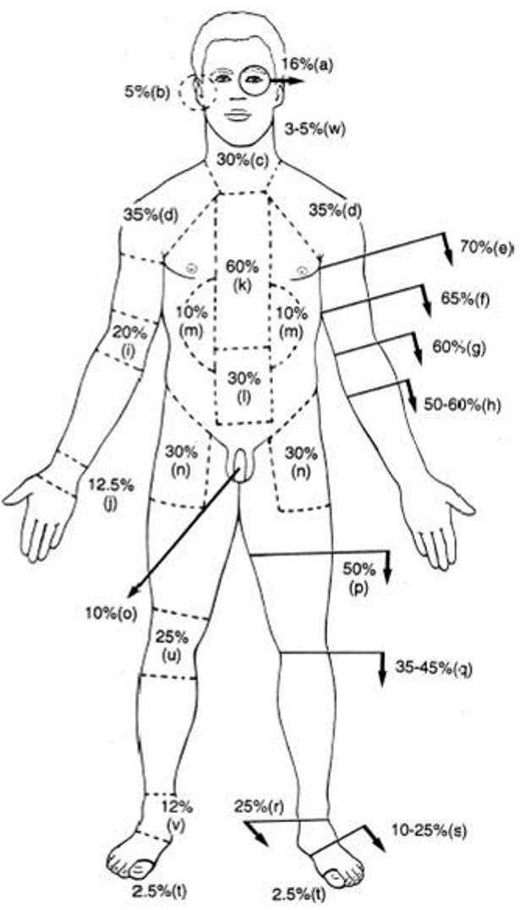
Loss of sight in one eye
Total deafness in one ear
Total immobility of cervical spine
Frozen shoulder
Amputation – proximal third of humerus
Amputation – middle third of humerus
Amputation – distal third of humerus
Amputation – forearm at radial tuberosity
Total immobility of elbow
Total immobility of wrist
Total immobility of entire spine
Total immobility of lumbar spine
Kidney loss
Total immobility of hip
Loss of penis
Amputation through thigh
Amputation through knee
Amputation through ankle
Amputation through foot
Amputation of greater toe
Total immobility of knee
Total immobility of ankle
Scarring of face
WSIB MEAT CHART
sf/cope343
Notes:
This is the chart used in the past by the WSIB. Now the jurisdictions are not quite so obvious about charts but the schedules they use are just meat charts without pictures

Slide 17
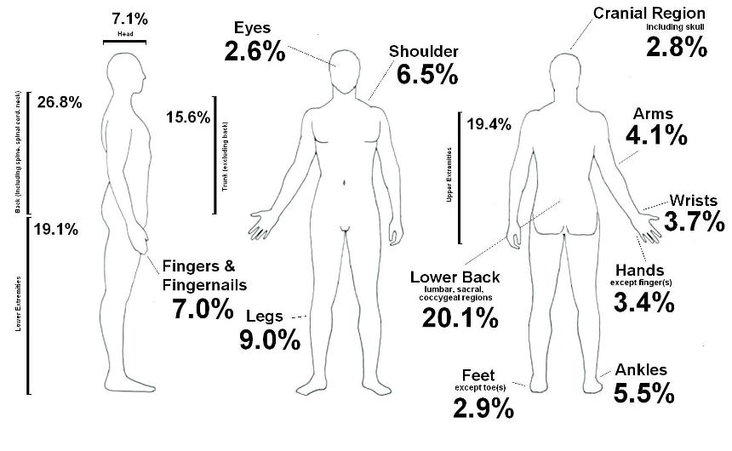
SAMPLE MEAT CHART
sf/cope343

Slide 18
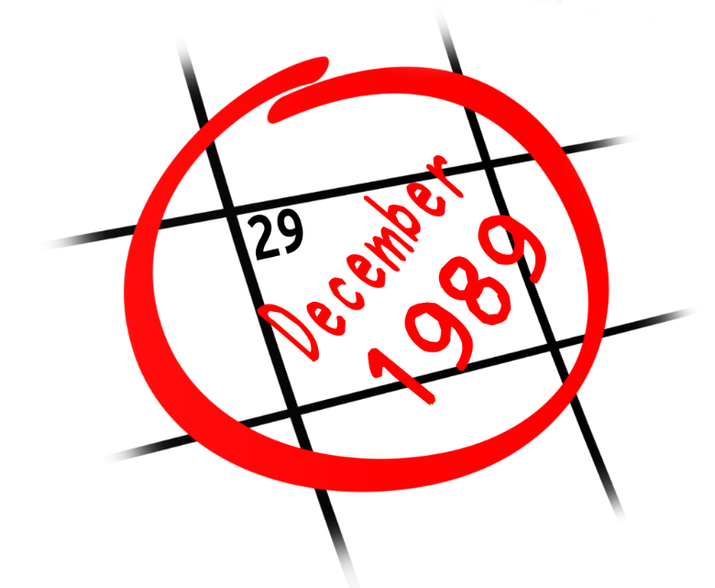
PRE-1990 - PERMANENT PARTIAL DISABILITY AWARD (PPD)
Injury before 1990
Worker age 45
10% Permanent Impairment
Monthly Compensation Rate - $2,000.00
Calculation 10% x $2,000.00
Award - $200 per month for life (PPD Award)
Note: Worker age 35 - $200 per month for life
sf/cope343
Notes:
Say/Explain:
Compare this to a NEL for same age worker. Worker now gets Base amount for 2018 = $59,981.69 x 10 % = $5,998.17 NEL once.
Excellent Flip Chart:
Do the calculations side by side (below) & walk through with participants
Then ask – what if the worker with the PPD lives to be 75?
(30 years x 12 months/year = 360 months x $ 200/month = $ 72,000 vs the NEL benefit)
2018 NEL Pre-1990 PPD
Age 45 Age 45
10% PI 10% PI
Base Amount Monthly Comp Rate
= $ 59,981.69 = $ 2,000
X 10% X 10%
= $ 5,998.17 = $ 200/month
ONCE FOR LIFE

Slide 19
2018 NEL Pre-1990 PPD
Age 45 Age 45
10% PI 10% PI
Base Amount Monthly Comp Rate
= $ 59,981.69 = $ 2,000
X 10% X 10%
= $ 5,998.17 = $ 200/month
ONCE FOR LIFE
sf/cope343
Notes:
Say/Explain:
Compare this to a NEL for same age worker. Worker now gets Base amount for 2018 = $59,981.69 x 10 % = $5,998.17 NEL once.
Excellent Flip Chart:
Do the calculations side by side (below) & walk through with participants
Then ask – what if the worker with the PPD lives to be 75?
(30 years x 12 months/year = 360 months x $ 200/month = $ 72,000 vs the NEL benefit)
2018 NEL Pre-1990 PPD
Age 45 Age 45
10% PI 10% PI
Base Amount Monthly Comp Rate
= $ 59,981.69 = $ 2,000
X 10% X 10%
= $ 5,998.17 = $ 200/month
ONCE FOR LIFE

Slide 20
Injured worker
10% Impairment
Age 35
1989
1990
2019
$200 monthly
for life
Lump sum
$5500
Lump sum
$7500
Age 55 = Same
Age 55 = $3500
Age 55 = $4772
sf/cope343
Notes:
2019 base rate = $61,361.27
Age Factor Plus/Minus $1,364.09 for each year under/over age 45
Worker age 35 = $61,361.27 + 13,640.90 ($1,364.09 x10) = 75002.17
Maximum - $88.632.37
Minimum - $34,090.12
Benefit paid as lump sum if $13,635.56 or less

Slide 21
Questions
sf/cope343

Slide 22
sf/cope343
Notes:
Clear up any issues that have been placed in the parking lot.
Hand out the course evaluation form, have participants spend 5 minutes to fill in the evaluation.

