Slide 1

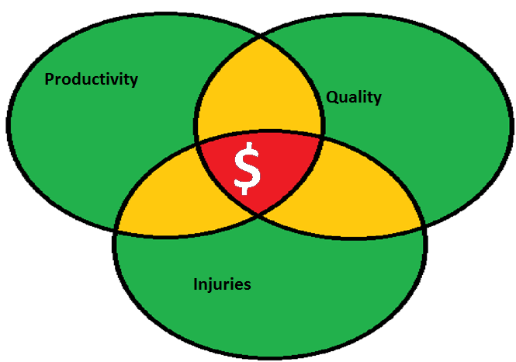
The Economics of
Ergonomics

Slide 2
Introduction
Use of “Ergonomics” is currently an industry buzzword, like adding “reduced fat” to food labels even if that food is a fat reduced Boston Cream Pie
There is no industry standard that determines whether a job, a manufacturing, a warehouse job or piece of material/equipment is truly ergonomic.
Notes:
Use of “Ergonomics” is currently an industry buzzword, like adding “reduced fat” to food labels even if that food is a fat reduced Boston Cream Pie
There is no industry standard that determine whether a job, a manufacturing, a warehouse job or piece of material/equipment is truly ergonomic.

Slide 3
Introduction
If you mention ergonomics, people often think computers such as keyboard trays, or chairs. In reality, ergonomics is so much more.
In a factory or warehouse ergonomics can cover much more: from lift assists, to table and counter heights, to proper footwear, and workplace organization
Notes:
If you mention ergonomics people often think computers such as keyboard trays, or chairs. In reality, ergonomics is so much more.
In a factory or warehouse ergonomics can cover much more from lift assists, to table and counter heights, to proper footwear, and workplace organization

Slide 4
Is Ergonomics Important ?
One of the most abused, misunderstood and underutilized concepts in business today.
Is viewed as difficult to measure and is not the first thing people look at to increase profitability.
Proper ergonomics can be as important as quality control, and strategic planning.
Has a real and direct impact on productivity, performance, throughput, delivery of services, and the bottom line.
Can enhance the most important business component – ability of workers to do their job.
Notes:
One of the most abused, misunderstood and underutilized concepts in business today
Is viewed as difficult to measure and is not the first thing people look at to increase profitability
When applied compressively, ergonomics can be as important as quality control, and strategic planning
It has a real and direct impact on productivity, performance, throughput, delivery of services, and the bottom line
Can enhance the most important business component – ability of workers to do their job

Slide 5
Bottom Line Benefits of Ergonomics Applications
Ergonomics can:
result in a three to tenfold improvement in performance, throughput and savings
reduce the risk of future occupational injuries and productivity problems.
improve productivity, reduce lost time, time loss, absenteeism, and save dollars measured through standard measurement systems. In addition, they can lead to lower WSIB premiums and medical costs.
Notes:
Ergonomics can result in a three to tenfold improvement in performance, throughput and corollary savings
Ergonomics also reduces the risk of future occupational injuries and productivity problems.
Ergonomic solutions improves productivity, reduces lost time, time loss, absenteeism, and saves dollars measured through standard measurement systems. In addition, they can lead to lower WSIB premiums and medical costs.

Slide 6
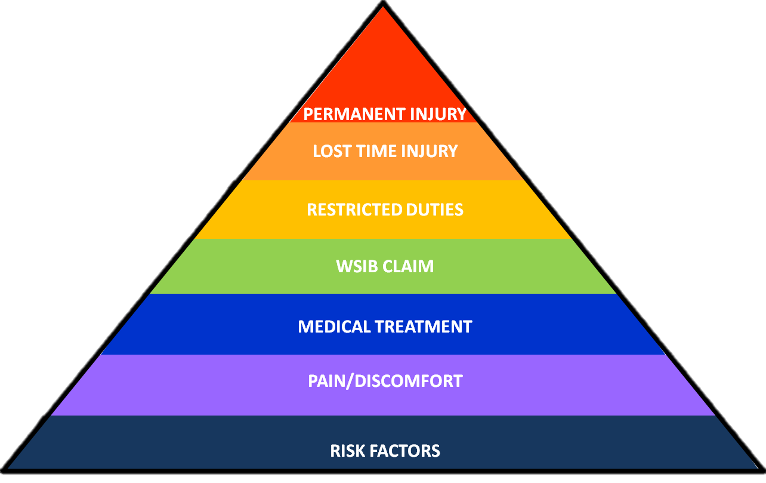
How much are you spending?
COSTS INCREASES BY 10-100 TIMES EACH TIME AN INJURY PROGRESSES TO THE NEXT LEVEL

Slide 7
Objective/Subjective Changes of Ergonomic Intervention
Reduced risk of injury in the workplace.
Reduced WSIB claims and payment.
Reduction in premiums.
Improved workplace morale.
Improved workplace relations and worker accountability.
Improvement in quality and productivity.
Notes:
Reduced risk of injury in the workplace
Reduced WSIB claims and payment
Reduction in premiums
Improved workplace morale
Improved workplace relations and worker accountability
Improvement in quality and productivity

Slide 8
Cost of Injuries of Increasing Severity
As the severity of an injury increases, so too does the cost that is incurred by such an illness.
Risk Factors→Pain/Discomfort→Medical Treatment→WSIB claim→Restricted duties→Lost Time injury→Permanent injury
When workplace risk factors are unaddressed, they can lead to expensive claims costs.
Reducing risk factors can effectively lower the serious costs associated with major injuries.
Notes:
As a general rule of thumb, as the severity of an injury increases, so too does the cost that is incurred by such an illness.
Risk Factors→Pain/Discomfort→Medical Treatment→WSIB claim→Restricted duties→Lost Time injury→Permanent injury, and at each step, the cost of treating the ailment 10 to 100 times more expensive. Therefore, when workplace risk factors are unaddressed, they can lead to expensive claims costs. Increased reporting negatively affects injury ratings, again increasing WSIB premiums. Alternatively, reducing risk factors can effectively lower the serious costs associated with major injuries.

Slide 9
Costs
Varies, depending on the condition, the severity and frequency of symptoms and whether, or not, these symptoms will result in short- or long-term disability
Direct Costs
  Health care products and services related to assessing and treating these disorders, to the costs of retraining should the injury lead to permanent disability.
Indirect Costs
  Absenteeism and presenteeism
Intangible costs
Human costs associated with a decreased quality of life associated with pain or disability.

Slide 10
How do we Measure Success?
Methods that are easy to measure are reductions worker compensation and medical costs.
Other areas are harder to measure such as productivity especially in white color jobs.
For example – ergonomic chairs make people feel better but how do you measure the effectiveness on a financial statement?
Notes:
Methods that are easy to measure are reductions worker compensation and medical costs
Other areas are harder to measure such as productivity especially in white color jobs
For example – ergonomic chairs make people feel better but how do you measure the effectiveness on a financial statement?

Slide 11
What Is It You Can Measure in White and Blue Collar Ergonomics?
The result, is a lost-time concept
  Lost time is a measure of how a worker is negatively impacted by an injury.
  When a worker is off on compensation, their productivity for that task would be zero.
  Measurements before and after interventions should show improvements in performance, measured against attainment or management goals.
  This measurement system can bring the benefits of ergonomics from a subjective concept into one that can be measured in dollars.
Notes:
The result, is a lost-time concept
Lost time is a measure of how a worker is negatively impacted by an injury
When a worker is off on compensation, their productivity for that task would be zero
Measurements before and after interventions should show improvements in performance, measured against attainment or management goals.
This measurement system can bring the benefits of ergonomics from a subjective concept into one that can be measured in dollars

Slide 12
Reasons to Evoke Change
Reason 1: Reducing Risk
  “Human error" has been identified as a cause of a serious accidents, but the real cause of the accident frequently is in the design of the system, the operating procedures, the expectations placed on the employees or in the lack of appropriate training.
  Ergonomics can address the system and worker issues to prevent expensive loss of lives and facilities.
      The Three Mile Island incident, in which an accident at a nuclear facility was caused by faulty design and processes, and not only human error, was a wake-up call for many processing businesses.
Notes:
Reason 1: Reducing Risk
Reducing the risk of catastrophic events, such as loss of life and destruction of property, motivates some organizations.
“Human error" has been identified as a cause of a serious accidents, but the real cause of the accident frequently is in the design of the system, the operating procedures, the expectations placed on the employees or in the lack of appropriate training.
Ergonomics can address the system and worker issues to prevent expensive loss of lives and facilities.
The Three Mile Island incident, in which an accident at a nuclear facility was caused by faulty design and processes, and not only human error, was a wake-up call for many processing businesses.

Slide 13
Reasons to Evoke Change
Reason 2: Meeting Productivity and Quality Demands
  Some organizations now link their ergonomics efforts with their overall approach to improving manufacturing processes, referred to by some as kaizen (improve/change for better).
Notes:
Reason 2: Meeting Productivity and Quality Demands
In the business environment, plant managers and operations managers strive to reduce production costs by reducing cycle time, minimizing product changeover time, reducing scrap, reducing time spent in rework, reducing work-in-process etc
Some organizations now link their ergonomics efforts with their overall approach to improving manufacturing processes, referred to by some as kaizen. The goals are similar: improve productivity and quality, reduce the cost of operations, and meet the expectations of customers. The process steps are virtually identical, and so, as the improvement or kaizen teams work together to identify and improve processes, they incorporate ergonomics solutions as part of the corrective actions.

Slide 14
Reasons to Evoke Change
  Reason 3: Controlling Costs of Injuries:
    The most admired companies value their employees and place employee safety and retention among top priorities for achieving their vision. Not only do healthy employees reduce workers' compensation and related costs, but experienced employees use their skills and knowledge to enable the company to provide better products and services.
Notes:
Reason 3: Controlling Costs of Injuries:

Slide 15
Examples of Costs
Costing of H&S issues is often avoided due to the inability to ‘cost a life’ given ethical/morale reservations.
If we believe no organization wants to kill its staff and work simply on the cost of the organization then morale reservations disappear.
Notes:
Costing of H&S issues is often avoided due to the inability to ‘cost a life’ given ethical/morale reservations
If we believe no organization wants to kill its staff and work simply on the cost of the organization then morale reservations disappear.

Slide 16
Examples of Costs
Disruptions in staffing from non-work-related sickness absence (flu).
Disruptions in staffing from work-related, chronic health issues (back pain, dermatitis).
Disruptions in staffing form lost time injuries.
Compensation payments (loss of limb).
Compensation payments against health effects (back pain, hearing loss).
Lost production due to accidents (time lost in accident recovery).
Social costs incurred in sickness benefits.
Cost per employee per productive hour.
Notes:
Cost incurred by disruptions in staffing from non-work-related sickness absence (flu)
Cost incurred by disruptions in staffing from work-related, chronic health issues (back pain, dermatitis)
Cost incurred by disruptions in staffing form lost time injuries
Cost incurred by compensation payments (loss of limb)
Cost incurred by compensation payments against health effects (back pain, hearing loss)
Direct costs in lost production due to accidents (time lost in accident recovery)
Social costs incurred in sickness benefits
Cost per employee per productive hour

Slide 17
Example – Recovery Cost from new Chair
Steps | Value
Chair cost | $500
New chair will add 10 minutes/day (0.021) of value added performance (based on $20/hr ($160)) | $3.33/day
Divide $500 by 3.33 to find number of workdays required to recover costs of chair | 150 days
Divide 150 days by number of workdays/year (240) to find number of years to recover cost of chair | 0.625 years
Assume a conservative 5 year period for the use of the chair, subtract 0.625 required for cost recovery for the five year period of recovery use | 4.375 years
Multiply 4.375 by number of work days per year (240) | 1, 050
Multiply 1050 days by days of work time by $3.33 | $3, 500
Within 5 years you have made $3500 profit just from purchasing a new chair with the initial investment being paid off in the first year.
Notes:
Chair costs $500.00
New chair will add 10 minutes/day of value added performance (based on $20/hr) = $3.33
Divide 500 by 3.33 to find number of workdays required to recover costs of chair = 150 days
Divide 150 days by number of workdays/year (200) to find number of years to recover cost of chair (0.75)

Slide 18
I Need Proof to Show that Ergonomic Interventions Work.
Wood Pro Injury Rates and Costs.
Wood Pro is a small company founded in 1980. By 1990, the company had grown. Although revenue was increasing, workers compensation costs had reached $38 600. 1992 proved to be the company’s worst year for recordable injuries. Incident rates rose to 31% and workers compensation costs exceeded $100 000.
With ergonomic intervention begun in 1992, they were able to reduce injury rates by 42% in their first year. By 1996, they had reduced injury rates by 87%, a savings of $42 000, which was reinvested into further ergonomic enhancements. This is one of many examples of how, over time, ergonomics can pay for itself!
Task redesign, job rotation plans, scheduling restructuring, behavioral analysis, and health and safety education were a few ergonomic tactics used in the Wood Pro example.
Notes:
Wood Pro Injury Rates and Costs
Wood Pro is a small company in the United States, originating in the early 1980s. By 1990, the company had grown. Although revenue was increasing, workers compensation costs had reached $38 600. 1992 proved to be the company’s worst year for recordable injuries. Incident rates rose to 31% and workers compensation costs exceeded $100 000.
With ergonomic intervention begun in 1992, they were able to reduce injury rates by 42% in their first year. By 1996, they had reduced injury rates by 87%, a savings of $42 000, which was reinvested into further ergonomic enhancements. This is one of many examples of how, over time, ergonomics can pay for itself!
Task redesign, job rotation plans, scheduling restructuring, behavioral analysis, and health and safety education were a few ergonomic tactics used in the Wood Pro example.

Slide 19
Steps to Success
Start small
  Pick one job or task based on lost time, injuries, concerns raised etc.
  If too many are done at once can become daunting to the workplace
Ensure with co-chairs of JHSC involved
Include workers performing the job under investigation for ideas, concerns re changes etc.
Implement change whether mock up or actual
Educate/inform all workers of changes made to their task
Evaluate effectiveness
Celebrate success with other departments
Move onto next project
Continue to track costs ie production, compensation, absenteeism etc

Slide 20
Change does not need to be expensive
Keyboard Tray
Keyboard Arm ~ $120.00
Black Melamine Board 48” ~ $11.00

Slide 21
Keyboard Tray
OR
Total Cost = $126.00
Total Cost = $251.00

Slide 22
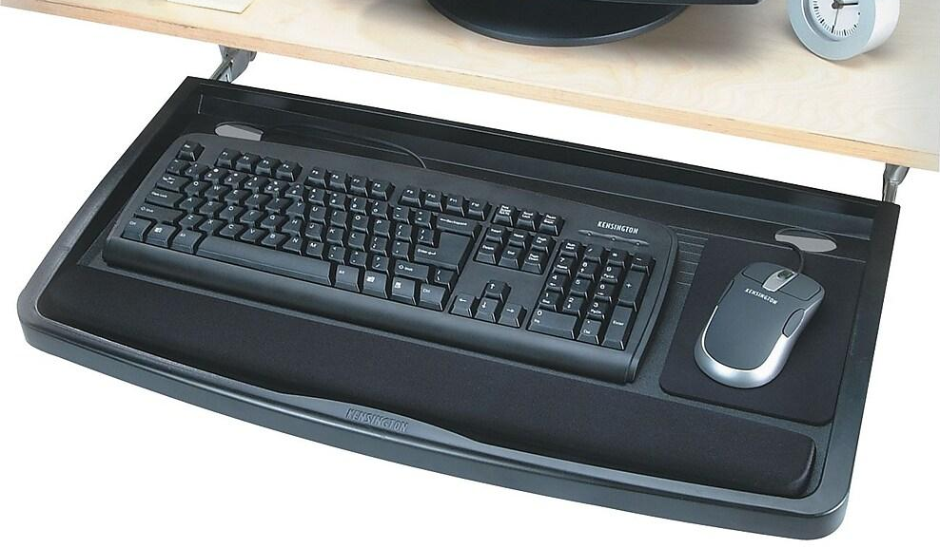

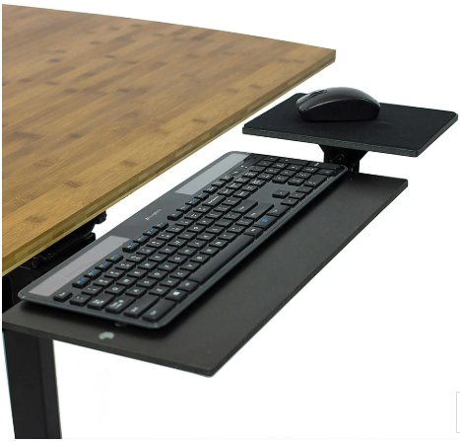
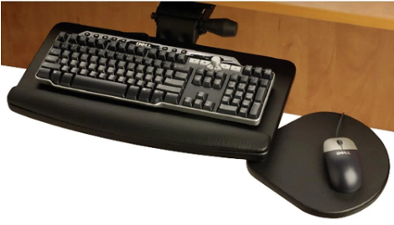

Keyboard Tray
$80.00
$140.00
$375.00
Total Cost = $126.00

Slide 23
Overfilled Garbage Can
$28.00
$27.00
$4.00

Slide 24
Overfilled Garbage Can

Slide 25
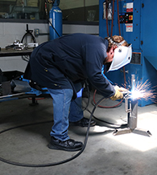
Welding

Slide 26
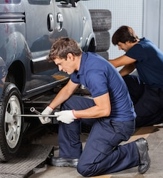
Kneepads
OR
$10.00
$113.00
$33.00

Slide 27
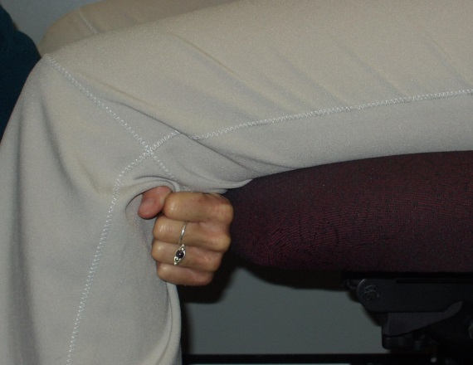
Office Chair
Fist Test

Slide 28

Laundry Bags

Slide 29
Sharp Worktable Edge

Slide 30

Carts Wheels

Slide 31
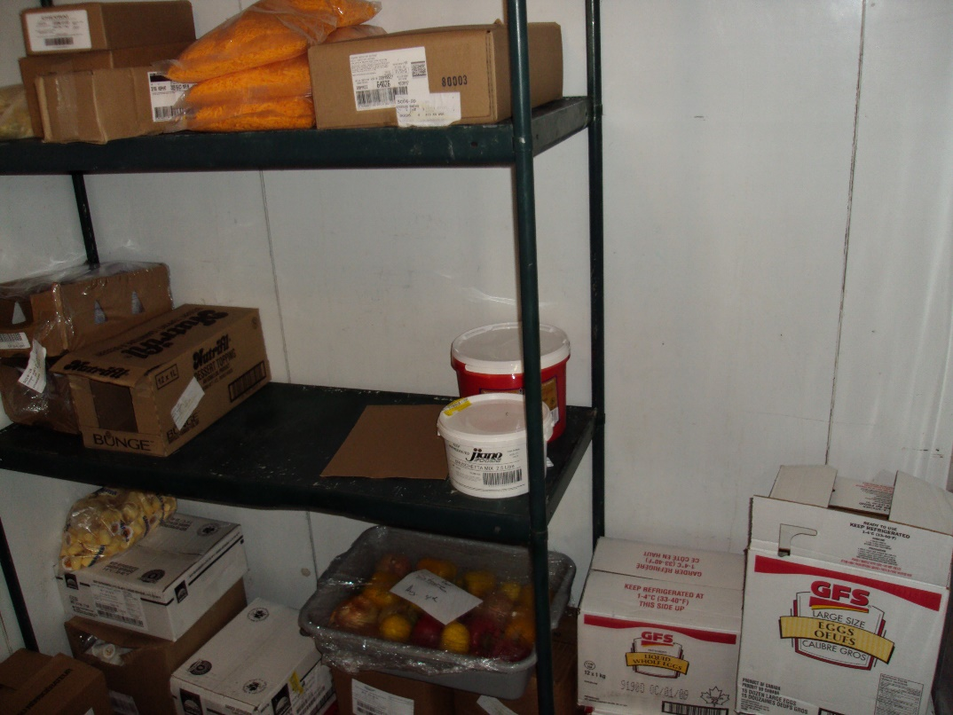
Storage Areas

Slide 32
Alternate Lifting Techniques

Slide 33
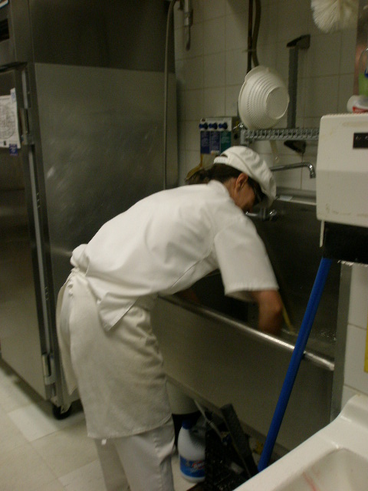
Industrial Sinks

Slide 34
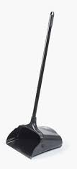
Dust Pan

Slide 35
Dust Pan Alternate

Slide 36
Discussion
Think of a ergonomic situation in your workplace
In a group can you find a cost effective solution
Take 5 minutes to discuss as a group
Select a speaker to present

Slide 37
Summary
Workplace changes do not need to be expensive
Many changes can be done in house using existing materials
Often workers have made subtle changes to their work area without even being aware of it
Useful links
https://www.ohcow.on.ca/ergotools/
https://www.msdprevention.com/

Slide 38
For More Information Contact your Local OHCOW Clinic
1-877-817-0336
www.ohcow.on.ca
HAMILTON
OTTAWA
SARNIA-LAMBTON
SUDBURY
THUNDER BAY
TORONTO
WINDSOR
Notes:
TREVOR

