Slide 1
Calculator - Training
Presented by Chelsie Desrochers, B.Sc, M.Sc (cand)

Slide 2
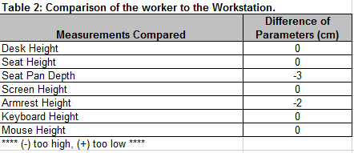
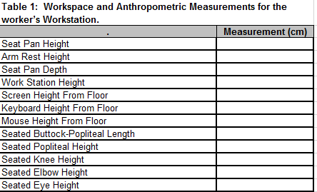
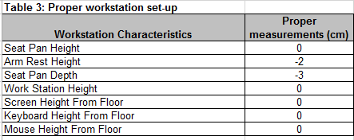
Excel Tables

Slide 3
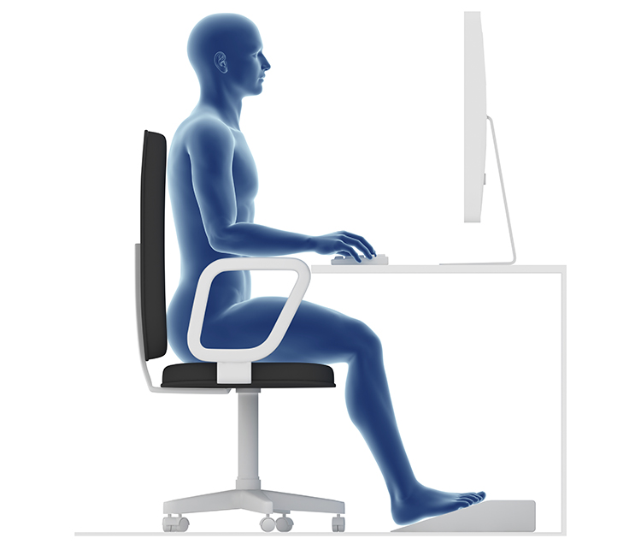
Measuring Seat Height
Measure from the floor to the top of the seat cushion

Slide 4
Measuring Armrest Height
Measure from the floor to the top of the armrest

Slide 5
Measuring Seat Pan Depth
Measure the depth of the seat cushion, from the back to the edge of the seat

Slide 6
Measuring Desk Height
Measure from the floor to the top of the desk

Slide 7
Measuring Screen Height
Measure from the floor to the top of the screen

Slide 8
Measuring Keyboard and Mouse Height
Measure from the floor to the top of the desk or tray where the keyboard/mouse are situated.

Slide 9
Measuring Buttock-Popliteal Lenght
Measure from the back of the buttock to the crease in the knee

Slide 10
Measuring Popliteal Height
Measure from the floor to the crease in the knee

Slide 11
Measuring Knee Height
Measure from the floor to the middle of the knee cap

Slide 12
Measuring Elbow Height
Measure from the floor to the elbow.
Note: ask user to place elbows in 90º angle

Slide 13
Measuring Eye Height
Measure from the floor to seated eye level

Slide 14
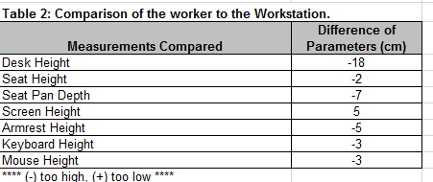
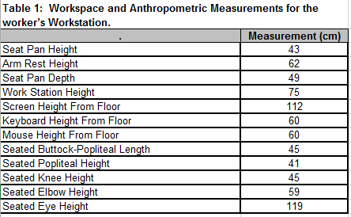
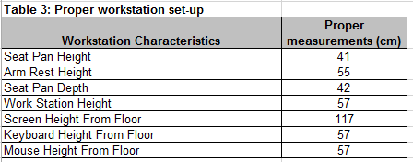
Example
Positive numbers = too low
Negative numbers = too high
0 = ideal

Slide 15
Desk Height
Desk 18 cm too high
Solutions:
Buy height adjustable workstation (not usually possible)
Purchase footrest

Slide 16
Seat Pan Depth
Seat pan 7 cm too deep
Solutions:
BUY A NEW CHAIR
Purchase OBUS Forme (not recommended)
Seat pan depth is the only exception in table 2 where a positive number is okay. 0 means perfect.

Slide 17
How to Purchase Proper Chair
1) Ensure the following are adjustable:
Armrests
Seat Height
Seat Pan Depth
Seat Tilt
Lumbar Support
2) Make sure the seat pan will fit the user:
See ideal seat pan depth measurement
42 cm = 16.5 inches so a 16 inch seat pan depth is needed
Request a 16 inch seat pan depth when ordering the chair

Slide 18
Screen Height
Screen 5 cm too low
Solutions:
Place screen on tray or books
Purchase height-adjustable monitor

Slide 19
Keyboard and Mouse Height
Keyboard and mouse are 3 cm too high
Solutions:
Purchase keyboard tray!
If proper keyboard tray is already installed, adjust it.

Slide 20
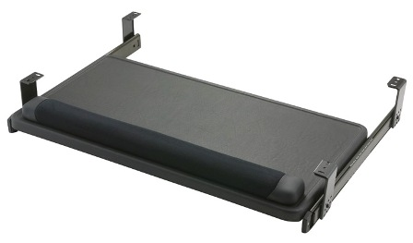
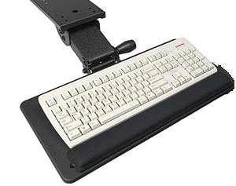
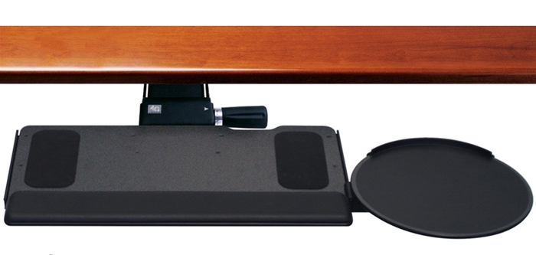
Keyboard Trays to Avoid
Tray with slide-out platform for the mouse: tray is unsteady, and causes user to lean on the right hip
Rail keyboard trays: are not adjustable in height or angle
Small keyboard trays: no space for the mouse, which causes user to place the mouse on the desk

Slide 21
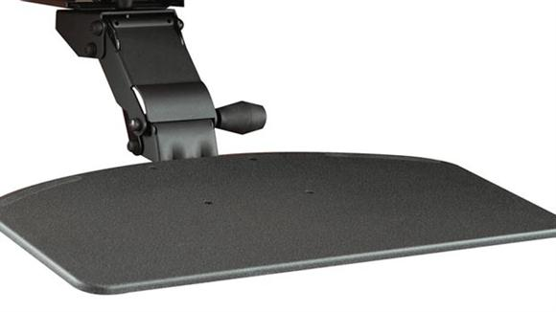
Ideal Keyboard Trays
Sturdy surface
Angle and height
adjustability
65 cm in length

Slide 22
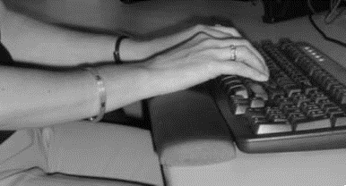
Wrist Rest
Improves wrist angle while typing and reduces pressure point on wrists

Slide 23
Excel Tables
?

Slide 24
Ideal Measurements
Once proper equipment is purchased and installed, refer to ideal measurements to properly setup the equipment for each user.

Slide 25
For More Information…
OTTAWA
1545 avenue Carling
Bureau 101
Ottawa, ON
K1Z 8P9 Téléphone: (613) 725-6999
Courriel: ottawa@ohcow.on.ca
www.ohcow.on.ca

